Slide 1
Robotics Traveling Van – 2nd Hardware Status Update
67% Milestone Check-in
Florence Fasugbe, Andres Gonzales, Colin Parsinia, Freddy Rivera
2/26/26

Slide 2
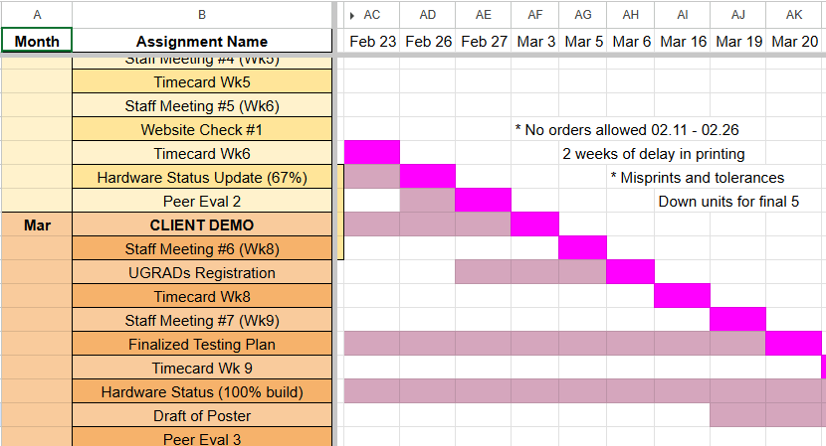
Gantt Chart & Schedule
Client demo in March
2 weeks of backlog in orders
Misprints due to tolerances being too tight
Overall, lost our lead, now slightly behind due to missing rods and filament.
RTV – Andres

Slide 3
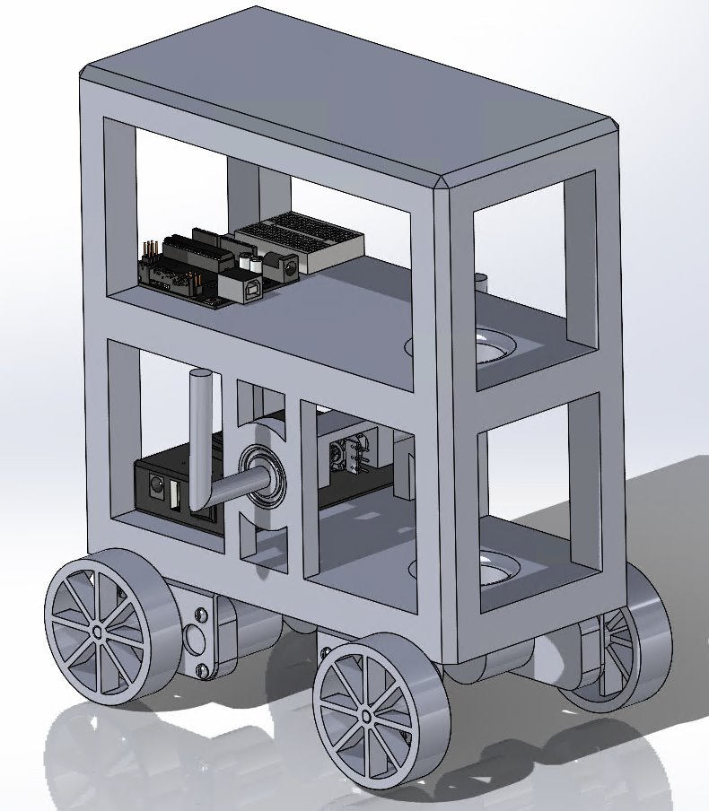
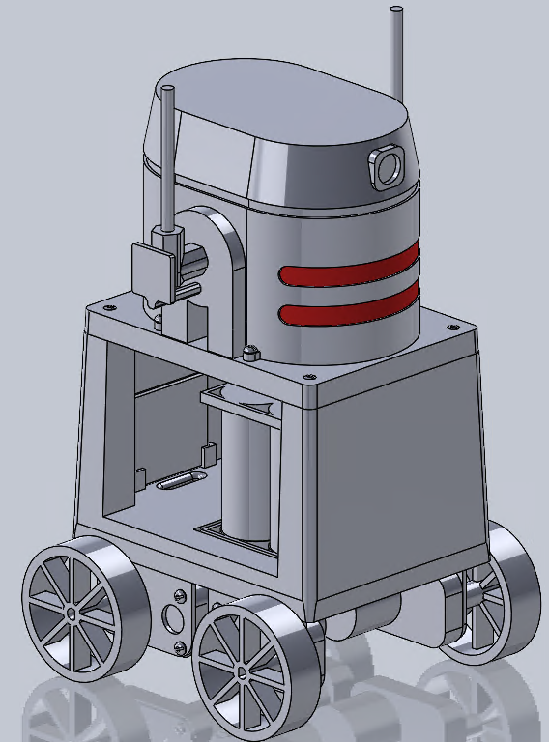
Design Efforts – Robot 1 (Inverted Pendulum)
Frame Completely Overhauled, Almost all electrical components now mounted on single level
Switched from Arduino to Raspberry-Pi control system
Battery system custom built.
Switched to Magnetic Potentiometer
Pendulum arm moved up, rebuilt to accommodate magnetic potentiometer
Overall more aesthetically pleasing
December 2025
February 2026
RTV – Colin

Slide 4
Design Efforts – Robot 1 (Inverted Pendulum)
Design mistakes revealed in testing
1) steel vs. alum
2) weak arm bracket w/ no radial stop
3) protoboard screw holes covered
4) tolerances too tight ~
RTV – Colin

Slide 5
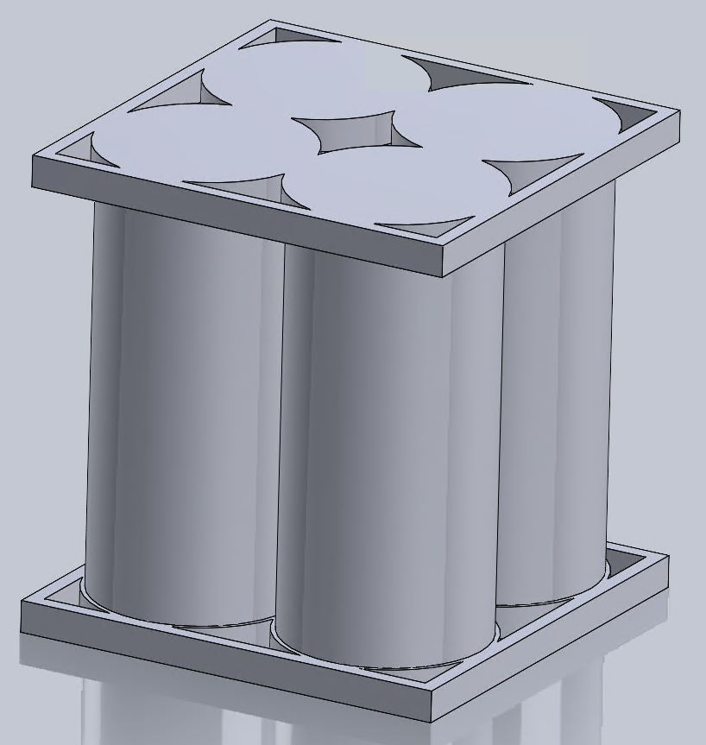
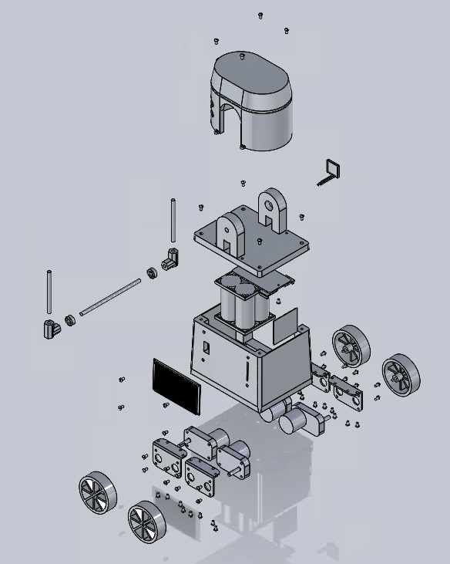
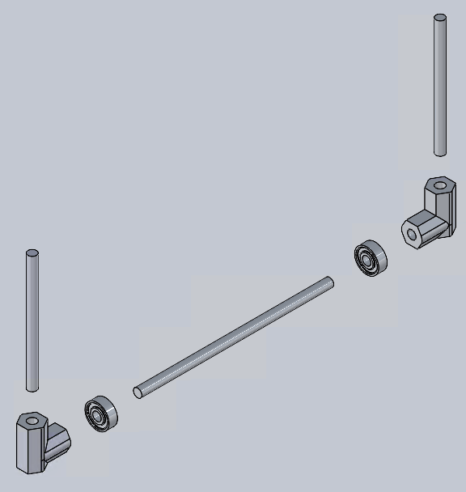
Robot 1 Updated CAD
Frame Separated into 2 pieces – Vastly Improves Print Quality
Pendulum Arm separated into 3 pieces, printed angled brackets to ensure precise angle.
Mounts for electrical Components added to both halves of frame
Divit added to bottom frame + holes to secure battery pack with zip-ties.
RTV – Colin

Slide 6
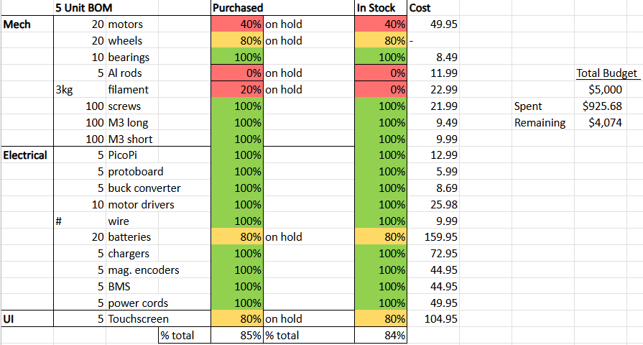
Purchasing Plan – Robot 1
We have a hold on ordering parts until project lead acknowledges
Almost all electrical components, missing PLA for prints
14 day backlog, 4 day lead time, 3-5 day print time
01/30 order sent & received
02/10 order denied
Notified team 02/23
85% on hand/purchased
100% on hold!
RTV – Andres

Slide 7
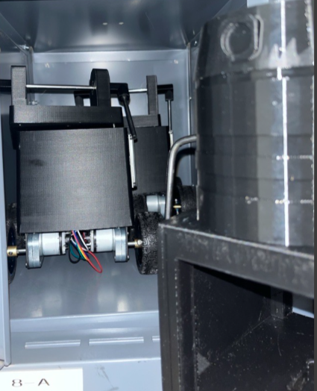
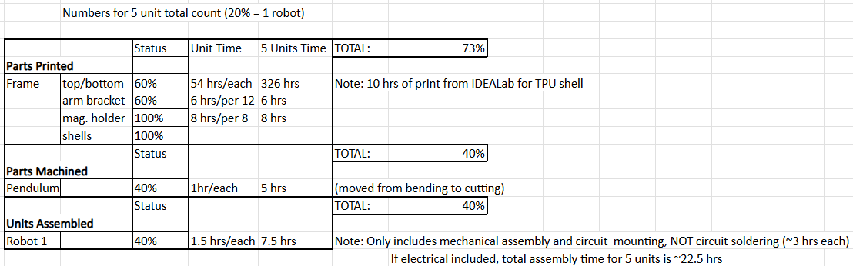
Manufacturing Plan – Robot 1
3/5 frames (top & bottom) + 5/5 shells + 2/5 circuits + 5/5 smaller parts (brackets, electrical holders)
Over all ~ 71% manufactured
RTV – Colin

Slide 8
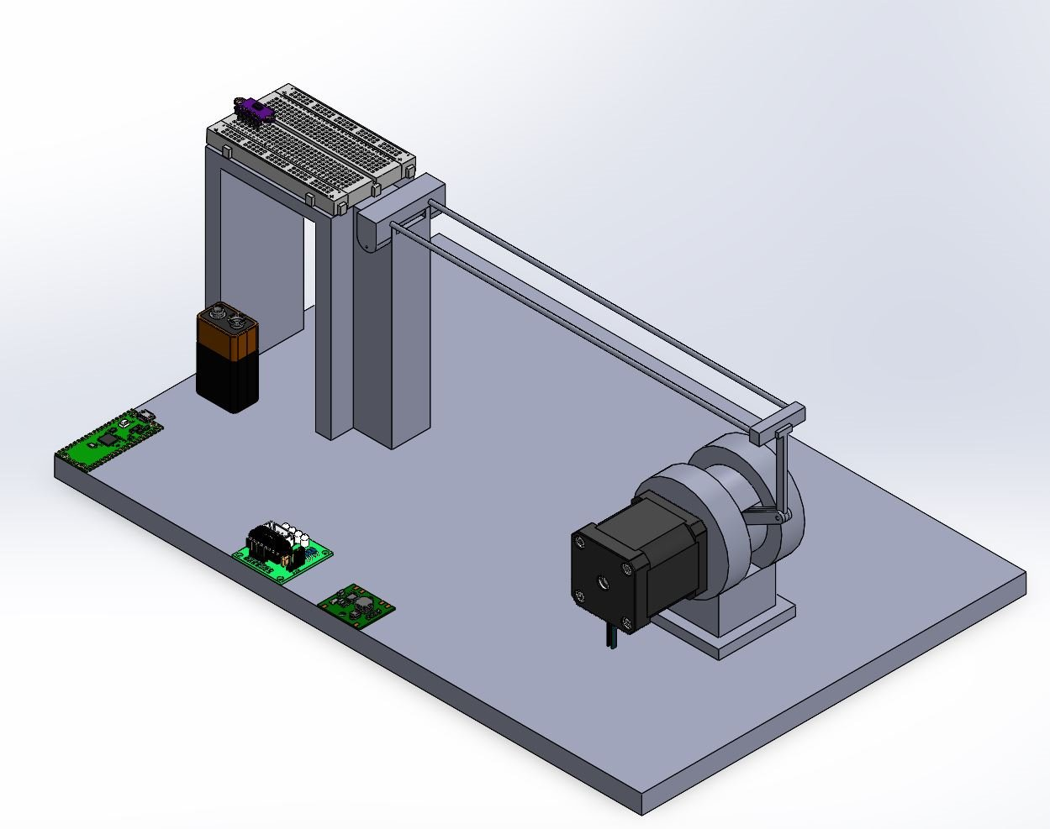
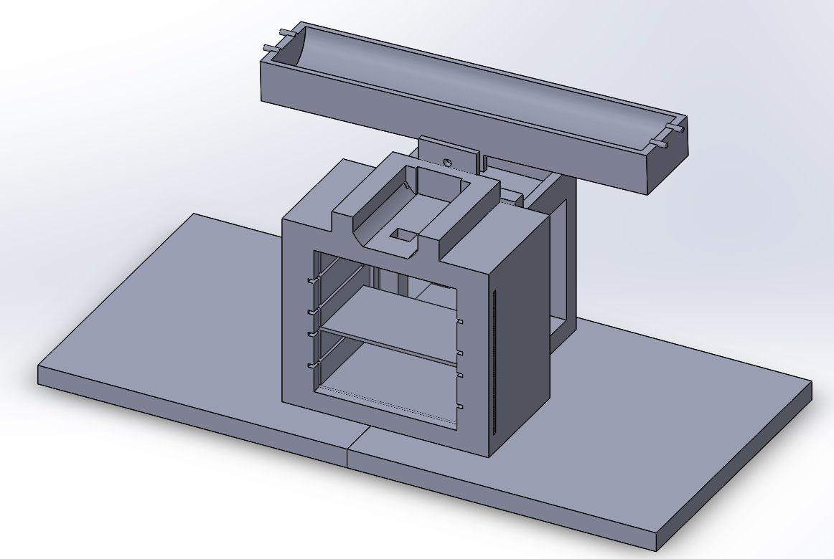
Design Efforts – Robot 2 (Ball-on-Beam)
Less parts = Less material
Stability
Reduction size (14"x 7.5")
Spacious for Electrical components
Multiple functionality with each individual part
Flows efficiently
September 2025 - December 2025
January 2026
RTV – Florence

Slide 9
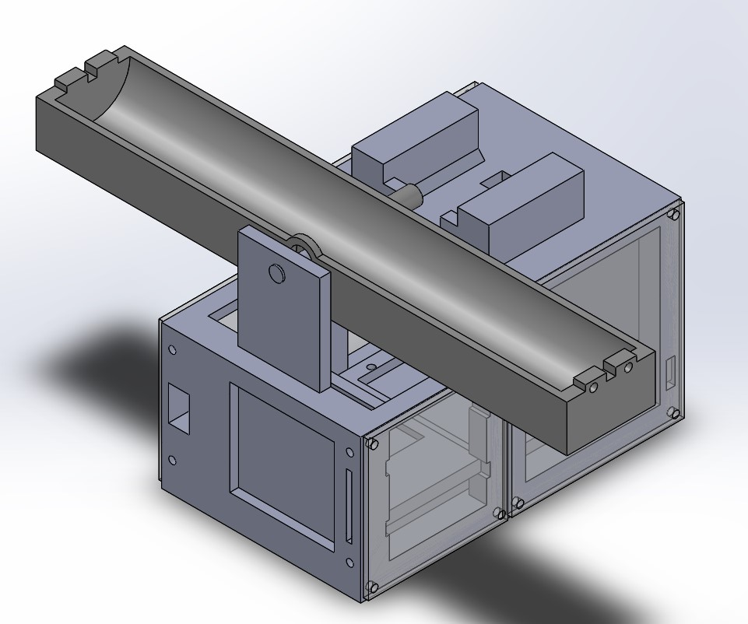
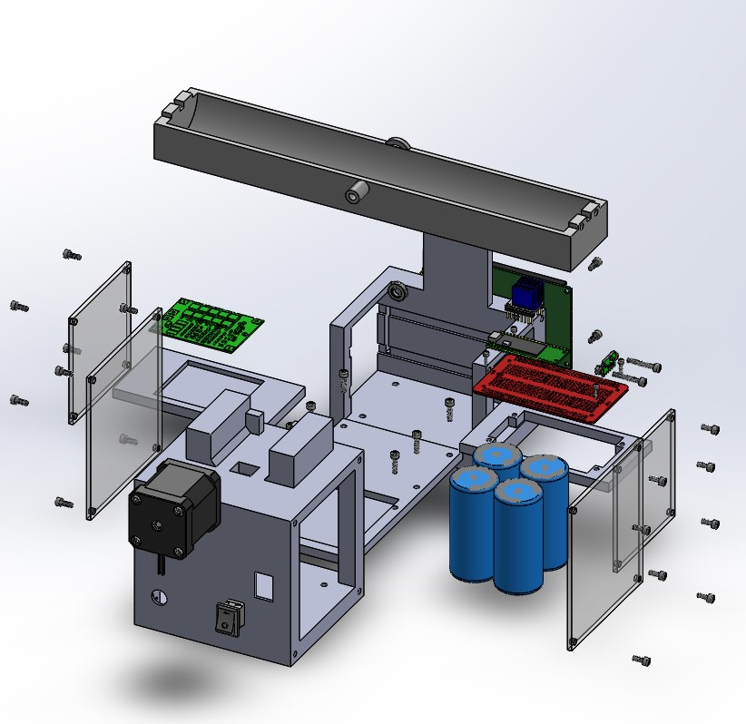
Robot 2 Updated CAD
RTV – Florence

Slide 10
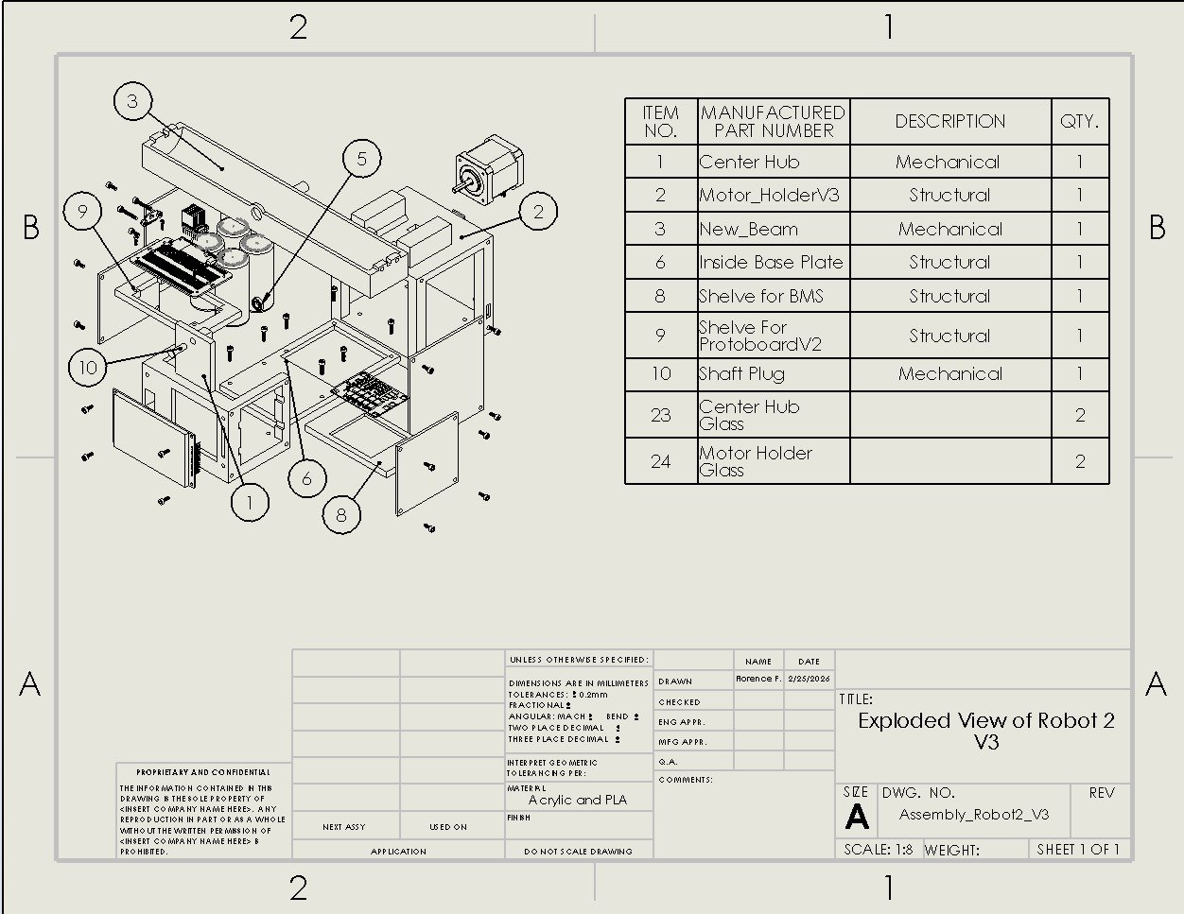
Robot 2 Updated CAD
RTV – Florence

Slide 11
Purchasing Plan – Robot 2
RTV – Freddy

Slide 12
Manufacturing Plan – Robot 2
RTV – Freddy

Slide 13
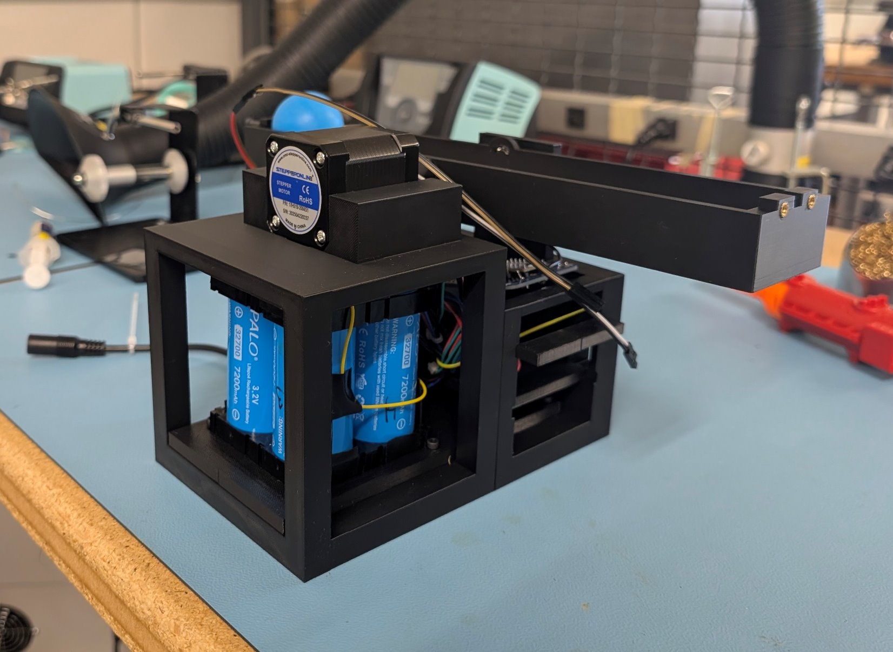
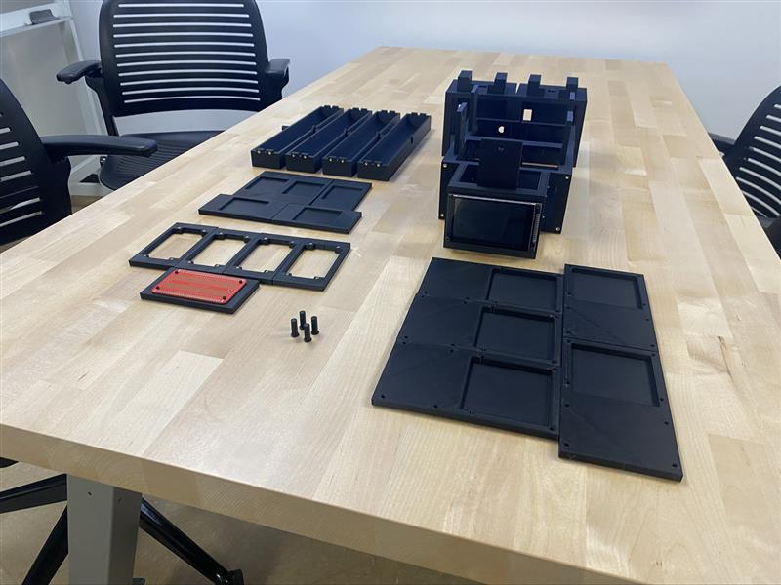
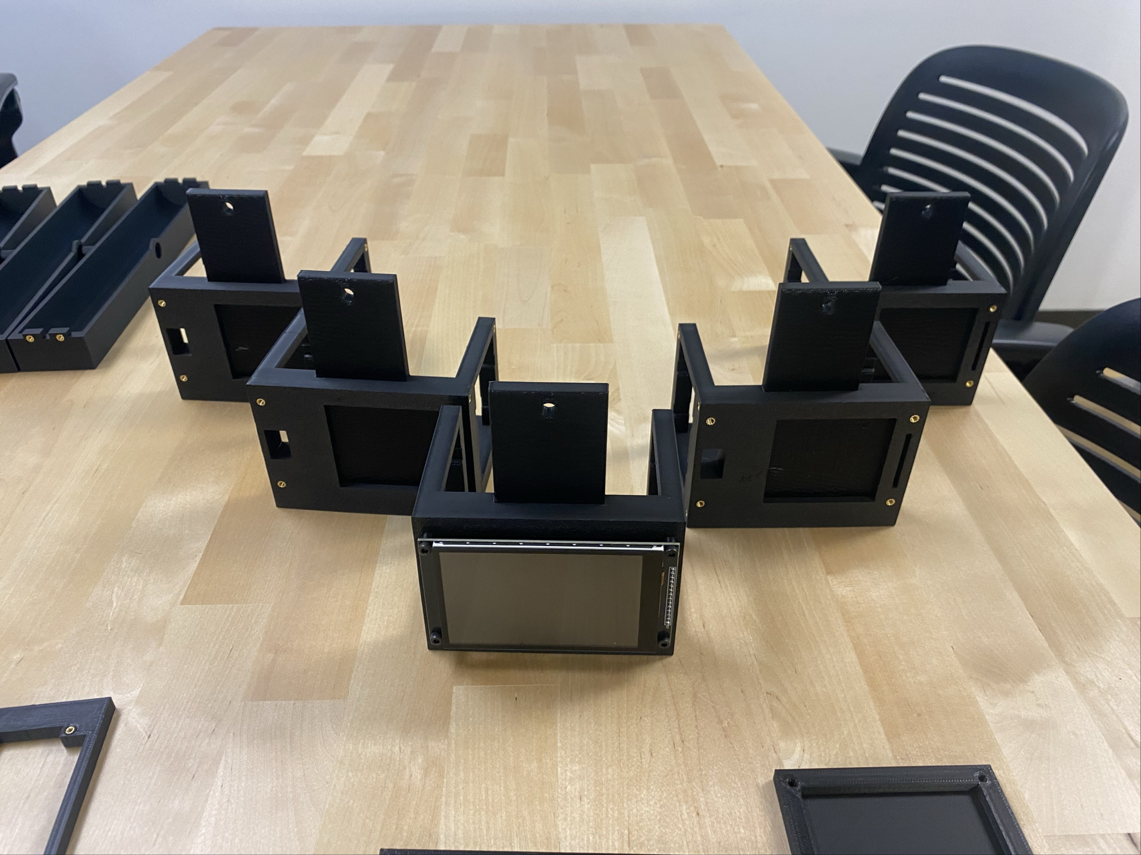
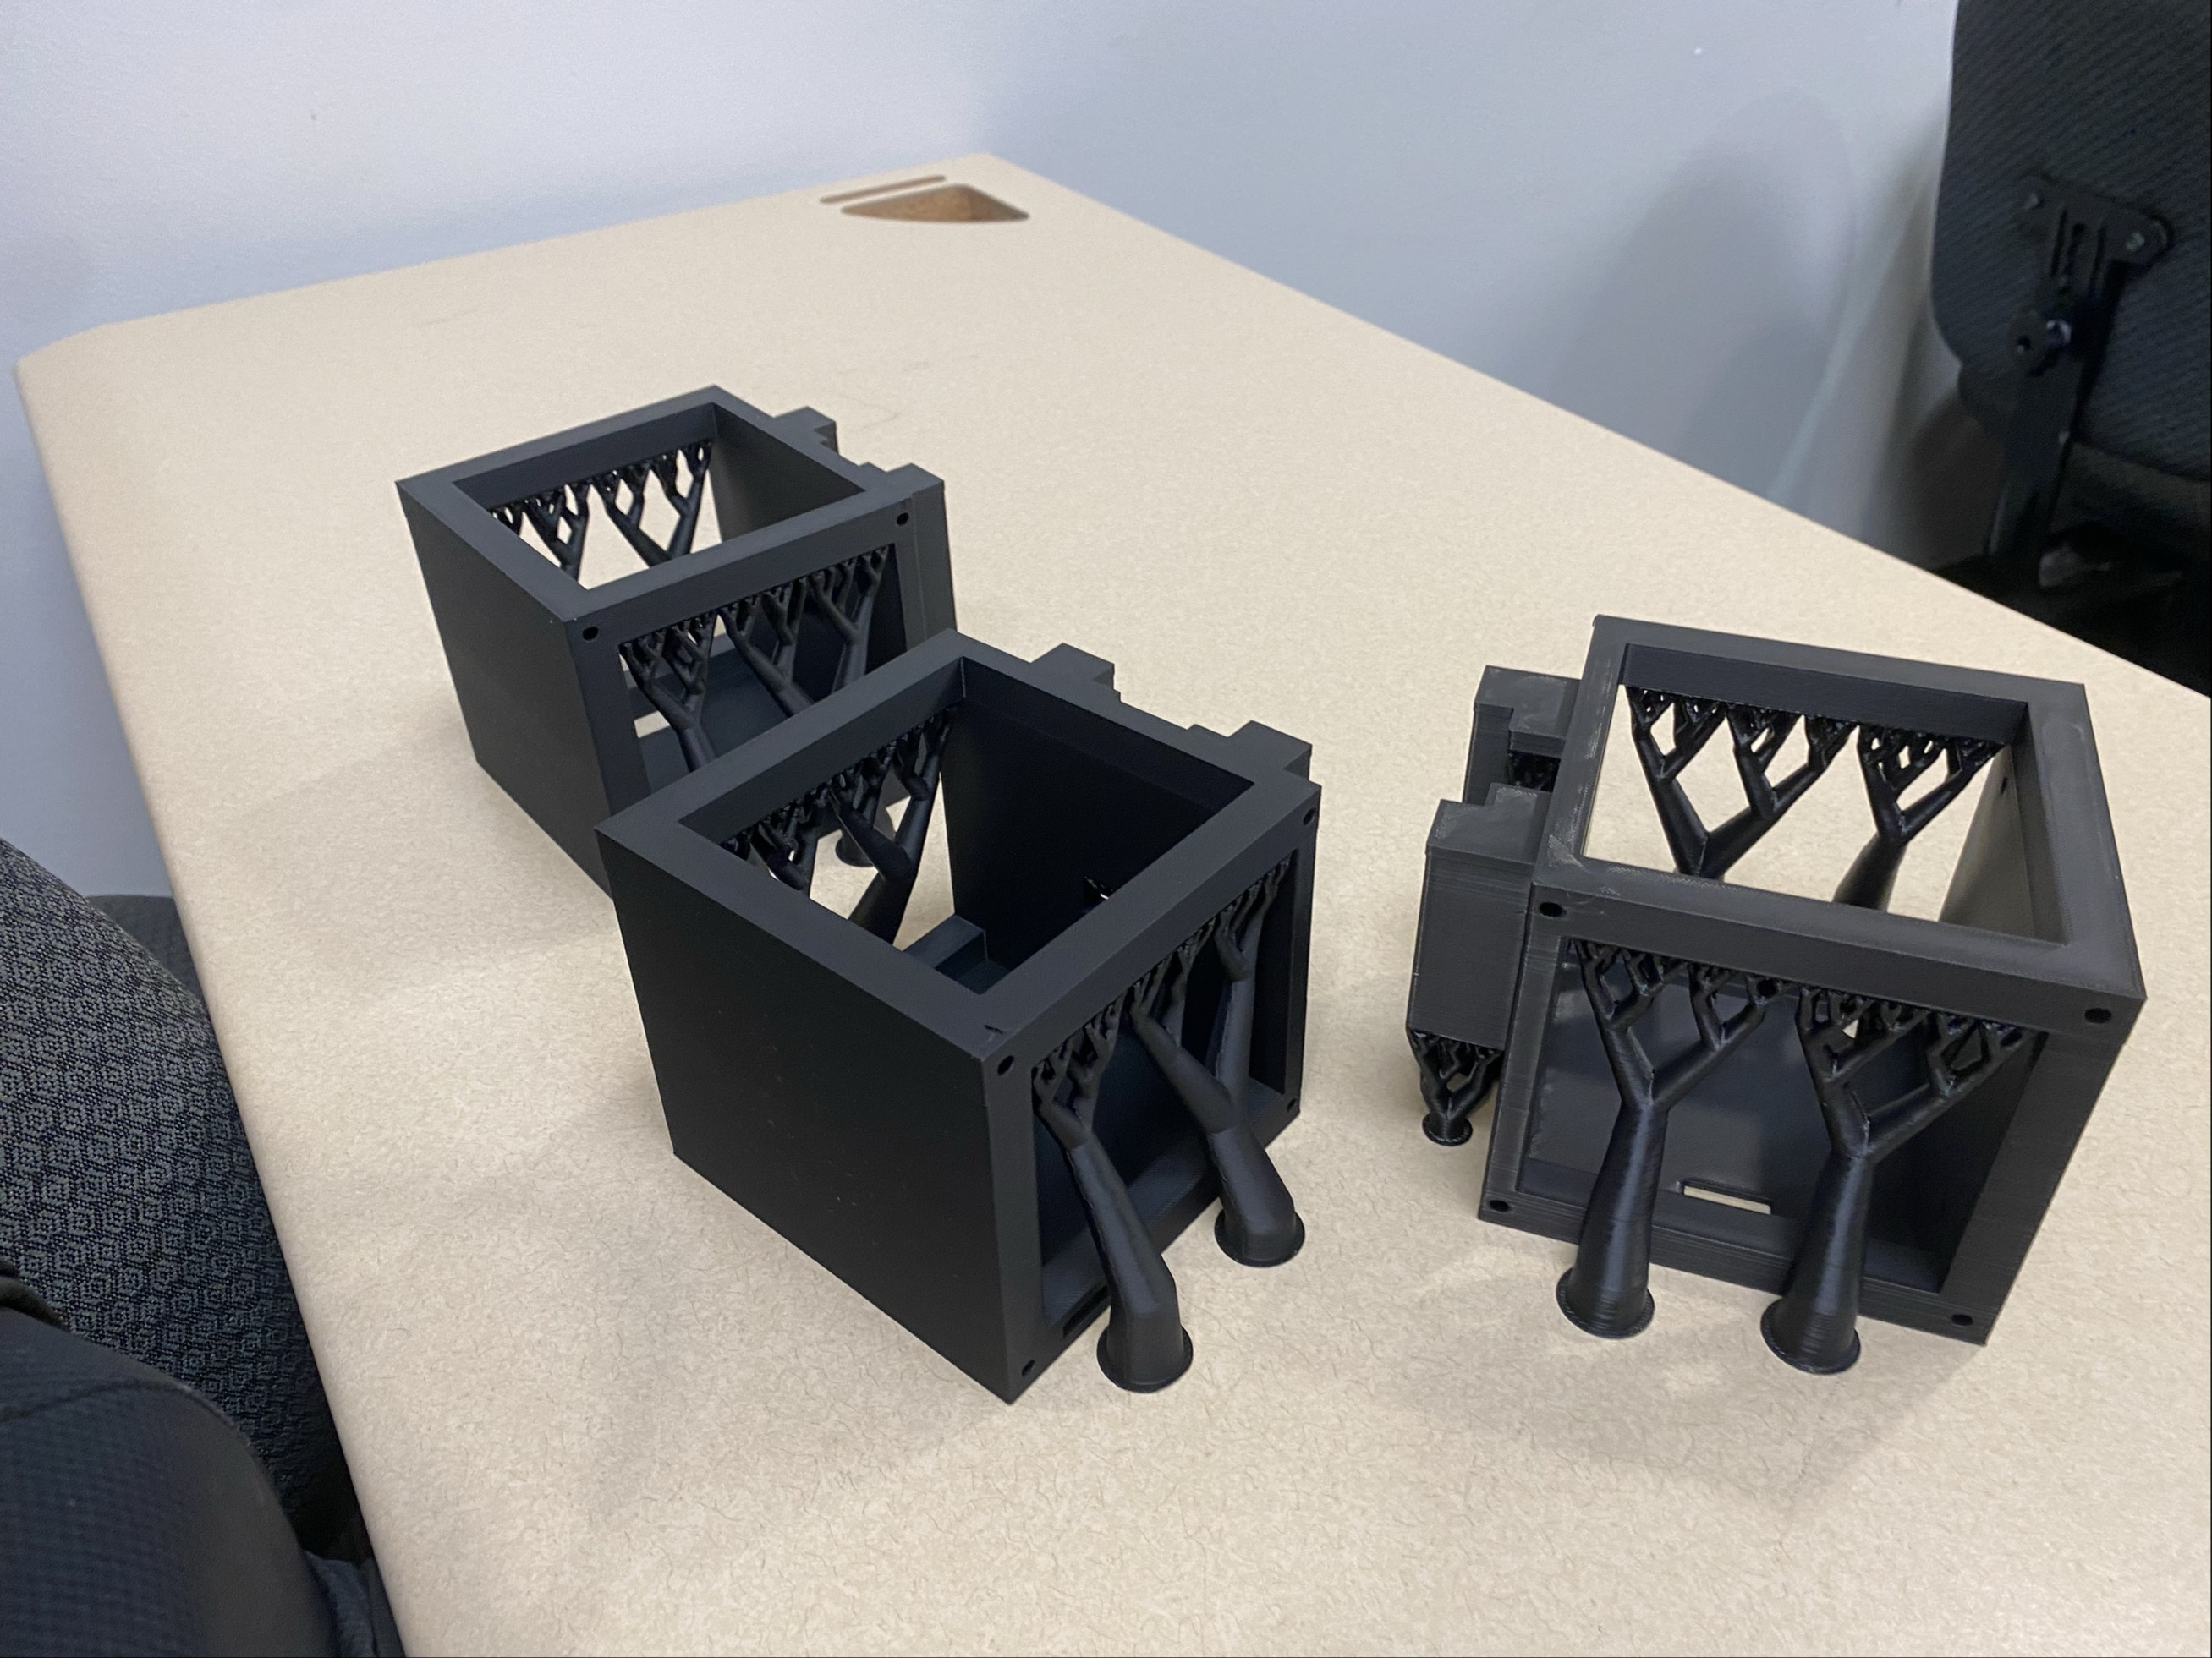
Physical Builds
Robot 2: Ball - on - Beam

Slide 14
Moving Forward – Robot 2 (Ball-on-Beam)
Integration Testing Initiated: We have successfully moved from mechanical assembly into active electrical integration and testing.
Current Roadblock (Dual-Power Conflict): We identified a critical power-rail issue. Connecting the primary battery simultaneously with the USB backfeeding and shorting the Raspberry Pi Pico boards.
Active Engineering Solution: To safely isolate the power sources, our sub-team is currently designing and prototyping a custom protection circuit
Strategic Pivot to 100% Build: Because mechanical manufacturing is 100% printed and ahead of schedule, all sub-team bandwidth is now reallocated directly to implementing this power-switching circuit to ensure a fully functioning 5-robot fleet for the final deadline.
RTV – Freddy

Slide 15
Thank You

