Slide 1
Robotics Traveling Van – 1st Hardware Status Update
33% Milestone Check-in
Florence Fasugbe, Andres Gonzales, Colin Parsinia, Freddy Rivera
2/5/26

Slide 2
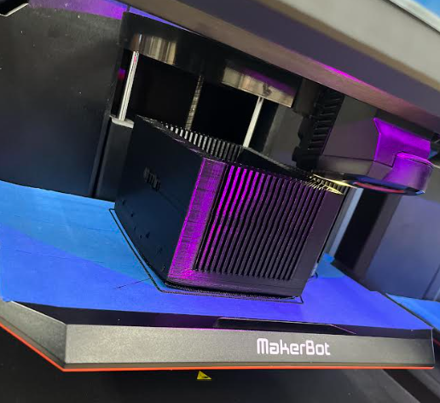
Design Efforts – Robot 1 (Inverted Pendulum)
Sensor change (pot => mag)
Frame height (shorter)
CAD design (bearing holes, inserts)
Steel vs. aluminum pendulum

Slide 3
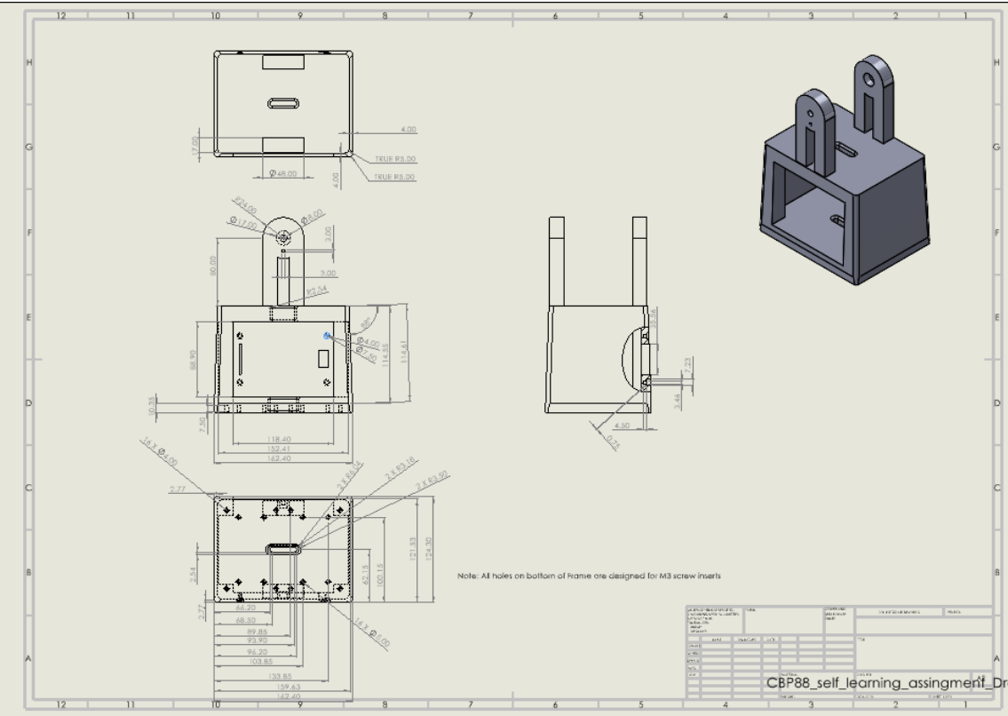
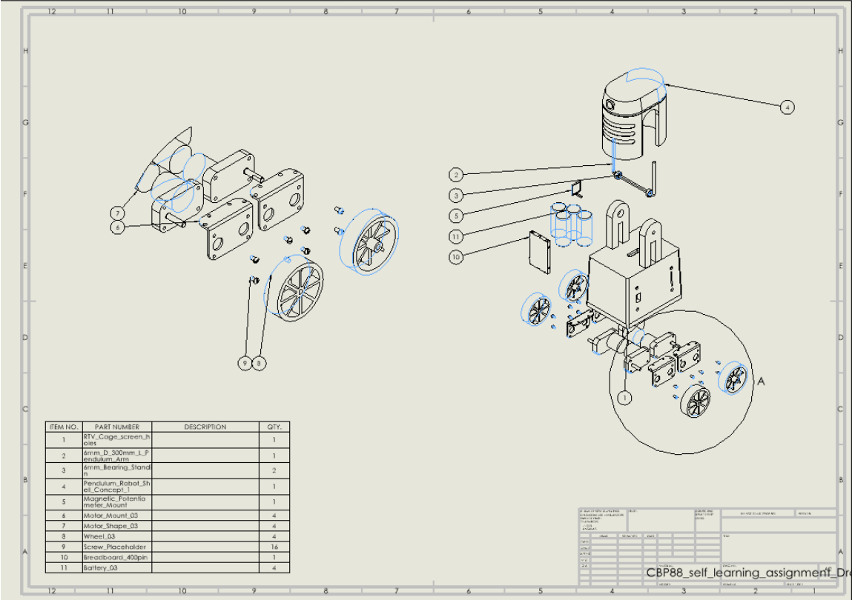
Updated CAD

Slide 4
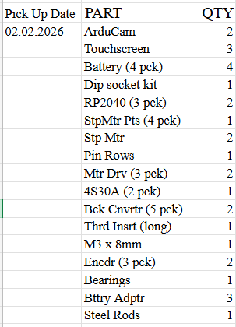
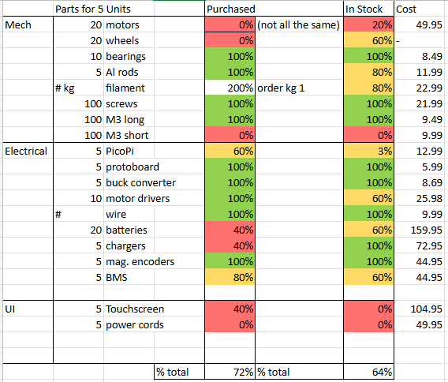
Purchasing Plan – Robot 1
Parts Received
Parts Ordered

Slide 5
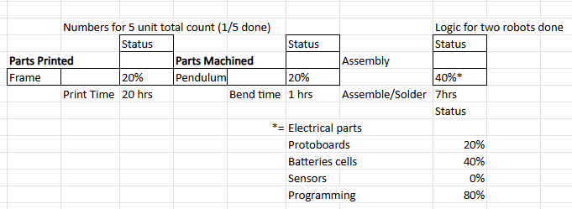
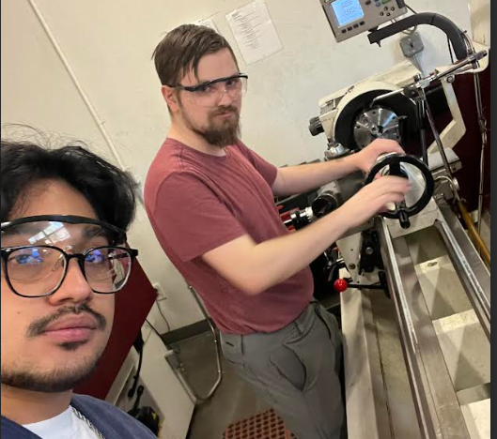
Manufacturing Plan – Robot 1
Next steps:
1) Print more frames
2) Solder complete robot
3) Produce 5 units

Slide 6
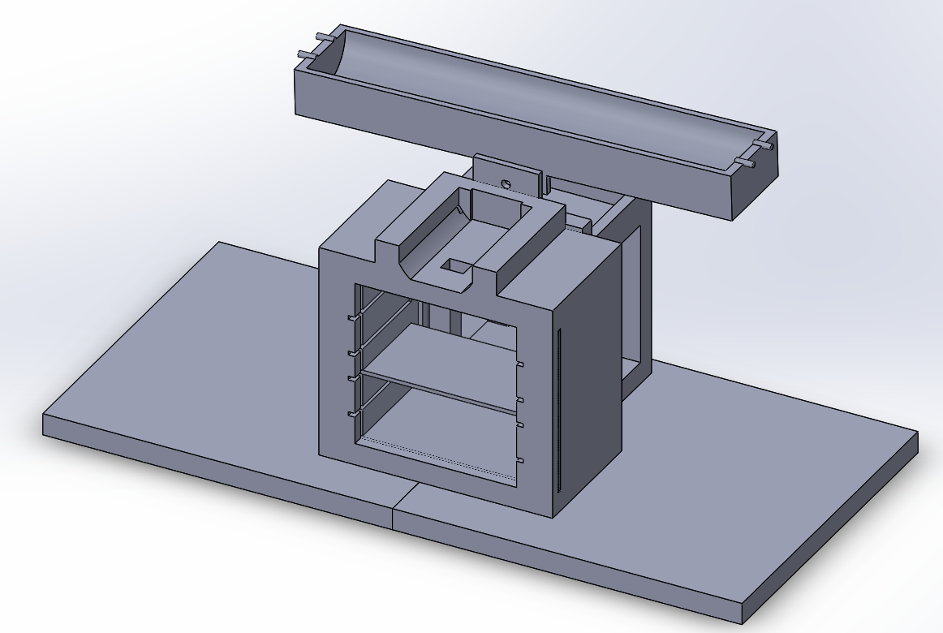
Design Efforts – Robot 2 (Ball-on-Beam)
  Mechanical Architecture: Finalized "Motor-at-Axis" pivot design.
  Sensor Integration: Custom sensor cylinders designed for modularity and professional finish.
  Safety: Integrated hard stops to prevent over-rotation.

Slide 7
Purchasing Plan – Robot 2
Project Allocation: $1,500.00
Unit Construction Cost: $238.44
Cost Breakdown (Per Unit):
Power (4S LiFePO4): ~$64.00
Touch Interface: ~$42.00
Structure (Filament): ~$11.00
Control & Drive: ~$60.00
Hardware/Misc: ~$63.00
Status: Significantly under the $1,500 cap

Slide 8
Manufacturing Plan – Robot 2
Part Name | Already Manufactured | Currently Manufactured | Future Manufactured | Qty. | Source
Central Hub |  |  |  | 1/5 | 3D
Electrical & Motor Cubby |  |  | 2/9 - 2/13 | 0/5 | 3D
Axel Pin |  |  |  | 1/5 | 3D
Trough Beam |  |  |  | 1/5 | 3D
Base 1 |  |  | 2/9 - 2/18 | 0/5 | 3D
Base 2 |  |  | 2/9 - 2/18 | 0/5 | 3D
Shelf |  | 2/5 - 2/7 |  | 0/5 | 3D
Acrylic Door |  | 2/7 - 2/ 10 |  | 0/5 | Amazon
  Method: High-Fidelity 3D Printing (PLA+/PETG) to ensure professional aesthetic.​
  Upcoming: Full assembly scheduled (Library Printing Plan in place).
 | Manufacturing Status *for one unit*
Manufactured (printing) | 4/8 parts = 50% completed | +90 hrs
Assembled | 3/8 parts = 37.5% completed | 2 hrs

Slide 9
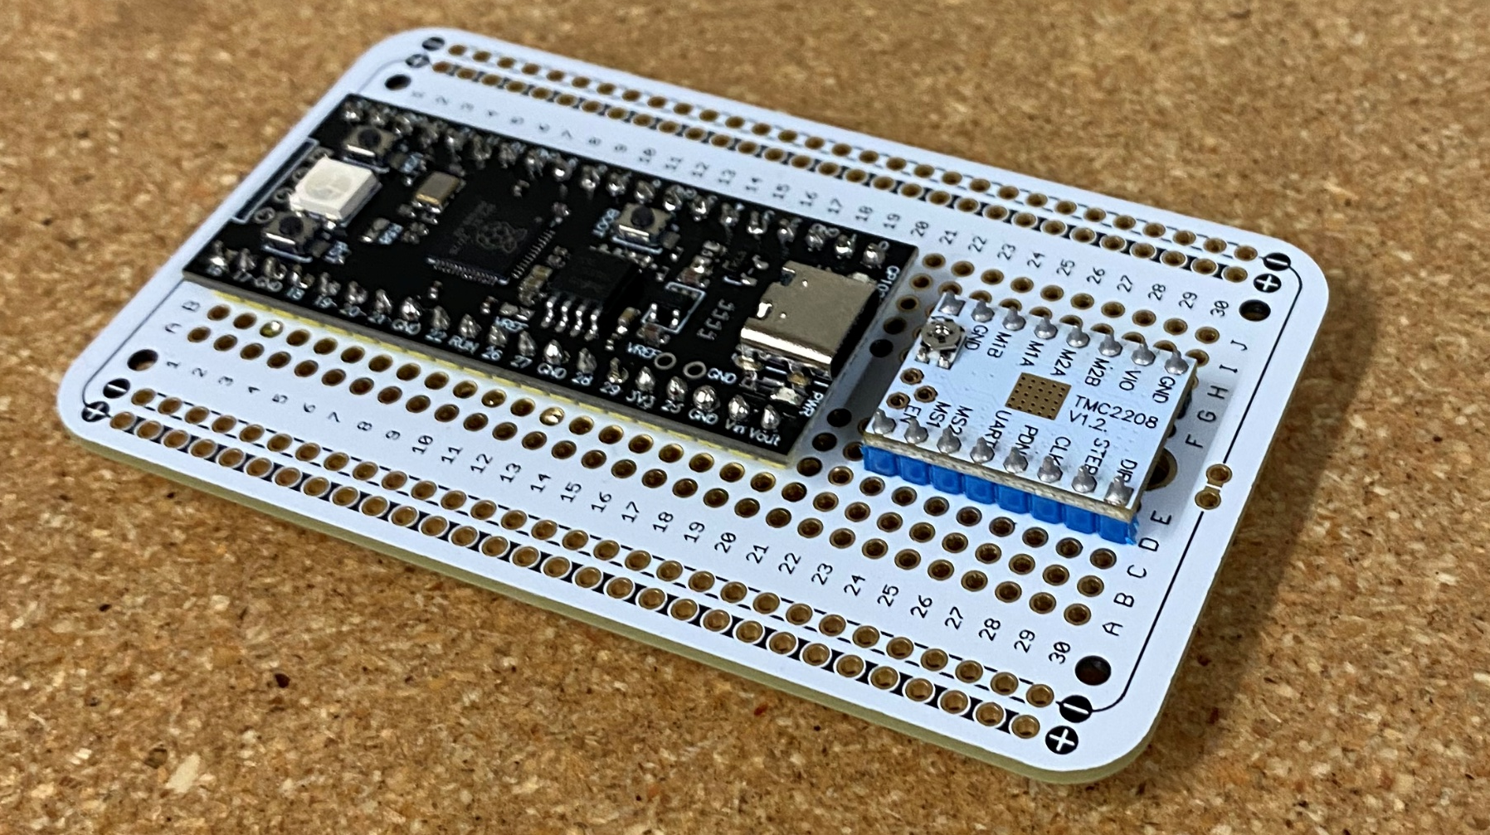
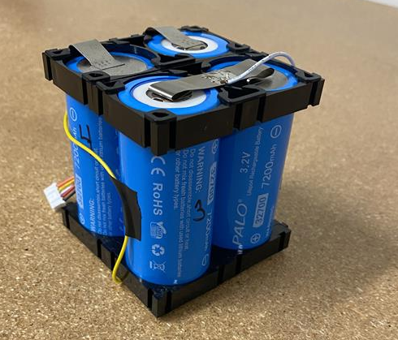
Manufacturing Plan – Robot 2
Power System Assembly (Status: In Progress)
  Energy Storage Unit: 4x LiFePO4 cells successfully soldered in 4S Series configuration (12.8V).
  Safety Hardware: Battery Management System (BMS) acquired and bench-verified; scheduled for pack integration during next lab session.
  Physical Status: Raw battery pack assembled; BMS termination pending.
Control Hardware
  Hardwired Logic: RP2040 Microcontroller permanently soldered to main protoboard.
  Motor Drive: Stepper drivers wired with 1/16 microstepping jumpers installed.

Slide 10
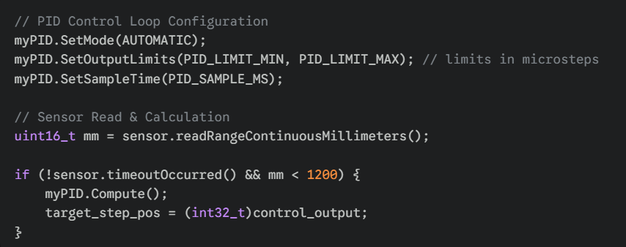
Manufacturing Plan – Robot 2
3. Firmware Logic
  Control Algorithm: Implemented AUTOMATIC PID mode with defined microstep output limits (SetOutputLimits) to prevent mechanical over-travel.
  Sensor Loop: System performs continuous millimeter-level distance polling (readRangeContinuousMillimeters) to drive the error calculation.
  Actuation: Control output is cast directly to target_step_pos for immediate motor response.

Slide 11
Physical Builds

Slide 12
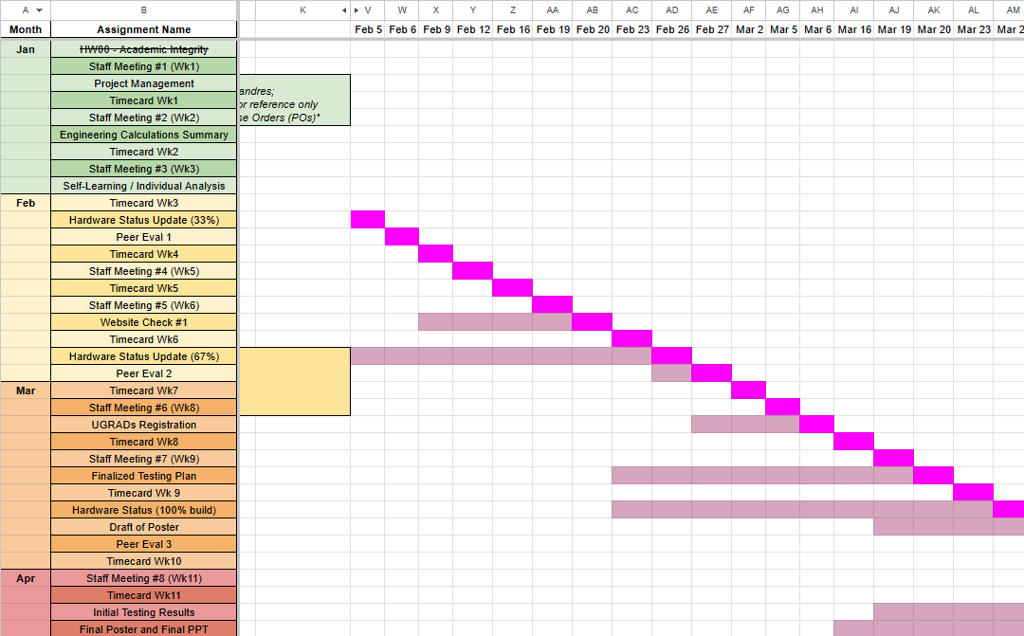
Gantt Chart & Schedule
Client meeting in March

Slide 13
Thank You

