Slide 1

Robotics Traveling Van
Florence Fasugbe, Andres Gonzales, Colin Parsinia, Freddy Rivera, & Ziyi Tang
Freddy – 01
Notes:
Team introduction and names (1 minute)

Slide 2
Table of Contents
1. Title Slide ......................................................... # 2. Table of Contents............................. # 3. Project Description ............................. # 4. Design Requirements (CR v. ER) ............ # 5. QFD .... # 6. Robot 1 – Design Overview .... # 7. Robot 1 – Subsystems ................................. # 8. Robot 1 – Circuit Diagram ................................. # 9. Robot 2 – Design Overview ................................. # 10. Robot 2 – Subsystems ............................. # 11. Robot 2 – Circuit Design .... # 12. Robot 1 - Mathematical Modeling .......... # 13. Robot 2 – Mathematical Modeling.... # 14. Robot 1 – FMEA & Risk Analysis .......... # 15. Robot 2 – FMEA & Risk Analysis .... # 16. Team Gantt Chart .... # 17. Extra title .................. # 18. Extra title ...................... # 19. Gantt Chart & Timeline ................................................ # 20. Budget Summary ...................................... # 21. End/Q&A ......................................................................... #
Freddy – 02
Notes:
"Here is our list of things to get through, so let's get going" (20 seconds)

Slide 3
Project Description
Our senior capstone project focuses on developing two educational control-system robots for K–12 STEM outreach in collaboration with our client, Dr. Michael Shafer. The goal is to create low-cost, classroom-ready robots that demonstrate fundamental control and mechatronic concepts in a hands-on, interactive format.
For the 2025 design cycle, our team is developing:
Robot #1 – Inverted Pendulum Robot: A self-balancing pendulum system that demonstrates feedback control and stability.
Robot #2 – Ball-on-Plate System: A dynamic balance platform where a motor-controlled beam adjusts to stabilize a rolling ball at a desired position.
The project aims to ensure both robots are mass-producible, reliable, and easy to use for teachers and students. Each design emphasizes durability, safety, and educational value while staying within the client’s specified budget and outreach goals.
Currently, the focus for Robot #2 is on the ball-on-beam prototype, which will later evolve into a ball-on-plate system with two-axis control. This phase allows the team to refine motor control, sensing, and feedback algorithms before scaling to the full design.
Freddy – 03
Notes:
Brief project description (1 minute)

Slide 4
Customer and Engineering Requirements
Customer:
Demonstrates control theory concepts clearly and safely for classroom settings.
Easy for instructors and students to operate with minimal setup.
Visually engaging and interactive for outreach demonstrations.
Durable and reliable through repeated classroom use and transport.
Compact and lightweight for portability to schools and events.
Cost-effective to manufacture and reproduce for future educational kits.
Modular design allowing upgrades or replacement of parts (e.g., different sensors or controllers).
Complies with safety standards for educational demonstrations.
Provides real-time feedback (e.g., angle, position) for learning purposes.
Demonstrates distinct types of control problems (stability vs. tracking) across the two robots.
Engineering
Response time: ≤ 1 s to reach steady-state position after disturbance.
Steady-state error: ≤ 5 % of reference signal.
Operating angle (inverted pendulum): ± 15° without instability.
Beam/plate tilt range: ± 15° with ± 2 mm position accuracy.
Controller sample rate: ≥ 50 Hz for stable feedback.
System mass: ≤ 3 kg total for portability.
System footprint: ≤ 0.5 m × 0.5 m.
Total cost: ≤ $1500 per robot.
Power source: 5–12 V DC, < 30 W consumption.
Operational duration: ≥ 30 min continuous operation.
Noise level: ≤ 60 dB during operation.
Safety margin: No exposed high-voltage components; emergency stop accessible.
Reproducibility: All parts 3D-printable or off-the-shelf for < 2-week fabrication time.
Colin – 04
Notes:
Top level description of Customer Requirements and Engineering Requirements, QFD (w/ units, target values, etc).

Slide 5
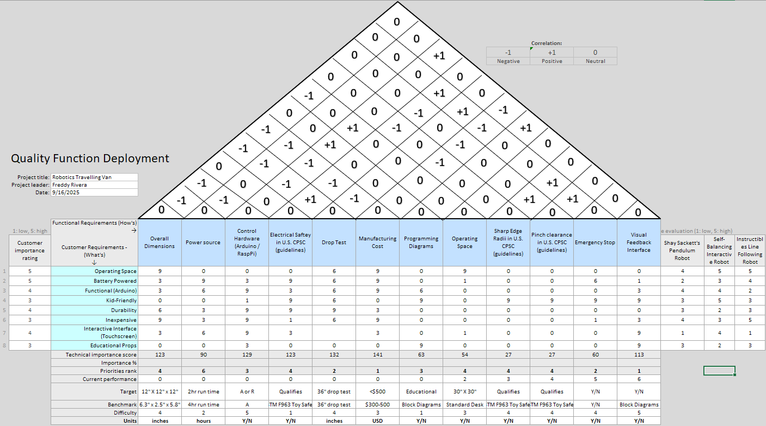
QFD
Andres – 05
Andres – 06
Notes:
Completed QFD that shows connections of CR and ER

Slide 6
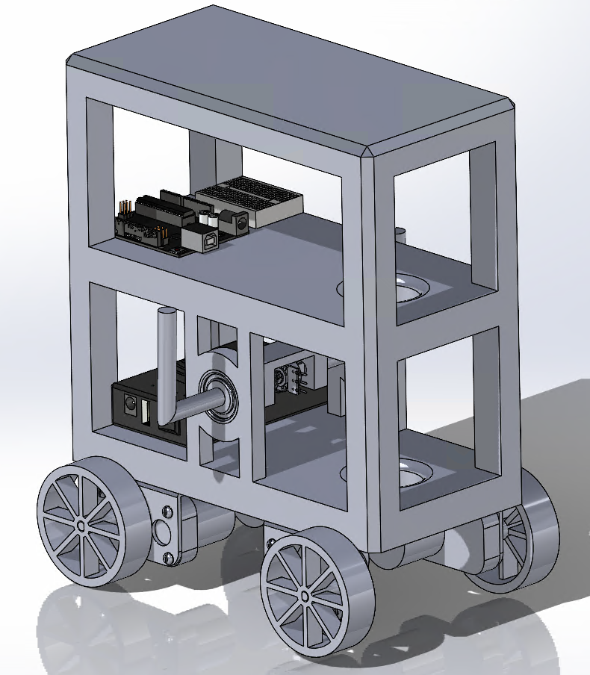
Robot 1 – CAD Model and Major Subsytems
Mechanical – Frame Design, support structures, all components holding structure together
Pendulum – main function of the robot, motion must act upon the pendulum and the angle must be discernable
Motors – Facilitate both the movement of the robot, and the pendulum
Control – Computation and control system for the robots functions
Battery – Provides power to all other subsytems enabling components to function
Colin– 07
Notes:
Goal: explain major subsystems (use leader line notes for CAD)
Explain overall design, present motor, potentiometer, arduino.
Bullet list explaining how top-level design functions
Full drawing odf total design
Sub assembly
Motor from cad online
Part drawings
Fritzing (for circuit diagram)
Flow chart for programming
FMEA for each robot
Recalcuate stuff for robot 1
Assembly drawings (wires for imporant things)
Sub assembly drawings
Part drawings (wires for circuit)
HW04
Simulation
How will we know if control algorithm will work?
Robot

Slide 7
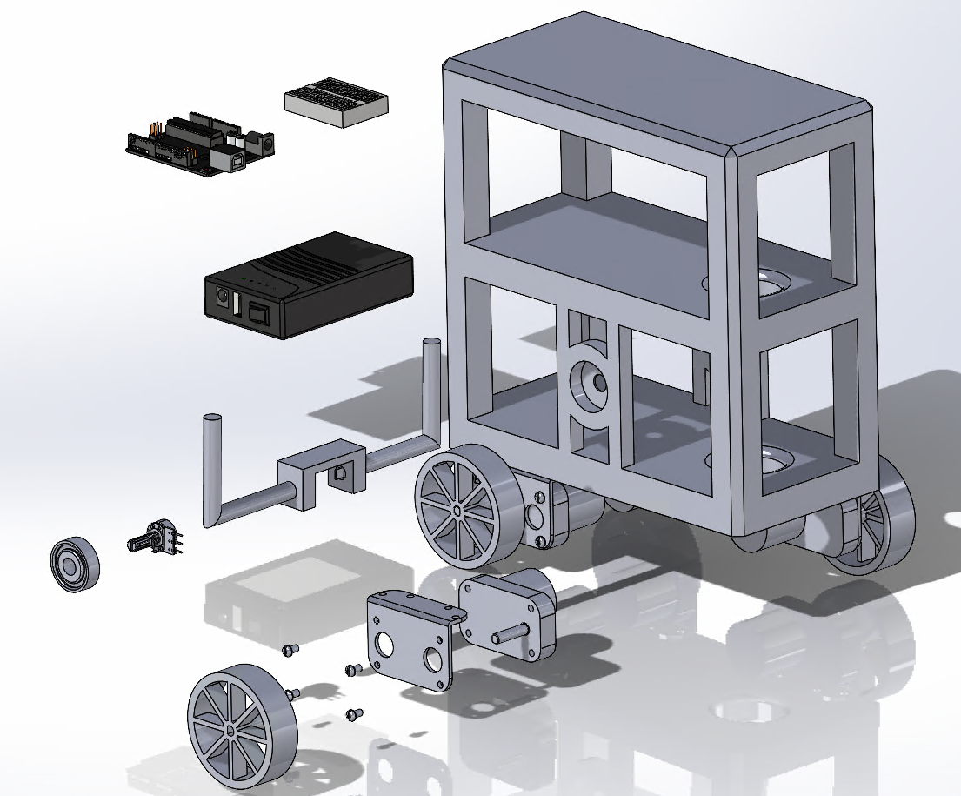
Robot 1 - Subsystems
Mechanical
Pendulum Robot Frame, all other systems attached to it. (1)
Motor Bracket, provides means of securing motors to frame.(2)
Pendulum Bearings, supports pendulum while allowing rotation.(3)
Screws for affixing Motor Brackets.(4)
Pendulum
Pendulum Assembly, comprised of 2 arms connected by a central join with point to secure potentiometer.(5)
Potentiometer – measures angle of pendulum. (6)
Motors
L-Type 520 Motors – Facilitate robots motion.(7)
67.5 mm Wheels,
Control
Arduino – Reads angle of pendulum and directs motors to actuate according to what is needed to stabilize pendulum, additionally ensures robot remains within operational area.(8)
Battery
Battery- Provides power supply through voltage and current.(9)
Other (Tool)
Breadboard (10)
10
1
8
9
5
6
3
2
7
4
8
Colin – 08

Slide 8
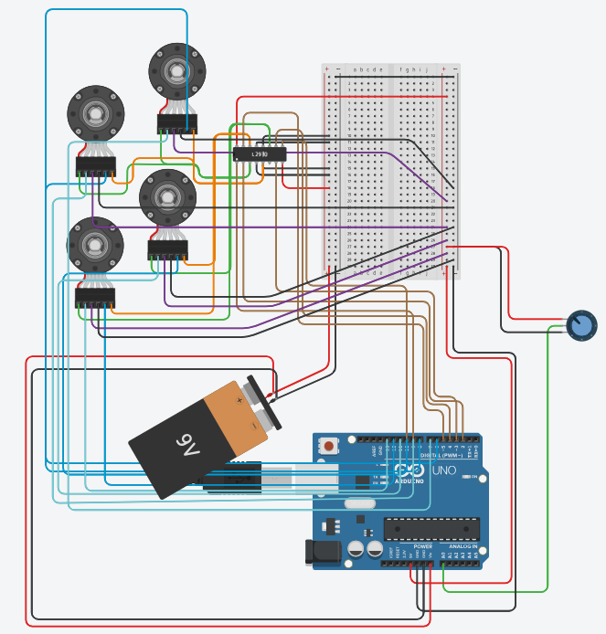
Robot 1 – Circuit Design
Name | Qty. | Component
U1 | 1 | Arduino Uno R3
Motor w/ encoders M1, M1, M2, M3 | 4 | 416 DC Motor with encoder
BAT1 | 1 | 9V Battery
Rpot1 | 1 | 250 kΩ Potentiometer
L293D (rep/ L298N) | 1 | H-bridge Motor Driver
The L298N will be used (not the 293) due to higher power motor driver and current handle
Used in schematic due to lack of L298N
Battery place holder for actual battery pack
Will likley be 12V
2 power rails (5V and 12V; left and right of BB)
Andres – 08

Slide 9
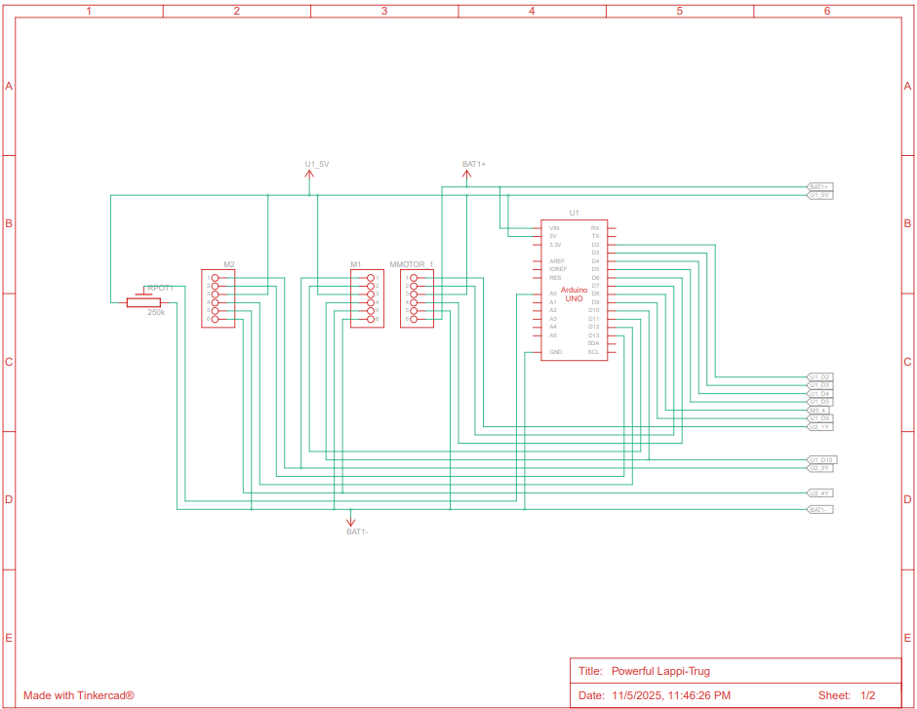

Slide 10
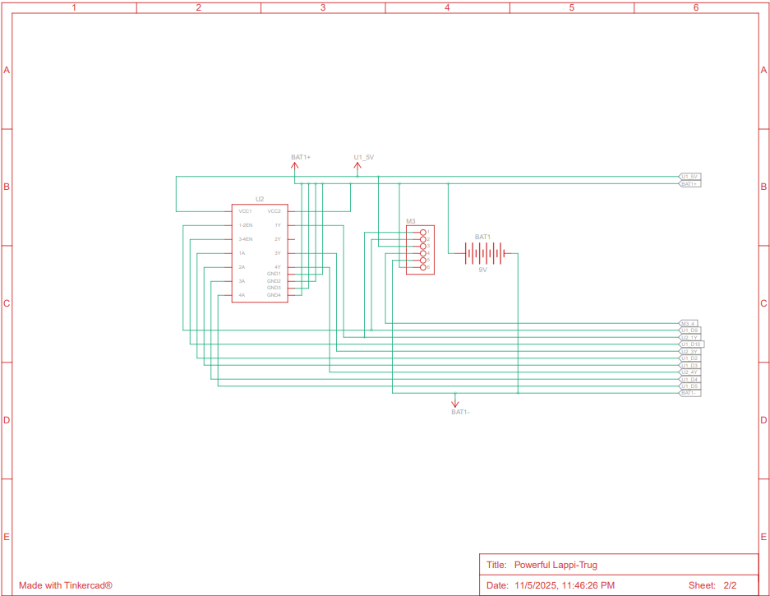

Slide 11
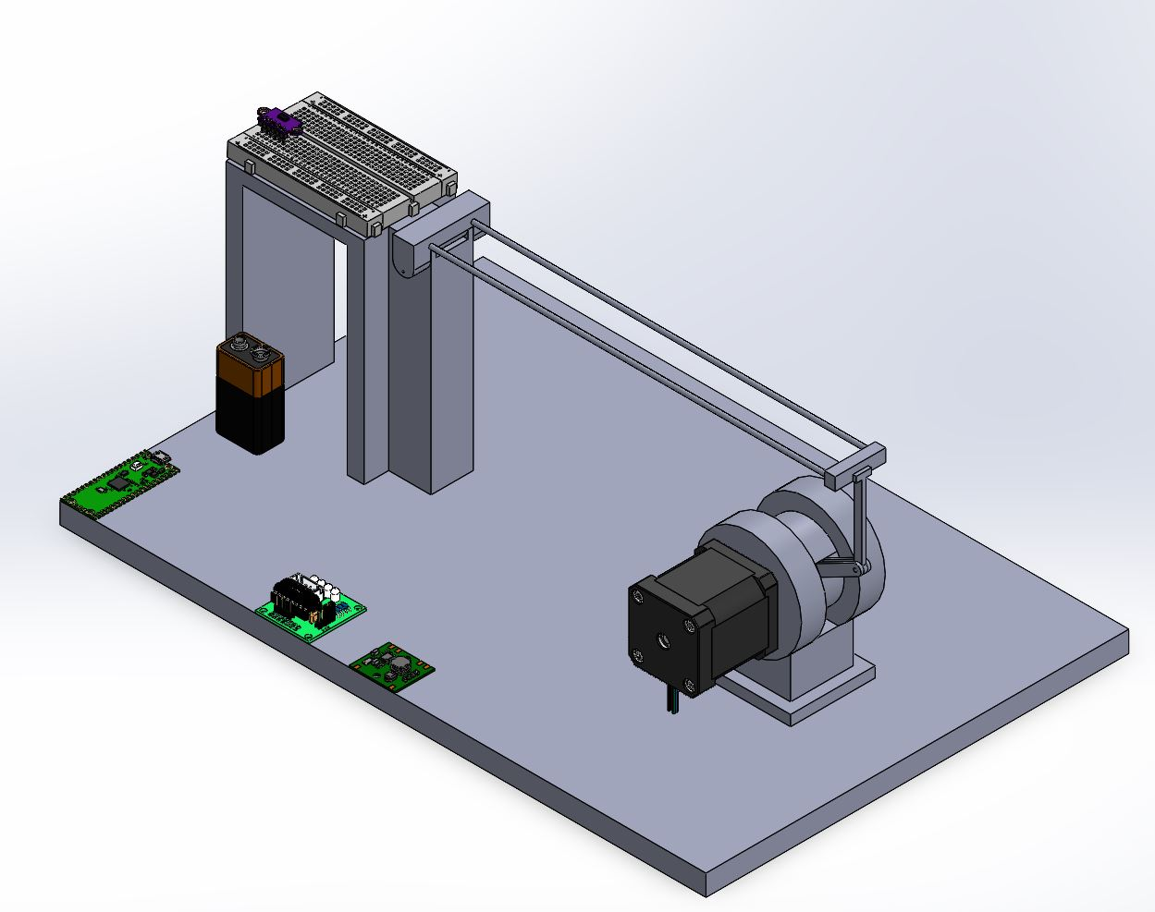
Robot 2 – CAD Model and Major Subsystems
Mechanical- Physical structure and dynamics.
Actuation-Converts the electrical signals into mechanical motion.
Sensing-Real time measurement for the control by measuring the ball's position and beam angle.
Control-Processing data and commands for the ball's stabilization.
Power/Regulator- Supplies and regulates electrical components to other components.
Florence – 09
Notes:
Goal: explain major subsystems (use leader line notes for CAD)
Explain overall design, present motor, potentiometer, arduino.
Bullet list explaining how top-level design functions
Full drawing odf total design
Sub assembly
Motor from cad online
Part drawings
Fritzing (for circuit diagram)
Flow chart for programming
FMEA for each robot
Recalcuate stuff for robot 1
Assembly drawings (wires for imporant things)
Sub assembly drawings
Part drawings (wires for circuit)
HW04
Simulation
How will we know if control algorithm will work?
Robot

Slide 12
Robot 2 - Subsystems
Mechanical
Rod-Guides the ball's motion.(1)
Ball- Rolls freely along the beam due to gravity.
Hinge- Connects the rods and tilting motion occurs.(2)
Fulcrum- Aid in rotating the stent.(3)
Stent- The rods connects to the motor that allows rotation.(4)
Base- Supports the assembly.(5)
Actuation
Servo motor- Applies tilt (torque) of the beam.(6)
Stepper Driver- Communication between the controller and motor. (7)
Sensing
VL53L0X- Measures distance of the ball.(8)
Control
Raspberry Pi- Brain of the system that runs the code through a closed-feedback loop control, which maintains the ball's position. (9)
Power/Regulator
Battery- Provides power supply through voltage and current.(10)
Regulator Module- Stabilizes the voltage.(11)
Other (Tool)
Breadboard (12)
8
12
2
10
1
9
4
7
6
3
11
5
Florence – 10

Slide 13
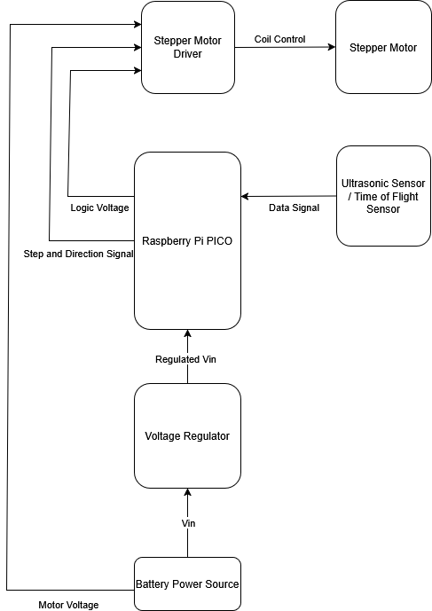
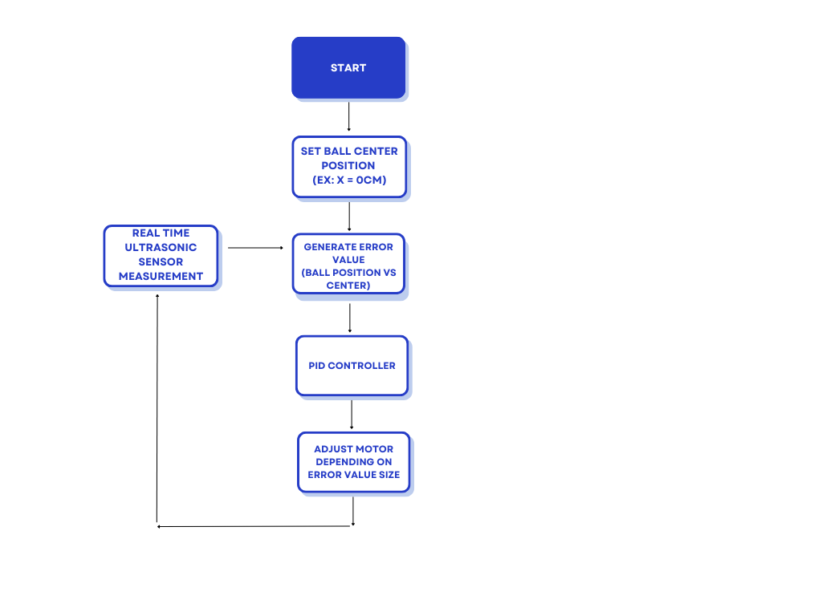
Robot 2 - Circuit Design
Figure 1: Robot 2 Flow Chart
Figure 2: Robot 2 Circuit Diagram
Freddy – 11
Notes:
Goal: Present important sub assembly
Explain circuit design and programming blocks
Flow Chart: This is the code flow chart of what the structure of our code is going to look like, which is a closed loop PID system. The simple explanation of the PID system is that we generate an error which we calculate as the difference between the set point and the sensors’ reading. We then take that error term and run it through the PID, which stands for Proportional Integrator derivative, and do some math on the error to determine how much to control the motor through the controller. Generally, we use the proportional term to control how much to tilt the balance beam, the farther away the target point, the more tilt we want to give to the system. The integral term generally helps with keeping the system stable over the long run as it generates a running total of the errors, which will eventually lead to finer control of the system. Finally, the derivative function helps with smoothing out future errors as we naively assume that the error function will be a straight line which helps with the control. For our final value we sum all three parts together and feed that into our motor controller which would then change the motor value, accordingly, translating into the rotation of the balance beam. Then we do it all over again, get a new error from the difference from the set point and the sensor reading, feeding it back into the PID once more.
Circuit Diagram: This is the system diagram for the ball and beam system. At the heart of the system is the Raspberry Pico. The input into the raspberry pi is the distance sensor, being either the ultrasonic sensor or time of flight sensor, and the power source for the raspberry pi. The reason that we cannot just hook up a 9V battery to the PICO is because 9V would overload the system, so we need to step it down. The other reason is that we need to connect the battery power source to the motor because it requires a higher voltage to operate. The motor stepper driver is important for interfacing the motor; it provides power and allows interfacing and reading which step the motor is on.

Slide 14
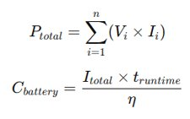
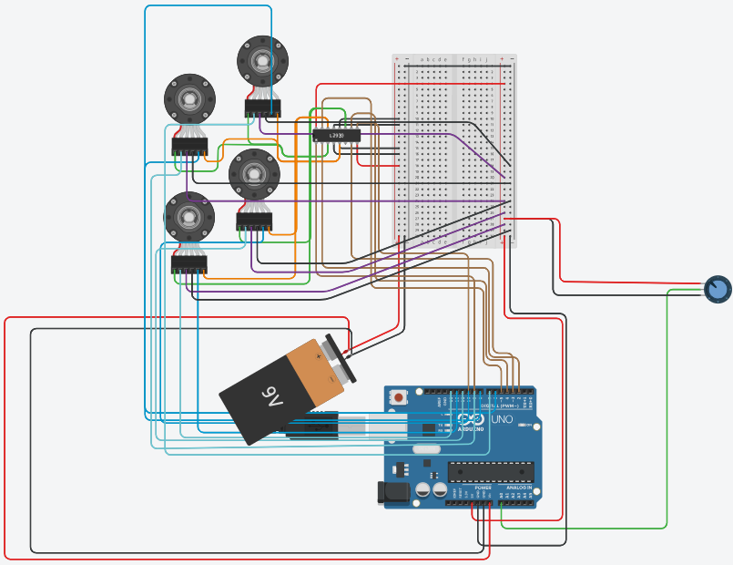
Andres' Engineering Calculations
Component | Voltage Req. | Current Req.
DC Motor (NEW) w/ encoder | 6-12 V | -.5 - 2 A
Encoder/ Tracking | 5V | 30 mA
Potentiometer | 5V | 1 mA
Motor Driver | 5V | 50 – 100 mA
Arduino Uno | 5V | 70 mA
Power Source | 6 – 12 V (5 V for logic) | 9 Ah
Kirchoff's Voltage Law
Notes:
Goal: Present important sub assembly
Explain circuit design and programming blocks
The total power required by all components (sum of V×I) must stay within the 6–12 V, 9 Ah source, while each unit’s capacity (C = I·t / n) ensures individual devices like the DC motor, encoder, sensors, driver, and Arduino can operate safely without exceeding source limits.

Slide 15
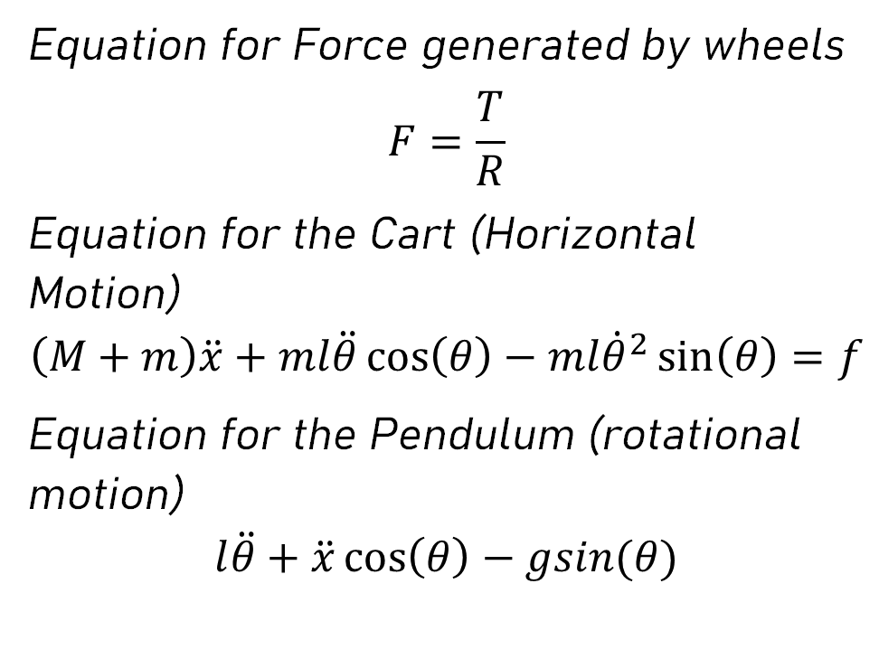
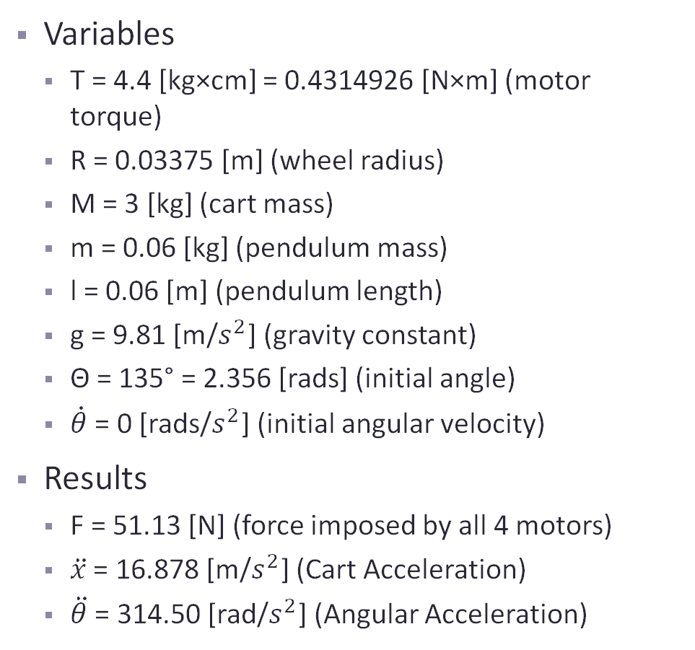
Colin – Engineering Calculations
Variables
T = 4.4 [kg×cm] = 0.4314926 [N×m] (motor torque)
R = 0.03375 [m] (wheel radius)
M = 3 [kg] (cart mass)
m = 0.06 [kg] (pendulum mass)
l = 0.06 [m] (pendulum length)
g = 9.81 [m/$s^{2}$] (gravity constant)
Θ = 135° = 2.356 [rads] (initial angle)
$\dot{θ}$ = 0 [rads/$s^{2}$] (initial angular velocity)
Results
F = 51.13 [N] (force imposed by all 4 motors)
$\ddot{x}$ = 16.878 [m/$s^{2}$] (Cart Acceleration)
$\ddot{θ}$ = 314.50 [rad/$s^{2}$] (Angular Acceleration)
Equation for Force generated by wheels
$$F=\frac{T}{R}$$
Equation for the Cart (Horizontal Motion)
$$\left(M+m\right)\ddot{x}+ml\ddot{θ}\cos\left(θ\right)−ml{\dot{θ}}^{2}\sin\left(θ\right)=f$$
Equation for the Pendulum (rotational motion)
$$l\ddot{θ}+\ddot{x}\cos\left(θ\right)−gsin(θ)$$
Colin-13

Slide 16

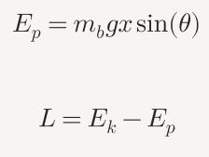
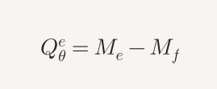

Florence – Engineering Calculations Ball-on-Plate Calculations ----> Ball-on-Beam Calculations (Energy, Forces, and Motion R)
Kinetic Energy
Potential Energy
Lagrangian
Beam
Motor Torque
= 0.015 J
= 0.0085 J
=0.0065 J
*If the current increases, then the torque increases. Helps determines how much energy is needed for the motor to rotate. (upcoming slides)
Parameters | Values
Ball mass (mb) | 0.1 kg
Beam inertia (Jb) | 0.02 kg•m^2
Ball position (x) | 0.05 m
Beam angle (theta) | 0.1745 rad
Ball angular velocity (theta dot) | 0.5 m/s
Motor Current (I) | 10 A
Torque Constant (kt) | 0.8508 N•m/A
Friction coeff. (mu) | 0.02
Florence – 14
Notes:
Goal: present new calculations (or old ones with more accurate numbers)
Show results, analysis (not process and drawn out calculations)
Identify CR or ER that need to be quantified and "mathed" out

Slide 17
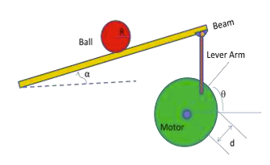
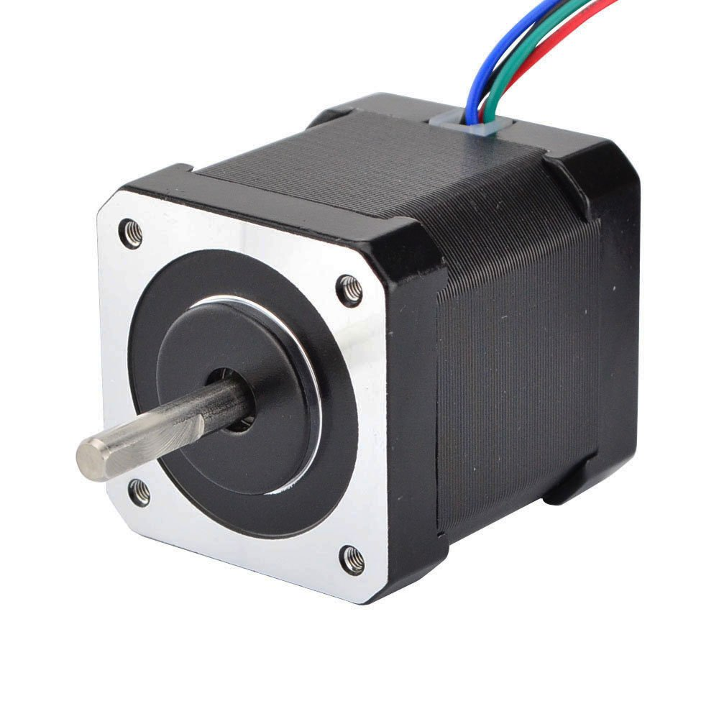
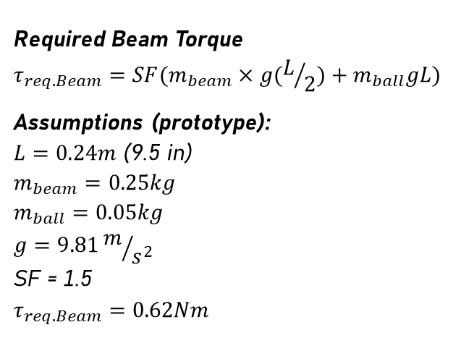
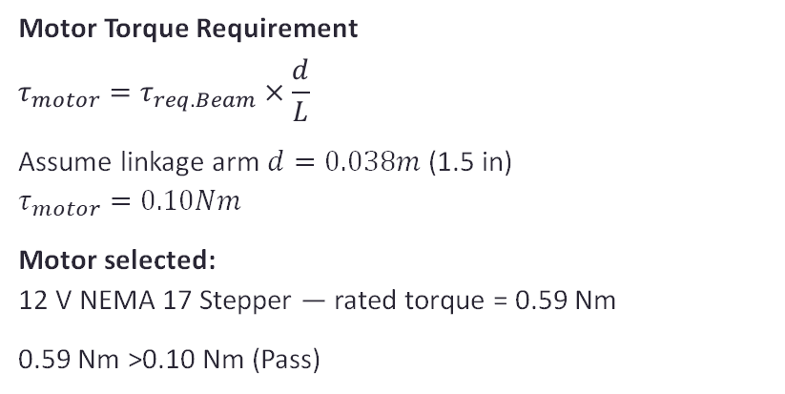
Freddy – Engineering Calculations
Required Beam Torque
$$τ_{req. Beam}=SF(m_{beam}×g(L/2)+m_{ball}gL)$$
Assumptions (prototype): $L=0.24m$ (9.5 in) $$m_{beam}=0.25kg \\ m_{ball}=0.05kg \\ g=9.81m/{s^{2}}$$ SF = 1.5
$$τ_{req. Beam}=0.62Nm$$
Figure 3: Ball-on-Beam System
Motor Torque Requirement
$$τ_{motor}=τ_{req. Beam}×\frac{d}{L}$$
Assume linkage arm $d=0.038m$ (1.5 in)
$$τ_{motor}=0.10Nm$$
Motor selected: 12 V NEMA 17 Stepper — rated torque = 0.59 Nm
0.59 Nm >0.10 Nm (Pass)
Figure 4: Chosen 12V Motor
Freddy – 15

Slide 18
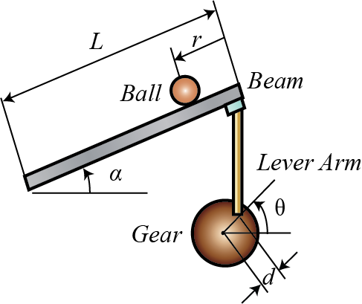
Ziyi – Engineering Calculations
System Model (Small Angle Approximation):
ẍ = (5/7) g · θ = kθ, k ≈ 7.01 m/s2/rad
Control Law (Closed-Loop):
θcmd = -a·x - b·ẋ, a ≈ 9.13, b ≈ 1.60
For x = 20 mm → θcmd ≈ 10.5° < 15° limit
Actuator Torque Calculation:
L = 0.241 m, m_p = 0.6 kg, m_b = 0.05 kg
θmax = 0.2 rad (≈11.5°), rp = 0.05 m, x = 0.10 m
τstatic ≈ 0.068 N·m
J ≈ 2.91×10-3 kg·m2
α ≈ 40 rad/s2 → τinertia ≈ 0.116 N·m
Total Required Torque: τreq ≈ 0.185 N·m
Figure 5: Ball-on-Beam System
Ziyi - 16
Notes:
Goal: present new calculations (or old ones with more accurate numbers)
Show results, analysis (not process and drawn out calculations)
Identify CR or ER that need to be quantified and "mathed" out

Slide 19
Robot 1 - FMEA
Andres – 17
Subassembly | Component | Function | Potential Failure Mode | Potential Effect(s) of Failure | S | Potential Cause(s) / Mechanisms | O | Current Design Controls / Tests | D | RPN | Recommended Action
Mechanical | Pendulum Robot Frame | Support for all subsystems | Frame cracks, warps, or misaligns | Robot tilts, components detach or misalign | 9 | Weak material, stress concentration, impact | 4 | Visual inspection, low-speed balance tests | 3 | 108 | Reinforce frame; use stiffer material (e.g., carbon-reinforced PLA); add gussets at stress points
Mechanical | Motor Bracket | Secure motors to frame | Bracket loosens or fractures | Motors shift, misalignment in drive system | 8 | Vibration, weak mounting points | 4 | Torque tests, visual inspection | 3 | 96 | Increase wall thickness; use locking washers or Loctite
Mechanical | Pendulum Bearings | Support pendulum rotation | Bearing seizes or adds friction | Pendulum movement restricted, poor control | 8 | Dust ingress, poor alignment, wear | 3 | Rotation smoothness test | 4 | 96 | Use sealed bearings; ensure alignment and lubrication
Mechanical | Motor Bracket Screws | Fasten brackets to frame | Screws loosen or strip threads | Motor misalignment or detachment | 8 | Vibration, over-torque | 4 | Visual inspection, torque checks | 3 | 96 | Use thread-locker; torque screws properly; use metal inserts if possible
Pendulum | Pendulum Assembly | Provides center arm for balance, supports potentiometer | Arms bend or joint loosens | Pendulum swings unevenly or angle changes unpredictably | 9 | Weak joint connection, fatigue | 4 | Manual deflection test | 3 | 108 | Strengthen joint; increase arm cross-section; use metal fasteners
Pendulum | Potentiometer | Measures pendulum angle | Incorrect or unstable readings | Robot miscalculates angle, loses balance | 8 | Loose mounting, electrical noise, wear | 3 | Calibration test, shielding wires | 4 | 96 | Secure mount; add RC filter or averaging in code
Motors | L-Type 520 Motors | Provide motion and balancing torque | Motor stalls or overheats | Robot falls or oscillates uncontrollably | 10 | Overload, friction, underpowered motor | 5 | Bench test under load | 3 | 150 | Verify torque margin; add heat sink; use higher-rated motors
Motors | 67.5 mm Wheels | Transfer motor torque to ground | Wheels slip or detach | Robot cannot move or balance | 9 | Loose fit, worn tires, low friction | 4 | Visual inspection, traction test | 3 | 108 | Improve tire grip; ensure tight hub fit; add lock nuts
Control | Arduino | Processes sensor data, controls motors | Software crash or voltage reset | Robot stops or behaves erratically | 10 | Power fluctuation, coding bug | 3 | Unit testing, watchdog timer, battery monitoring | 4 | 120 | Add capacitor for power smoothing; implement watchdog recovery
Battery | Battery | Supplies system voltage/current | Battery drains mid-operation | Robot shuts off mid-test | 9 | Low capacity, poor contact, over-discharge | 5 | Voltage check before use | 3 | 135 | Use higher-capacity battery; add connector lock and low-voltage cutoff
Other (Tool) | Breadboard | Distributes circuit connections | Loose or intermittent connections | Random resets or inconsistent control | 8 | Poor contact, vibration | 4 | Visual inspection, continuity test | 3 | 96 | Transition to soldered PCB or terminal block; secure wires
Notes:
FMEA Highlights
Identified critical potential failures:
Motor stalls → robot tips
Software/Arduino crash → loss of balance
Battery drain → sudden stop
Chassis deformation → instability
Mitigations:
Verified motor torque, current protection
Reinforced chassis with gussets
PID tuning in simulation
Secured battery and wiring
Risk Trade-Offs
Balanced motor/battery power vs. weight
Chassis strength vs. ease of fabrication
Goal: RPN < acceptable threshold for all subassemblies

Slide 20
Robot 1 Testing Procedures and Equipment
Test | Purpose | Method | Expected Outcome | Equipment / Resources
Chassis Stress Test | Validate frame and bracket strength | Apply static load to chassis and motor brackets; inspect for deformation or cracks | No visible cracking or excessive flex; brackets remain aligned | Weights, calipers, camera, test stand
Bearing Friction Test | Verify smooth pendulum motion | Rotate pendulum manually and record resistance torque | Bearings rotate freely with minimal resistance | Torque gauge, bearing alignment jig
Motor Torque Test | Confirm motor capability under load | Run motors with incremental loads; measure speed and stall torque | Motors meet or exceed required torque; no overheating | Arduino, tachometer, load rig, multimeter
Driver Thermal Test | Validate L293D thermal stability | Continuous drive for 10–15 mins; monitor IC temperature | Temperature remains within safe range (<70°C) | Thermocouple, Arduino, fan/heat sink
Sensor Accuracy Test | Verify potentiometer angle readings | Sweep pendulum through full range; compare analog readings to actual angles | Linear and repeatable voltage response | Arduino, protractor, multimeter, data logger
PID Tuning / Control Test | Validate balancing and control stability | Run robot on flat surface, log tilt and motor response | Robot self-stabilizes within ±5° tilt; no oscillation | Arduino, test stand, data logger
Battery Runtime Test | Confirm power capacity and consistency | Run full system until battery cutoff | Operates for entire demo duration without brownout | Battery, stopwatch, voltage monitor
Andres – 18
Notes:
Testing Overview (2nd Semester)
Chassis stress test → frame integrity
Motor torque test → performance under load
L293D driver thermal test → prevent overheating
Potentiometer sensor accuracy → reliable tilt data
PID tuning → robot maintains balance
Battery runtime → full operation duration
Wiring check → no intermittent connections
Equipment / Resources Needed
Arduino, L293D drivers, motors w/ encoders, battery
Potentiometer, wires, breadboard/soldering tools
Multimeter, tachometer, thermocouple
Flat test surface, safety cage
Data logging software

Slide 21
Robot 2 - FMEA
Used for Both our Prototype and our Final Design (Ball-on-Plate)
Subassembly | Component | Function | Potential Failure Mode | Potential Effect(s) of Failure | S | Potential Cause(s) And Mechanisms of Failure | O | Current Design Controls Test | D | RPN | Recommended Action
Base / Stand | Base plate | Support robot on table | Base tips or slides when bumped | System moves; camera misaligned; ball rolls off | 7 | Narrow base; light frame | 4 | Rubber feet; wide stance | 3 | 84 | Increase weight or clamp base during demo
Base / Stand | Base plate | Mount electronics and actuator | Mounting screws loosen | Actuator misalignment; unstable leveling | 6 | Vibration; frequent transport | 3 | Lock washers; inspections | 4 | 72 | Apply threadlocker; retighten before demos
Plate / Structure | Plate panel | Provide rolling surface | Plate sags or flexes | Ball drifts despite control | 8 | Thin or weak material | 3 | Rigid material selection | 3 | 72 | Use aluminum or composite plate
Plate / Structure | Plate panel | Provide low-friction surface | Surface dirty or sticky | Ball sticks or slows unexpectedly | 6 | Dust; fingerprints | 4 | Cleaning before demo | 3 | 72 | Apply smooth matte coating; routine cleaning
Plate / Structure | Plate edge | Keep ball contained | Edge too low or missing | Ball falls off during outreach | 6 | Design oversight | 2 | Visual check | 2 | 24 | Add 1–2 cm guard wall around plate
Tilt Mechanism | Ball joint / hinge | Allow plate rotation (X,Y) | Joint binds | Uneven motion; oscillations | 8 | Dust; tight fit | 3 | Lubrication | 3 | 72 | Use precision ball joints; routine maintenance
Tilt Mechanism | Ball joint / hinge | Allow plate rotation | Joint has excessive play | Unstable or delayed response | 7 | Wear; poor tolerances | 4 | Metal inserts; periodic check | 4 | 112 | Replace worn joints; tighten tolerance
Actuation | Servo motor (x3) | Tilt plate corners | One servo fails or drifts | Plate tilts diagonally; unstable system | 9 | Uneven load; motor failure | 3 | Matched servos; torque sizing | 3 | 81 | Use identical servos; test prior to demo
Actuation | Servo motor (x3) | Continuous motion | Overheats or stalls | System shutdown mid-demo | 8 | Aggressive PID; overuse | 3 | Temperature testing | 4 | 96 | Add cooling; tune PID gains
Figure 6: Robot 2 FMEA
Freddy – 19
Notes:
Goal: show table describing potential failures, risk assesment, and testing procedures
Discuss critical potential failures, how our design mitigates them, list equiptment, space, resources, etc. needed to test and procedures to follow

Slide 22
Robot 2 – FMEA Continued
Used for Both our Prototype and our Final Design (Ball-on-Plate)
Subassembly | Component | Function | Potential Failure Mode | Potential Effect(s) of Failure | S | Potential Cause(s) And Mechanisms of Failure | O | Current Design Controls Test | D | RPN | Recommended Action
Actuation | Servo mount | Hold motor to frame | Bracket cracks or shifts | Loss of accuracy; vibration | 7 | Brittle print; fatigue | 3 | Reinforced bracket | 3 | 63 | Use metal bracket or denser print infill
Sensing / Vision | Overhead camera | Detect ball position (XY) | Camera misaligned | Incorrect position data | 8 | Vibration; bump | 3 | Fixed mount; calibration grid | 3 | 72 | Add adjustable mount; re-calibrate before demos
Sensing / Vision | Overhead camera | Detect ball position | Lighting interference | Tracking errors | 7 | Reflections; bright room | 4 | Matte surface; controlled lighting | 3 | 84 | Add light shield; auto-exposure tuning
Sensing / Vision | Camera housing | Protect sensor | Sensor exposed to spills | Short circuit; failure | 8 | K–12 handling | 3 | Acrylic cover | 3 | 72 | Add full enclosure; warning labels
Control / Electronics | Controller board | Process control signal | Board resets / crashes | Loss of control; unsafe motion | 8 | Voltage drop; noise | 3 | Separate power rails | 3 | 72 | Add capacitor; watchdog timer
Control / Electronics | Breadboard wiring | Temporary electrical connections | Wire disconnects | Unstable behavior | 8 | Loose wires; student contact | 4 | Dupont headers; ties | 3 | 96 | Move to soldered protoboard; secure wiring
Control / Electronics | Exposed terminals | Safety protection | User touches live pins | Shock risk; damage | 7 | No enclosure | 3 | Visual caution | 3 | 63 | 3D-print protective lid; label warnings
Power / Safety | Power supply / battery | Deliver system power | Wrong voltage applied | Damage to components | 8 | Misconnection | 3 | Labeled connectors | 3 | 72 | Use keyed connectors; color-code leads
Power / Safety | Power supply / battery | Provide current to servos | Overcurrent without fuse | Wires overheat | 8 | Servo stall | 3 | Current limits | 3 | 72 | Add inline fuse or breaker
Power / Safety | E-stop / main switch | Allow emergency shutdown | Not reachable during demo | Can’t stop runaway plate | 9 | Poor switch placement | 2 | Red toggle on frame | 2 | 36 | Move switch to front face; mark clearly
Figure 7: Robot 2 FMEA Continued
Freddy – 20
Notes:
Goal: show table describing potential failures, risk assesment, and testing procedures
Discuss critical potential failures, how our design mitigates them, list equiptment, space, resources, etc. needed to test and procedures to follow

Slide 23
Robot 2 – Testing Procedures
Objective: To verify that the final Ball-on-Plate robot meets all engineering requirements (ERs) related to response time, steady-state error, range of motion, stability, and control accuracy.
Planned Testing Procedures:
System Calibration:
Calibrate sensors (camera or ultrasonic) to map pixel or distance readings to precise X–Y coordinates on the plate.
Verify actuator range of motion (±15° per axis).
Static Balance Test:
Place ball at the center and confirm system maintains steady position (steady-state error ≤ 5%).
Dynamic Response Test:
Displace ball from center and measure return time (response time ≤ 1 s).
Record overshoot, oscillation, and settling behavior.
Cross-Axis Coupling Test:
Move the ball along X and Y axes independently to ensure motion in one direction does not induce instability in the other.
Endurance and Reliability Test:
Continuous operation for ≥30 minutes to ensure no thermal or component degradation.
Safety and Power Test:
Verify system draws <30 W during operation and all high-voltage areas are enclosed.
Test emergency stop or power-cutoff features.
Freddy – 21

Slide 24
Robot 2 - Equipment
Klein Tools Lightweight Wire Cutters – Used to trim electrical leads and cut wires to proper length during circuit assembly.
WGGE Professional Wire Multitool/Crimper – Multi-functional tool for cutting, stripping, and crimping wires for clean and secure electrical connections.
Elegoo Solderless Breadboards (3-Pack) – Provides a reusable platform for testing and assembling temporary circuits without soldering.
YUEONEWIN Electronics Assortment Kit – Contains essential components (resistors, capacitors, transistors, etc.) for testing circuit behavior and fine-tuning control systems.
Minidodoca IC Assortment Kit – Provides various logic ICs (transceivers, counters, multiplexers, decoders, etc.) for experimenting with signal control and feedback logic.
TUOFENG Hookup Wire Set (6 colors) – Color-coded wire rolls used for organized and durable breadboard or protoboard connections.
Generic Protoboards (PCB-style) – Used to simulate the physical layout of the printed circuit board (PCB) for early-stage testing and prototyping.
Honbay 40-Pin Male/Female Header Connector Kit – Provides reusable header pins for connecting sensors, motors, and other electrical components on protoboards.
Elegoo Dupont Jumper Wires – Pre-terminated jumper wires used for quick and reliable interconnections between breadboard components.
Freddy – 22

Slide 25
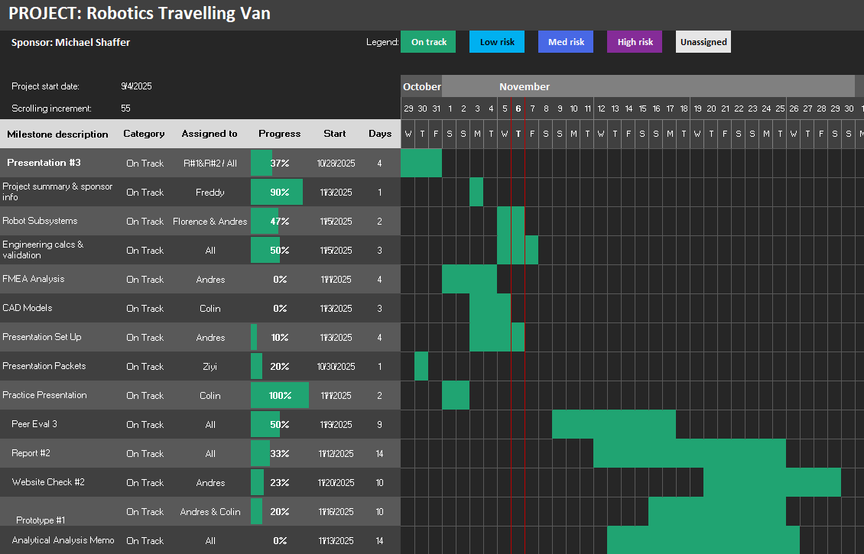
Team Gantt Chart
Notes:
Are we on, ahead, or behind schedule

Slide 26
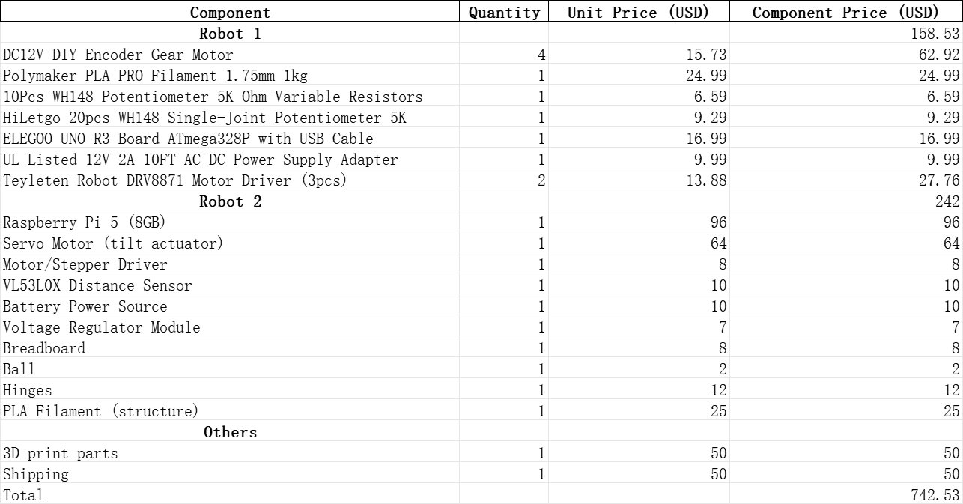
Budget
Our spending remains within budget, and the remaining balance will be used for additional functional components and system adjustments.
Usage Category | Allocation (USD) | Remaining
Robot #1 Prototype Development | $1500 | $1291.47
Robot #2 Prototype Development | $1500 | $1208
Adjustments & Redesign Phase | $2000 | $2000
Future fundraising efforts will be flexibly incorporated into the budget plan.
Notes:
Total budget available, past expenses, anticipated expenses, resulting balance, discuss fundraising efforts

Slide 27
Fundraising Updates
We set up an account with NAU Foundation
Working on creating Events with Panda Express
Set up a GoFundMe
Freddy – 25
Notes:
Total budget available, past expenses, anticipated expenses, resulting balance, discuss fundraising efforts

Slide 28

Thank You

Slide 29
References
[1] H. Schmidt, M. Käß, R. Lichtinger, and M. Hülsebrock, "Simulation-based FMEA for the reliability assessment of printed circuit boards," Microelectronics Reliability, vol. 125, p. 115613, 2025. DOI: 10.1016/j.microrel.2025.115613. Accessed Nov. 06, 2025
[2] A. Md. Khairul Alam, M. R. Karim, and S. M. Mahmud Hasan, “Stabilising a cart inverted pendulum system using pole placement control method,” in 2017 3rd Int. Conf. on Electrical Information and Communication Technology (EICT), Khulna, Bangladesh, 2017, pp. 1–6. doi: 10.1109/EICT.2017.8168481. [Online]. Available: https://ieeexplore.ieee.org/abstract/document/8168481. [Accessed: Sept. 13, 2025].
[3] S. Anand and R. K. Prasad, “Dynamics and Control of Ball and Beam System,” International Journal on Recent and Innovation Trends in Computing and Communication (IJRITCC), vol. 5, no. 5, pp. 1332–1339, May 2017. Accessed: Nov. 3, 2025.

