Slide 1
Robotics Traveling Van
Robots on the Road
Florence Fasugbe, Andres Gonzales, Colin Parsinia, Freddy Rivera, & Ziyi Tang
ME 476C Sec.2
Notes:
Topic 1: Project intro = 1 min
Topic 2: 3 slides, customer requirements, engineering requirements, QFD
Topic 3: pros and cons of best in class systems to benchmark off of (3 at least) 3 mins
Topic 4: Looking for standards; lit review; one slide per 7 references, annotated bib, full citation and a bullet that shows how reference applies to project
Topic 5: math, one model per person (slide); answer 3 questions; no work, just answer; validate with example;
Topic 6: schedule as a bullet point list with dates and names --> ghantt chart; 486C under long term management doc; budget template income and expenses, outline plane to fundraise 10%; show % of budget for 1st, 2nd, and final demo prototypes
Q: ask for standards and applications;

Slide 2
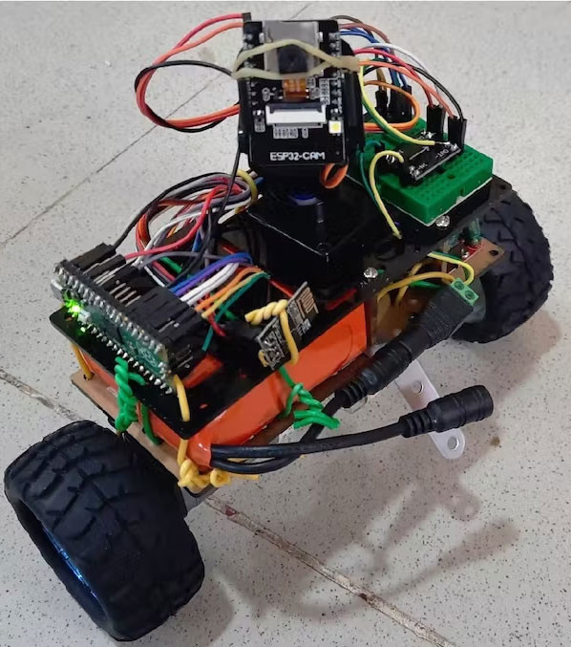
Project Description
Freddy
Design and develop a small-scale Pendulum Balancing Robot and a Control-Based Robot to demonstrate control systems
Robot uses PID control with adjustable parameters to maintain balance in real time, integrate a RaspPi or Equivalent with a touchscreen
Intended as a K–12 educational tool to spark interest in robotics and engineering
Sponsored by Michael Shafer (NAU), emphasizing the importance of STEM outreach and hands-on learning
Fig. 1. Self-Balancing Robot Using PID [31], source: Elektor Magazine (2022).
Notes:
1 minute

Slide 3
Customer Requirements
Florence
Objective: To demonstrate how feedback controls affects the functionality of robots on continuous systems for K-12 students.
Durable
Inexpensive
Functionality
Battery powered
Interactive interface (touchscreen)
Operating space
Educational
Kid friendly
Emergency button
Chamfer and fillet parts
Reduction of pinching (3mm between wheels)
Notes:
2 minutes

Slide 4
Engineering Requirements
Colin
Dimensions:
14" by 10" by 5" (the dimensions of a shoebox)
Operate within a 20" by 20" space
Power Source:
On a single set of batteries, system should be able to operate regularly for an hour to an hour and a half
Arduino or RasberryPi:
RasberryPi allows more flexibility in programing and offers touch screen capability, Arduino is more space efficient and power efficient
U.S. CPSC Guidlines:
Guidlines regulating design elements of childrens toys, includes numerous requirements such as no exposed batteries or wiring, hazerdous edges, etc.
Drop Test:
Survive a 30" fall onto concrete surface and continue functioning.
Programming Diagrams:
Method of organizing program functions into if-then trees
Notes:
2 minutes

Slide 5
Background & Benchmarking
Ziyi
Focus of Our Project Since our project targets K–12 students, benchmarking emphasizes: → Simplicity & visibility → Interactivity → Excitement & engagement Existing Designs → Comparison → Insights → Our Project.

Slide 6
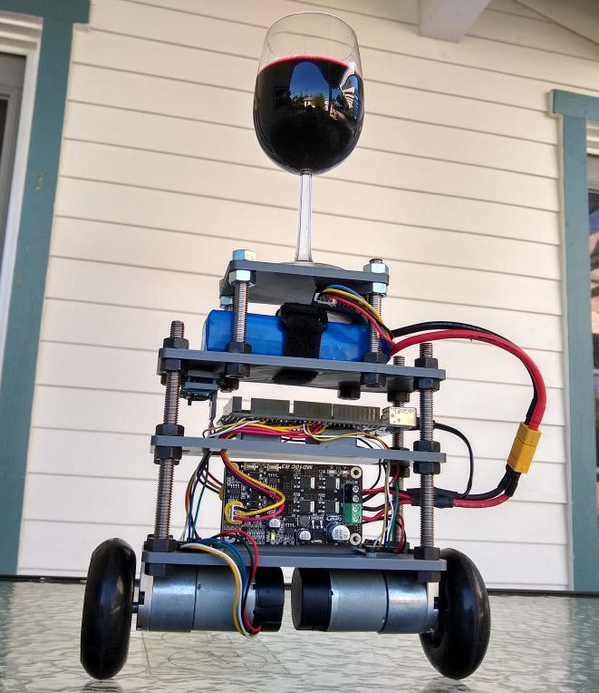
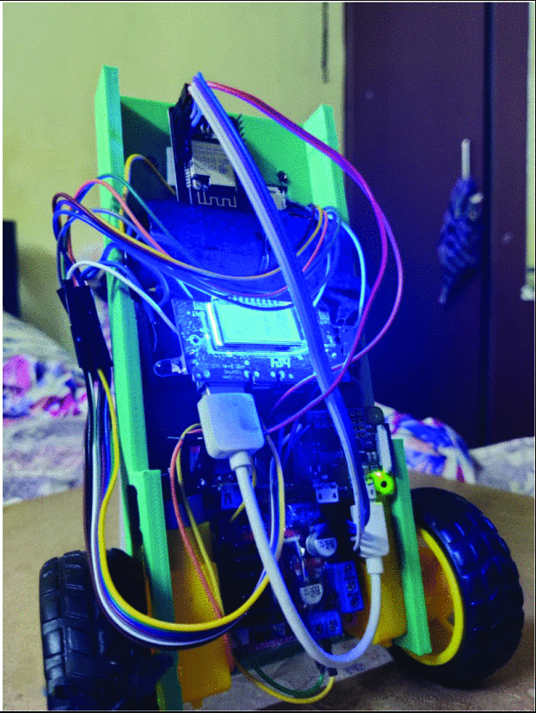
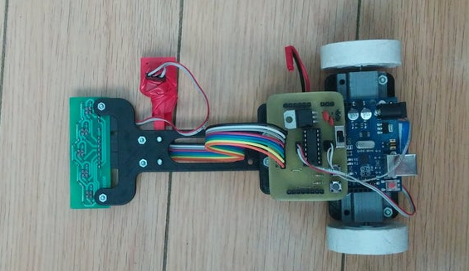
Benchmarking-Competitors
Ziyi
Shay Sackett's Inverted Pendulum Robot:
Strengths: Low cost, small size, demonstrates core concept
Best-in-Class: Design simplicity
Project Relavence: good baseline design to expand off of
"Roolie" Self-balancing Interactive Robot:
Strengths: voice controlled, small size, Rasberry Pi based
Best-in-Class: most advanced interactive system
Project Relavence: Very similar in concept to our desired final design
Line Follower Robot with Arduino:
Strenghts: Unique, simple, compact design
Best-in-Class: Most cost effective in terms of materials
Project Relavence: serves as a concept for our secondary design
Fig 2. Shay Sackett's Inverted Pendulum Balancing a glass of wine [23]
Fig 3."Roolie" Self- Balancing interactive robot prototype [15]
Fig. 4 "Line Follower Robot with Arduino completed assembly [8]

Slide 7
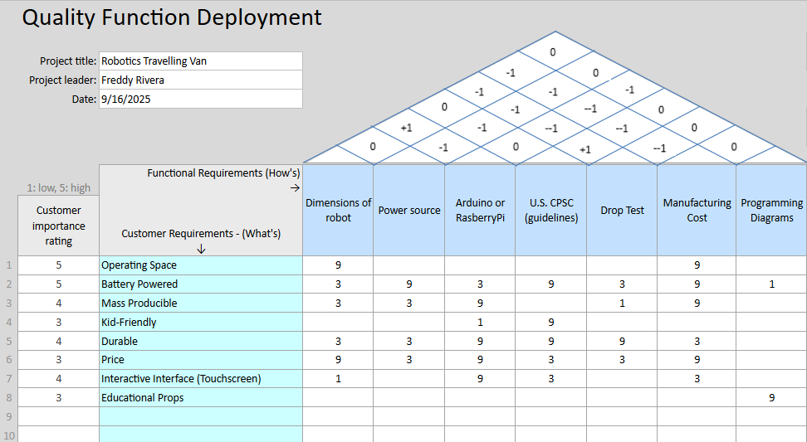








QFD
Andres
Notes:
The ER came from the CR as seen in the highlights

Slide 8
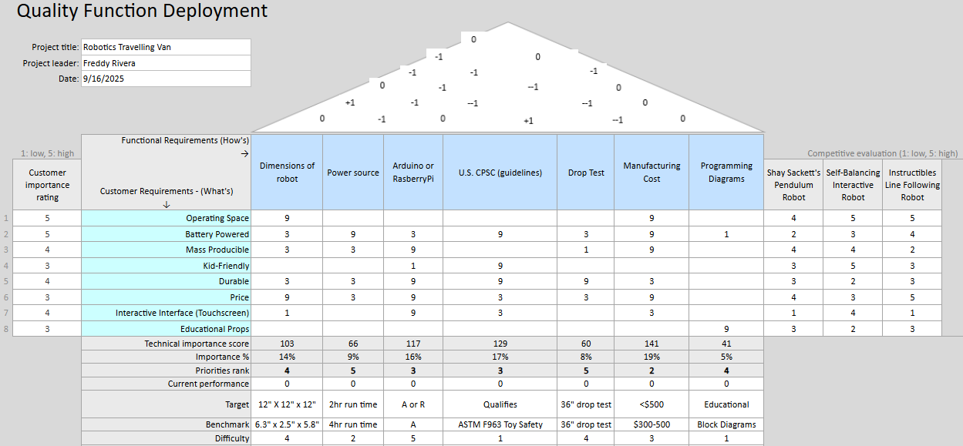
QFD
Andres
Notes:
Here you can see the total over view of the QFD.
On the right the benchmarks we have were pitted against our CR and ER
The goal of each CR

Slide 9
State of the art (SOTA)
Florence

Slide 10
Literature Review TO BETTER UNDERSTAND WHAT AN INVERTED PENDULUM AND HOW it is imPLEMENTED IN EVERYONE'S LIVES
Florence
Comparison of CoP estimation and center-of-gravity sway measurement in human standing posture using inertial sensors [1]
Center of Pressure (COP) of humans using sensors to analyze gait patterns.
Human stick balancing: Tuning Lèvy flights to improve balance control [3]
Erecting and Balancing of the Inverted Pendulum by an Industrial Robot [5]
Inverted pendulum on an industrial robot by using one algorithm to swing it up and a state-space controller with offset adaptation to balance it.
Effect of the hip motion on the body kinematics in the sagittal plane during human quiet standing [2]
Balancing of an inverted pendulum with a SCARA robot [4]
Balancing an inverted pendulum with a robotic manipulator is a benchmark problem requiring precise sensing and compensation for nonlinear effects like friction, backlash, and elasticity.
Stabilizing an Inverted Pendulum with PID Controller[6]
Stabilizing an inverted pendulum with a reaction wheel and PID (Proportional Integral Derivative) controller is simulated to balance it effectively and efficiently.
Vision-based control system for an inverted pendulum, using OpenCV to calculate its deflection angle and verify effective stabilization without relying on encoder sensors.
Concept of stabilization of rapid human movements which is determined by equilibrium and limit cycles with motor controls analysis like closed loop control (automatic control systems).
Research on Inverted Pendulum Control System Based on Vision Sensor[7]
Standing still affects hip motion due to the center of mass (COM).

Slide 11
Literature Review
Colin
Manufacturing Robotics: Basic Issues and Challenges [8]
Explains various methods used in the manufacture of robots, particularly those for mass manufacture, useful since we are trying to design for a product run of at least 100
Designing robots with movement in mind [10]
Discusses the Benefits of Robots capable of human motion and expression, something to consider in the design of our robots in order to make them appealing to k-12 students
Design and control of a multi-DOF two wheeled inverted pendulum robot [12]
Breaks down the math behind a multi-Degree-of-Freedom inverted pendulum robot, has some useful equations and can serve as a model for other types of robots
How to include User eXperience in the design of Human-Robot Interaction [9]
Highlights methodology of human robot interactions, useful when setting up our interactive elements
Design and Implementation of an Open-Source Educational Robot for Hands-On Learning Experiences in IoT [11]
Presents a design for a modular educational robot that utilizes Arduino hardware, as well as making use of some laser cut parts, good baseline for prototyping
Mechanical Design and Dynamic Modeling of a Two-Wheeled Inverted Pendulum Mobile Robot [13]
Showcases a design for an inverted pendulum robot designed for navigating small obstacles and inclines, some design elements could be useful if robot proves unstable
Design and Implementation of Self-Balancing Interactive Robot [14]
Proposes a design for a Pendulum robot companion with voice control features, overall design is comparable to our desired design for pendulum robot
Notes:
Not final, will ask GTA for help formatting

Slide 12
Literature Review
Andres
Bacterial foraging‑optimized PID control of a two‑wheeled machine with a two‑directional handling mechanism [15]
A Self‑adaptive SAC‑PID Control Approach based on Reinforcement Learning for Mobile Robots, Mandeno [16]
Design of an inverted pendulum laboratory stand to teach mechatronics [20]
Inverted Pendulum Control — PythonRobotics documentation [21]
Uses a bacterial foraging optimization algorithm to tune a PID controller for a 5‑DOF two‑wheeled robotic system (with payload in two directions) and shows improvement in stability and performance over conventional PID control across multiple work scenarios.
Introduces a hierarchical control method: a soft actor‑critic RL agent selects parameters for an incremental PID controller in real time, improving adaptability and robustness in varied environments with mobile robots.
Learns stable and accurate control policies for a wheeled inverted pendulum from demonstration data, offering a way to replicate expert performance in balancing while reducing design of controllers from scratch.
Explains standard implementations of inverted pendulum control algorithms in simulation (e.g. linearization, PID control, swing‑up control), providing code examples and visualizations for education or prototyping.
Proposes an adaptive‑robust control (ARC) scheme for uncertain Euler‑Lagrange systems with uncertainties satisfying linear‑in‑parameters bound, addressing over/underestimation of switching gains, and demonstrates experimental gains over adaptive sliding mode control.
Presents a physical laboratory setup (a real inverted pendulum stand with USB I/O card control) designed for mechatronics teaching—students can implement and observe control algorithms in real time on actual hardware.
Theory and Application on Adaptive‑Robust Control of Euler‑Lagrange Systems with Linearly Parametrizable Uncertainty Bound [18]
K. Ogata, System Dynamics, 4th ed; Chapter 11 [19]
U.S. Consumer Product Safety Commission, “Toys,” Safety Education — Toys, CPSC.gov. [Online].[22]
Explains standards for toys and devices intended for use of children, different standards for different age ranges. Useful for knowing what aspects of our robots need modifying for children use.
A Wheeled Inverted Pendulum Learning Stable and Accurate Control from Demonstrations [17]
Modeling and feedback control concepts from Ogata’s System Dynamics guided our system modeling and controller design. Enabled accurate simulation of system behavior and stability analysis before hardware implementation.
Notes:
[1]
The first applied a bio-inspired optimization method to fine-tune PID controllers on a two-wheeled robot. Their approach emphasized the importance of adaptive control—something we considered when dealing with shifting dynamics in our own system.”
[2] Mandeno took this further by integrating reinforcement learning to auto-tune PID gains. That introduced us to the idea of combining classical control with learning algorithms, to maintain performance under unpredictable conditions.
[3] “Kawlewski and Wątroba [4] designed a lab-scale inverted pendulum platform for teaching. Their mechatronics setup informed how we built and interfaced our own prototype, especially around real-time feedback and modular testing.
[4] “Božek and Nikitin [5] looked at PID control for actuators with variable loads. That was directly relevant to our challenge of maintaining balance when system inertia shifts—for example, during movement or when interacting with external forces.”
[5] “We also relied on Ogata’s System Dynamics [6] for theoretical grounding—specifically state-space modeling and closed-loop behavior, which helped us simulate and predict system responses.”
[6] We also leaned on the PythonRobotics repository [21], which includes standard inverted pendulum simulations. These open-source models let us validate our control logic before moving to hardware, saving time and reducing debugging in physical setups. [7] And finally, we referred to safety standards outlined by the U.S. Consumer Product Safety Commission [22]. Since parts of our system may be used in educational or child-facing settings, these guidelines helped us understand what features—like protective housing or speed limits—might be necessary.

Slide 13
Literature Review
Ziyi
Embedded Computer Vision System Applied to a Four-Legged Line Follower Robot, 2021 [23]
ISO/IEC 29182 Sensor Network Reference Architecture [27]
Raspberry Pi Ltd., Raspberry Pi Documentation, 2023. [26]
H. Kerzner, Project Management, 12th ed., 2017. [28]
AACE Int., Cost Estimation for Manufacturing Projects, 2020. [29]
S. P. Mamidi, AI model on Raspberry Pi, M.S. thesis, Linnaeus Univ., 2019. [24]
Raspberry Pi Ltd., Raspberry Pi 5 Product Brief, 2023. [25]
The study proposes an embedded vision-based line-following system that uses color space segmentation and thresholding methods to extract track features, achieving real-time path recognition and control on resource-constrained hardware platforms. It provides practical insights into deploying vision-based line-following algorithms on low-power devices.
This thesis goes in depth on deploying AI models onto Raspberry Pi, including optimizations and hardware interfacing. It’s directly useful for us because it gives a framework for connecting sensors and motors efficiently, which is exactly what we need for balancing and stabilization.
The product brief provides the specs for the Pi 5. This document lets us match processing power, GPIO availability, and I/O speeds with the requirements of our touchscreen interface and motor drivers.
This is the official setup and wiring guide. It’s basically our roadmap for integrating the touchscreen, coding the PID interface, and wiring up motor drivers to the Pi.
This standard defines a layered reference architecture for sensor networks, covering nodes, gateways, service, and application layers. It provides interoperability and scalability guidelines
Kerzner’s book gives us a structure for managing the capstone. We’re applying his frameworks for milestone planning, like building Robot #1, Robot #2, and then finalizing, so we stay on track with deliverables.
This guideline shows how to do professional cost estimation for manufacturing. It’s critical for us when we justify that our design isn’t just a one-off prototype, but can be scaled to 100 units realistically within the sponsor’s budget.

Slide 14
Literature Review
Freddy
Inverted Pendulum: System Modeling (CTMS) [30]
Provides mathematical modeling and linearization of an inverted pendulum system, as well as MATLAB representation . Foundation for equations of motion used in project calculations.
Derivation of the Dynamics of the Ball and Beam System [32]
Detailed step-by-step derivation of nonlinear dynamics. Supports equation development for our pendulum system.
Stabilizing a Cart Inverted Pendulum Using Pole Placement [34]
Academic paper applying pole placement to stabilize a pendulum. Serves as a benchmark design and guides control strategy selection.
Ball and Beam: System Modeling (CTMS) [31]
Inverted Pendulum: Control Theory and Dynamics (Instructables) [35]
Self-Balancing Inverted Pendulum Robot (Sackett) [36]
DC Motor Speed: System Modeling (CTMS) [33]
Explains motor dynamics and transfer functions with MATLAB representation. Helps link pendulum control equations to motor actuation.
Simplified tutorial for hobbyists. Helps bridge theory to practical implementation.
Independent project documenting design and challenges. Benchmark for real-world feasibility and lessons learned.
Illustrates a comparable unstable control system as well as MATLAB representation. Useful analogy for understanding feedback control concepts.
IEEE Standard for Ontologies for Robotics and Automation (ORA): Core Ontologies for Robotics and Automation (CORA) [37]
This standard provides a structured framework for describing robotics tasks, environments, and control actions. Helps us formalize how we represent the robot’s balancing task, its interaction with users, and safety considerations. Referencing this standard ensures that our design follows professional best practices and that our inverted pendulum robot is consistent with established robotics system modeling approaches.

Slide 15
Mathematical Modeling
Florence

Slide 16
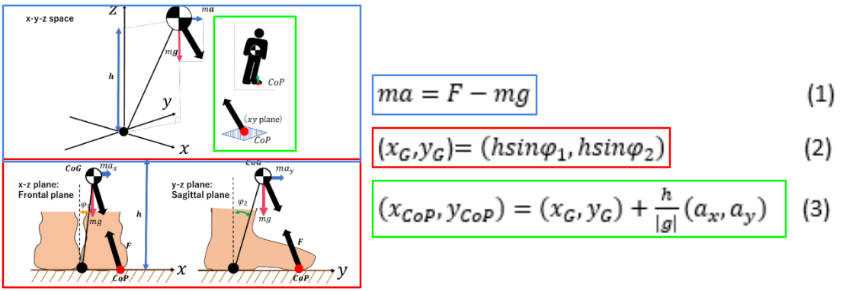
Inverted pendulum Within Humans
Florence
Ankle joint/Wheel axle (pivot point), Body(Pendulum), Feet/Wheels (Center of Pressure (COP))
(x_{G},y_{G} )=(hsinφ₁,hsinφ₂)
h=0.90 m (COM height above the ankle) g= 9.81 m/s^2
Fx= 75 N Fy= 0 N
m= 70 kg (Average Adult)
φ₁= 0.05 rad (~2.9 deg.)
φ₂= -0.03rad (~-1.7deg.)
a_{x}=a=0.8 m/s^2 (forward)
a_{y}=-0.5 m/s^2 (lateral)
(x_{COP},y_{COP} )=(x_{G},y_{G})+ h/|g|(a_{x},a_{y})
ma = F - mg
m=mass
a=acceleration
F=force
g=gravity
h=height of COP
φ₁=body tilted in xz projection plane (forward)
φ₂=body tilted in yz projection plane (backward)
(x_{G},y_{G})= position of COP
(a_{x},a_{y})= acceleration fixed near the COP
x_{G} = 0.90·sin(0.05) ≈ 0.045 m (4.5 cm forward)
y_{G} = 0.90·sin(−0.03) ≈ −0.027 m (2.7 cm left)
*COM shift*
Figure 2: Diagram (left) representing the inverted pendulum model to show the relationship between the equations (right) displayed in Mr. Takamoto’s paper [1]
Notes:
What is CoP?

Slide 17
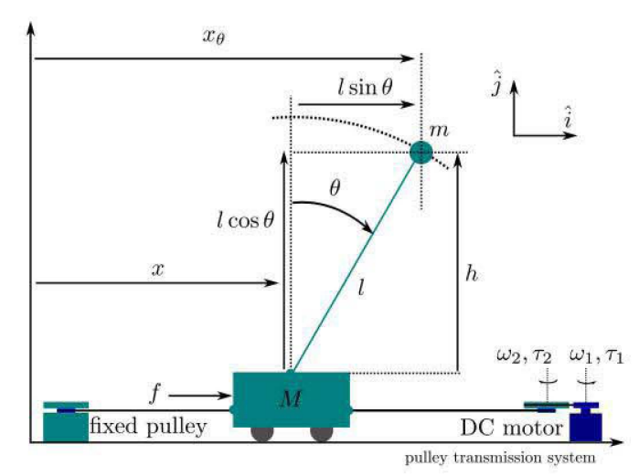
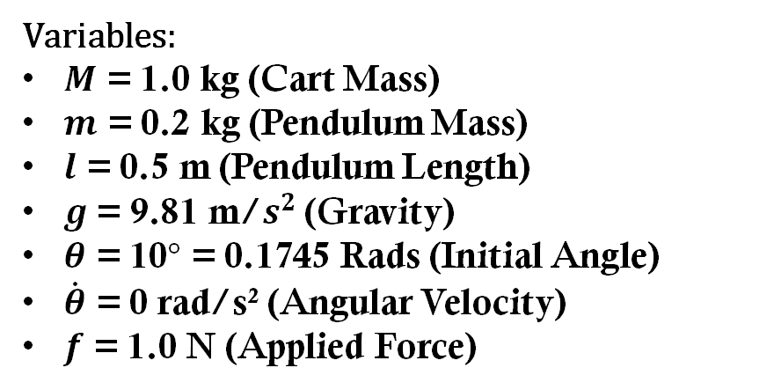
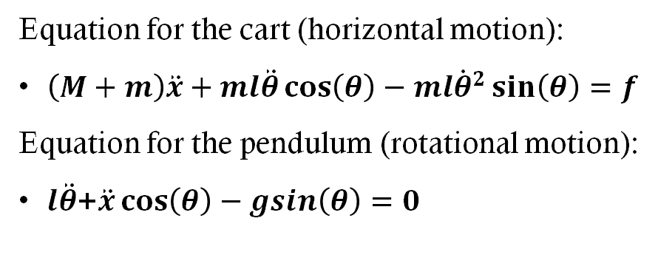
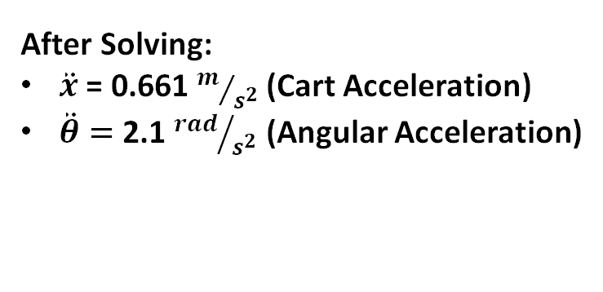
Cart/angular acceleration of an Inverted Pendulum
Freddy
Equation for the cart (horizontal motion):
$\left(M+m\right)\ddot{x}+ml\ddot{θ}\cos\left(θ\right)−ml{\dot{θ}}^{2}\sin\left(θ\right)=f$
Equation for the pendulum (rotational motion):
$l\ddot{θ}$+$\ddot{x}\cos\left(θ\right)−gsin\left(θ\right)=0$
Variables:
$M$ = 1.0 kg (Cart Mass)
$m$ = 0.2 kg (Pendulum Mass)
$l$ = 0.5 m (Pendulum Length)
$g$= 9.81 m/$s^{2}$ (Gravity)
$θ$ = 10$°$ = 0.1745 Rads (Initial Angle)
$\dot{θ}$ = 0 rad/s² (Angular Velocity)
$f$ = 1.0 N (Applied Force)
Fig. 3. Cart-Inverted Pendulum System [28].
After Solving:
$\ddot{x}$ = 0.661 $m/{s^{2}}$ (Cart Acceleration)
$\ddot{θ}=$ 2.1 ${rad}/{s^{2}}$ (Angular Acceleration)

Slide 18
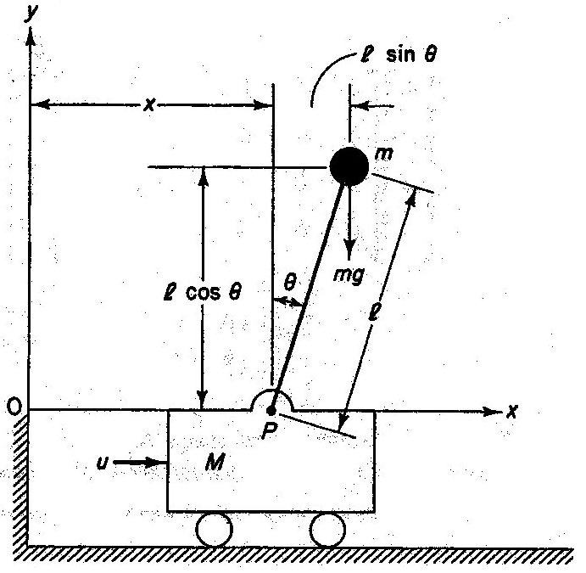
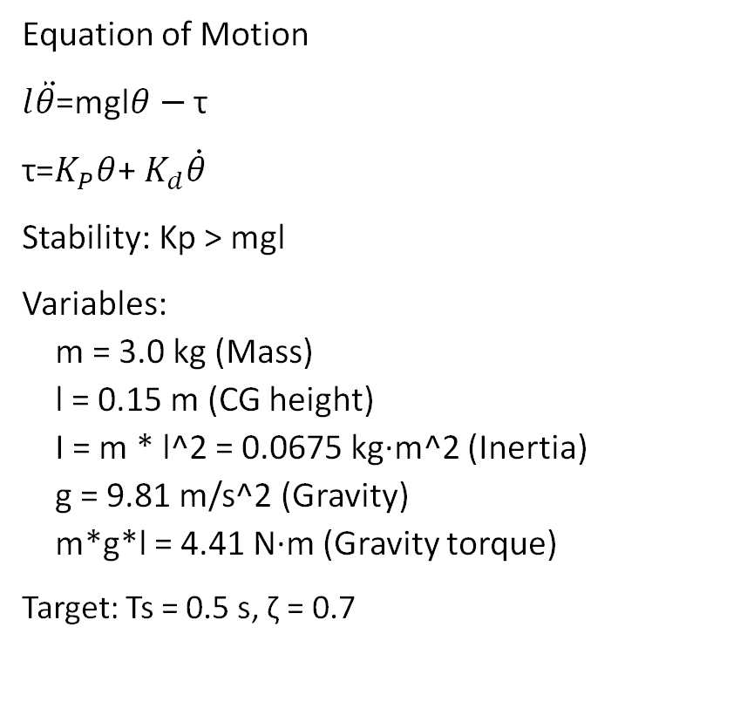
Self-Balancing of Inverted Pendulum Robot
Ziyi
Equation of Motion
$l\ddot{θ}$=mgl$θ−$ τ
τ=$K_{P}θ$+ $K_{d}\dot{θ}$
Stability: Kp > mgl
Variables: m = 3.0 kg (Mass) l = 0.15 m (CG height) I = m * l^2 = 0.0675 kg·m^2 (Inertia) g = 9.81 m/s^2 (Gravity) m*g*l = 4.41 N·m (Gravity torque)
Target: Ts = 0.5 s, ζ = 0.7
After Solving:
ωn = 11.4 rad/s (Natural freq.)
Kp ≈ 13.2 N·m/rad
Kd ≈ 1.08 N·m·s/rad
At θ0 = 5°:
Control torque τ = 1.16 N·m
Gravity torque = 0.39 N·m

Slide 19

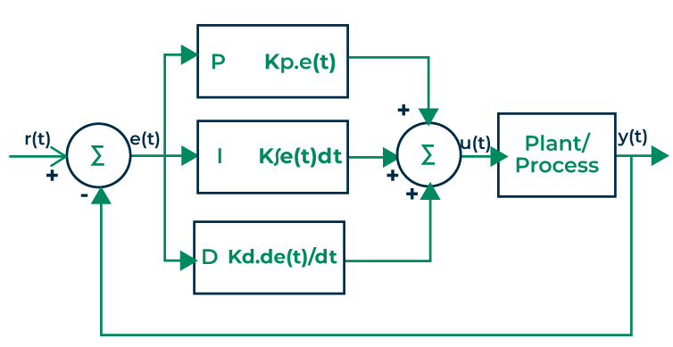

Laplace Transforms - Time domain for PID
Andres
Laplace Transform (pendulum)
Design Analysis on transfer function
Apply Laplace to find T(s)
Fine tuning PID using coefficients of K_{p}, K_{i}, and K_{d} help fine tune the system
K_{p} = proportional gain (poles of response)
K_{i} = integral gain (poles of error)
K_{d} = derivative gain (dampen overshoot)
Partial – Integral – Derivative
Implementation
Assumptions:
M = 1 kg
m = 0.2 kg
L = 0.5 m
More...​
...negative real parts = stability ​
...complex poles = speed of response ​
...complex parts = oscillations
Notes:
What question were we trying to answer? We wanted to know: How can we make our self-balancing robot stay upright and respond smoothly to movement? Basically, how do we tune the robot’s brain — its controller — so that it doesn’t wobble, fall over, or react too slowly?
What was our answer and how did we validate it? Our answer was to use the Laplace transform to move our system into the frequency domain, where we could analyze the full transfer function. This allowed us to mathematically link the PID gains—Kp , Ki , and Kd —to how the system behaves. We validated this by:
Observing how the poles of the system behave when we change gains.
Using simulations to confirm changes in stability and responsiveness in the simulation. For example, when we increased Kp, we saw the poles shift left—indicating faster, more stable behavior, which matched our simulation results.
How did this answer inform our design? This approach gave us a systematic way to tune the PID controller. Instead of guessing, we could adjust each gain to target specific performance goals. It also helped us:
Ensure stability before testing on the actual robot.
Quickly iterate on controller settings using simulations. So the Laplace-domain model became a core tool in our design decision-making, especially for safety, efficiency, and performance tuning.

Slide 20
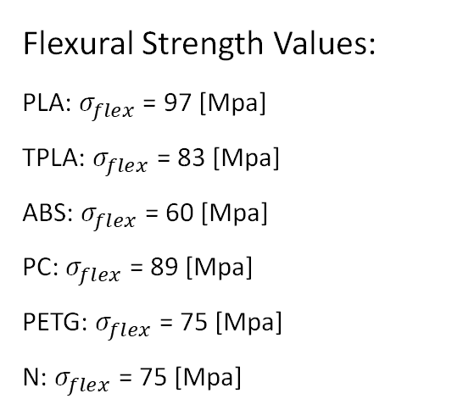

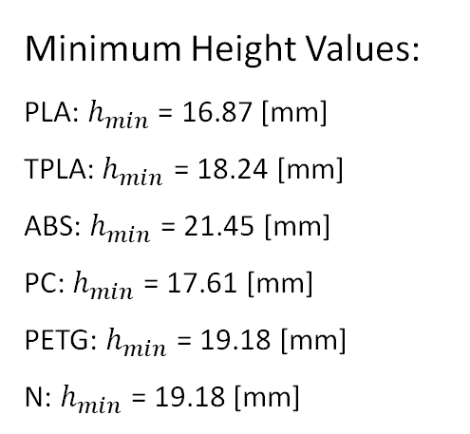
Determining Base-Plate thickness to survive fall test
Colin
Equations:
$$v= \sqrt{2gh} { F}_{avg}=\frac{mv}{∆t} h≥\sqrt{\frac{6FL}{bσ_{flex}}}$$
Variables:
m = 3 [kg]
g = 9.81 [m/$s^{2}$]
h = 0.762 [m] (30 in.)
L = 0.254 [m] (10 in.)
b = 0.127 [m] (5 in.)
$$∆t=0.005s$$
Flexural Strength Values:
PLA: $σ_{flex}$ = 97 [Mpa]
TPLA: $σ_{flex}$ = 83 [Mpa]
ABS: $σ_{flex}$ = 60 [Mpa]
PC: $σ_{flex}$ = 89 [Mpa]
PETG: $σ_{flex}$ = 75 [Mpa]
N: $σ_{flex}$ = 75 [Mpa]
Minimum Height Values:
PLA: $h_{min}$ = 16.87 [mm]
TPLA:${ h}_{min}$ = 18.24 [mm]
ABS: $h_{min}$ = 21.45 [mm]
PC: $h_{min}$ = 17.61 [mm]
PETG: $h_{min}$ = 19.18 [mm]
N: $h_{min}$ = 19.18 [mm]
[16]

Slide 21
Schedule & Budget
Freddy

Slide 22
Pre-phase 1
Freddy
1. Project Management
(WK4–WK15)
Deliverable: Meeting minutes, progress reports, risk assessments
2. Requirements Analysis
2.1 Literature Review
Deliverable: Summary report of relevant prior work
2.2 QFD Development
Deliverable: Completed Quality Function Deployment document
Deliverable: Finalized project plan, Gantt chart, resource allocation
(WK4–WK5)
1.1 Planning & Scheduling
1.2 Meetings & Reporting

Slide 23
Phase 1
Freddy
3. Robot #1 Development
3.1 Mechanical Design
Deliverable: Purchase orders, BOM for Robot #1
3.1.3 Assembly of Prototype #1
Deliverable: Fully assembled mechanical prototype
3.2 Electrical Design
3.2.2 Programming
Deliverable: Control software with basic functionalities
3.2.3 Testing & Debugging
Deliverable: Verified hardware/software integration and debugging reports
3.1.1 CAD Modeling
Deliverable: 3D CAD models of key components
3.1.2 Material Procurement
3.2.1 Circuit Design
Deliverable: Schematics and PCB layout
(WK6–WK12)
(WK6–WK8)
(WK7–WK12)

Slide 24
Phase 2
Freddy
4. Robot #2 Development
4.1 Mechanical Design
Deliverable: BOM and purchase orders for Robot #2
4.1.3 Assembly & Prototyping
Deliverable: Functional mechanical prototype
4.2 Electrical Design
4.2.2 Programming & PID Implementation
Deliverable: Control software with PID controller integrated
4.2.4 Testing & Debugging
4.1.1 CAD Modeling & Design
Deliverable: CAD models for Robot #2 components
4.1.2 Material Procurement
4.2.1 Circuit Design
4.2.3 Circuit Assembly & Prototyping
Deliverable: Assembled and tested electrical prototype
(WK8–WK15)
(WK8–WK14)
(WK9–WK15)
Deliverable: Robot #2 circuit schematics
Deliverable: Final test reports and debugging logs

Slide 25
Phase 3
Freddy
5. Final Testing & Integration
5.1 Functional Testing Robot #1
5.2 Functional Testing Robot #2
5.3 Final Tuning & Optimization
Deliverable: Optimized designs, ready for project close-out
(WK12–WK15)
Deliverable: Testing report & performance validation
Deliverable: Testing report & performance validation

Slide 26
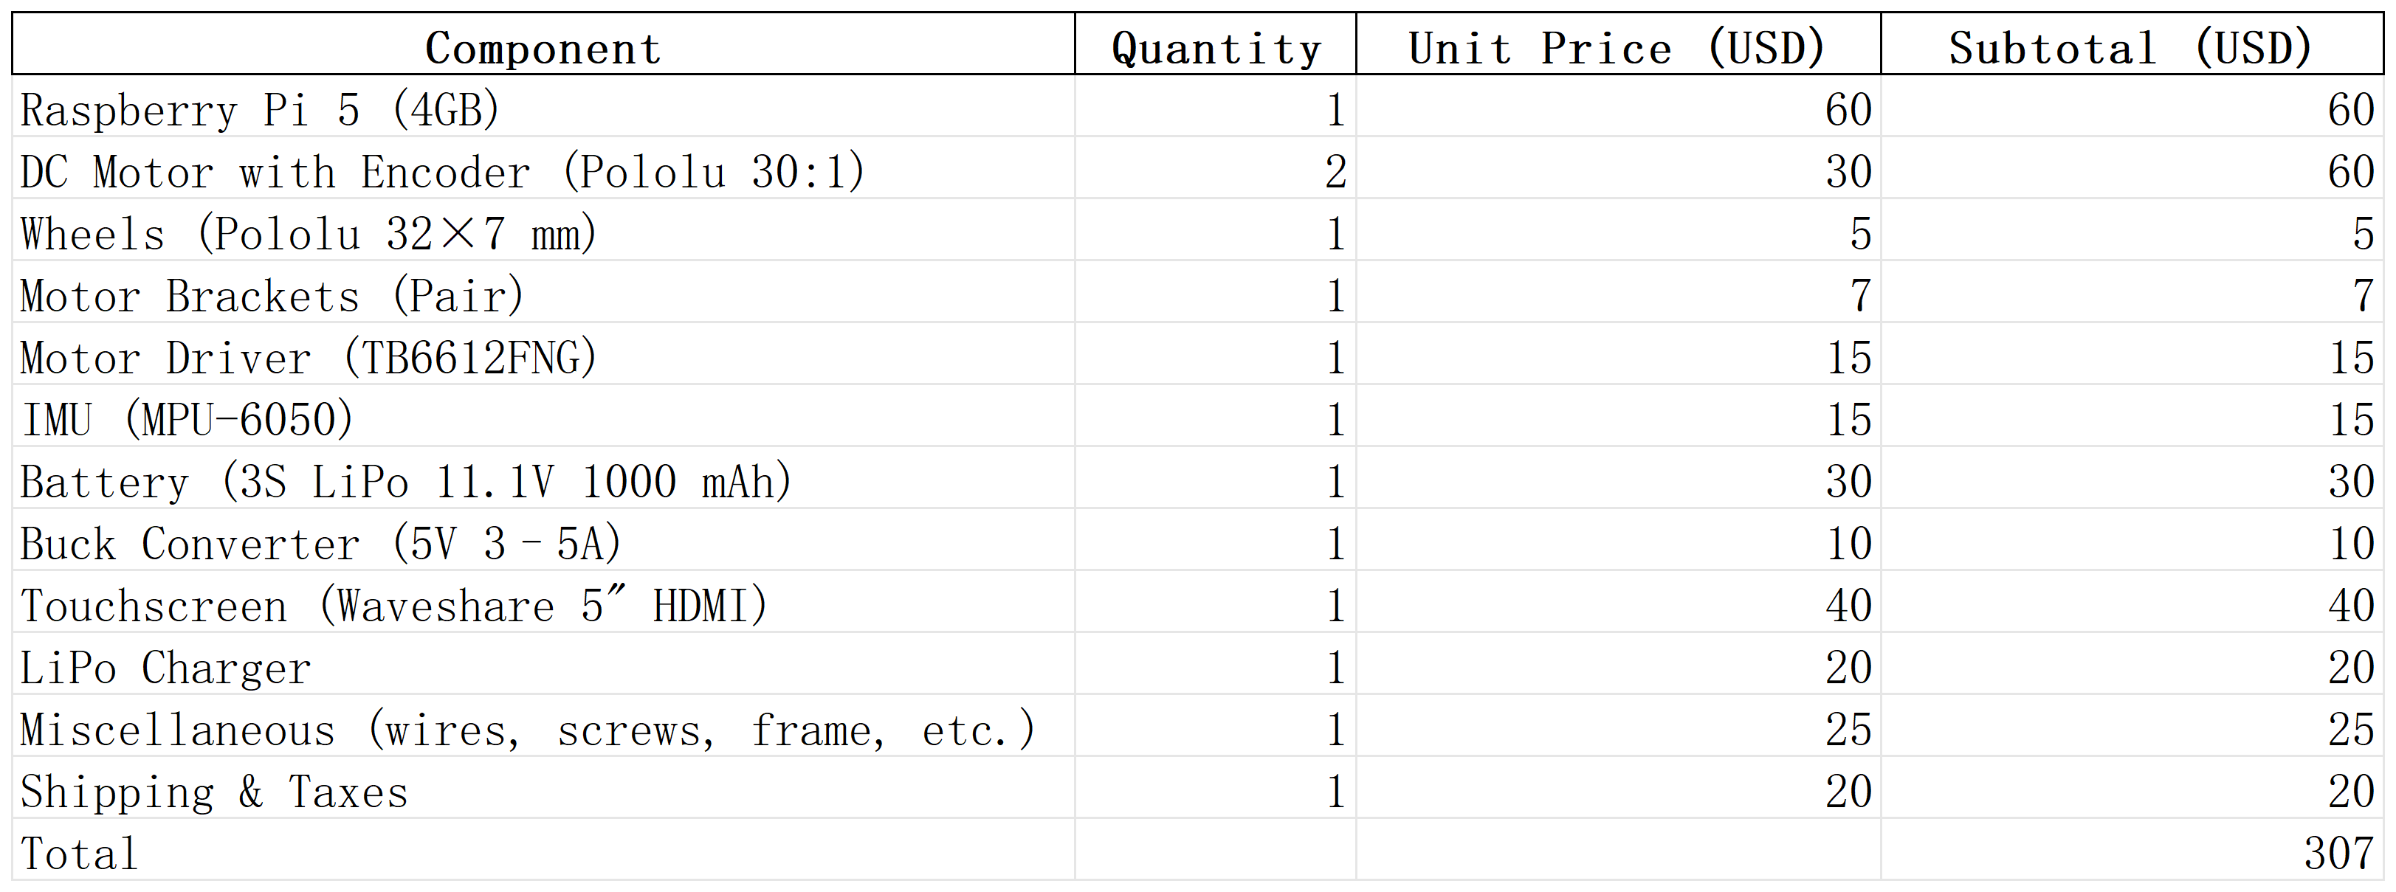
Budgeting
Ziyi
Total budget : $5000 Project 1 : Detailed cost estimate completed
Project 2 : Budget allocated
Project 3: Testing/development and scaling
At least 10% fundraising ($500) will be performed to support the overall budget
Project | Budget (USD) | Status
Pendulum Robot | 1500 | ✅ Detailed estimated
Line-Following Robot | 1500 | 🔄 Planned (details TBD)
Testing/development and scaling | 2500 | ❓ Not yet decided

Slide 27
Fundraising
Freddy
GoFundMe
Panda Express
20% Give-Back in Neighborhood Fundraising
Setting up GoFundMe to raise funds
Grant
Applying for a $500 dollar research grant

Slide 28
References
[1] 井手隆統, 本田功輝, 金田礼人, 中島康貴, and 山本元司, “Comparison of CoP estimation and center-of-gravity sway measurement in human standing posture using inertial sensors,” Dissertation, Kyushu University Graduate School of Engineering 1, Kyushu University Graduate School of Engineering 2.
[2] S. Sasagawa, J. Ushiyama, M. Kouzaki, and H. Kanehisa, “Effect of the hip motion on the body kinematics in the sagittal plane during human quiet standing,” Neuroscience Letters, vol. 450, no. 1, pp. 27–31, Jan. 2009, doi: https://doi.org/10.1016/j.neulet.2008.11.027.
[3] J. L. Cabrera and J. G. Milton, “Human stick balancing: Tuning Lèvy flights to improve balance control,” Chaos: An Interdisciplinary Journal of Nonlinear Science, vol. 14, no. 3, pp. 691–698, Sep. 2004, doi: https://doi.org/10.1063/1.1785453.
[4] B. Sprenger, L. Kucera and S. Mourad, "Balancing of an inverted pendulum with a SCARA robot," in IEEE/ASME Transactions on Mechatronics, vol. 3, no. 2, pp. 91-97, June 1998, doi: 10.1109/3516.686676.keywords: {Robot sensing systems;Robot kinematics;Sensor systems;Manipulators;Benchmark testing;Open loop systems;Control design;Actuators;Friction;Elasticity},
[5] Winkler and J. Suchý, “Erecting and Balancing of the Inverted Pendulum by an Industrial Robot,” IFAC Proceedings Volumes, vol. 42, no. 16, pp. 323–328, 2009, doi: https://doi.org/10.3182/20090909-4-jp-2010.00056.
[6] Y. Y. Lim, C. L. Hoo, and Y. M. Felicia Wong, “Stabilizing an Inverted Pendulum with PID Controller,” MATEC Web of Conferences, vol. 152, p. 02009, 2018, doi: https://doi.org/10.1051/matecconf/201815202009.
[7] D. Zhang, J. Wang, H. Zhang and L. Yu, "Research on Inverted Pendulum Control System Based on Vision Sensor," ICMLCA 2021; 2nd International Conference on Machine Learning and Computer Application, Shenyang, China, 2021, pp. 1-5.
‌

Slide 29
References
[8] Line Follower Robot With Arduino - Very Fast and Very Simple : 11 Steps (with Pictures) - Instructables
[9] Haruhiko H. Asada, “Manufacturing Robotics: Basic Issues and Challenges,” IFAC Proceedings Volumes, Volume 29, Issue 1, 1996, Pages 319-330, [Online Document], Available: Science Direct https://www.sciencedirect.com/science/article/pii/S147466701757682X [Accessed September 11, 2025]
[10] Elisa Prati, Margherita Peruzzini, Marcello Pellicciari, Roberto Raffaeli, “How to include User eXperience in the design of Human-Robot Interaction,” Robotics and Computer-Integrated Manufacturing, Volume 68, 2021, [Online Document], Available: Science Direct https://www.sciencedirect.com/science/article/pii/S0736584520302805 [Accessed September 11, 2025]
[11] Guy Hoffman and Wendy Ju. 2014. Designing robots with movement in mind. J. Hum.-Robot Interact. 3, 1 (February 2014), 91–122. [Online Document], Available: https://dl.acm.org/doi/10.5898/JHRI.3.1.Hoffman [Accessed September 11, 2025]
[12] Z. Mamatnabiyev, "Design and Implementation of an Open-Source Educational Robot for Hands-On Learning Experiences in IoT," 2023 17th International Conference on Electronics Computer and Computation (ICECCO), Kaskelen, Kazakhstan, 2023, pp. 1-4, [Online Document], Available: IEEE Xplore https://ieeexplore.ieee.org/document/10146599 [Accessed September 12, 2025]
[13] F. Dai, J. Li, J. Peng, Z. Zhu, S. Jiang and X. Gao, "Design and control of a multi-DOF two wheeled inverted pendulum robot," Proceeding of the 11th World Congress on Intelligent Control and Automation, Shenyang, China, 2014, pp. 497-502, [Online Document], Available: IEEE Xplore https://ieeexplore-ieee-org.libproxy.nau.edu/document/7052763 [Accessed September 14, 2025]
[14] J. Li, X. Gao, Q. Huang, Q. Du and X. Duan, "Mechanical Design and Dynamic Modeling of a Two-Wheeled Inverted Pendulum Mobile Robot," 2007 IEEE International Conference on Automation and Logistics, Jinan, China, 2007, pp. 1614-1619, [Online Document], Available: IEEE Xplore https://ieeexplore-ieee-org.libproxy.nau.edu/document/4338830 [Accessed September 14, 2025]

Slide 30
References
[15] B. S. Siddhartha, T. Ghosh and D. M, "Design and Implementation of Self-Balancing Interactive Robot," 2023 Fourth International Conference on Smart Technologies in Computing, Electrical and Electronics (ICSTCEE), Bengaluru, India, 2023, pp. 1-6, [Online Document], Available: IEEE Xplore https://ieeexplore-ieee-org.libproxy.nau.edu/document/10584954 , [Accessed September 14, 2025]
[16] Arun Chapman, "What is the strongest 3D printing material?," ultimaker.com, May 20, 2022, [Online], Available: https://ultimaker.com/learn/what-is-the-strongest-3d-printing-material/ [Accessed: September 17, 2025]
[17] K. M. Goher and S. O. Fadlallah, "Bacterial foraging-optimized PID control of a two-wheeled machine with a two-directional handling mechanism," Robot. Biomim., vol. 4, no. 1, 2017. [Online]. Available: https://doi.org/10.1186/s40638-017-0057-3
[18] X. Yu, Y. Liu, L. Wang, J. Li, H. Cheng, and H. He, "A self‐adaptive SAC‐PID control approach based on reinforcement learning for mobile robots," Int. J. Robust Nonlinear Control, vol. 32, no. 18, pp. 9625–9643, 2022.
[19] S. Jin and Y. Ou, "A wheeled inverted pendulum learning stable and accurate control from demonstrations," Appl. Sci., vol. 9, no. 24, p. 5279, 2019. [Online]. Available: https://doi.org/10.3390/app9245279
[20] S. Roy, S. B. Roy, and I. N. Kar, "Adaptive–robust control of Euler–Lagrange systems with linearly parametrizable uncertainty bound," IEEE Trans. Control Syst. Technol., vol. 26, no. 5, pp. 1842–1850, Sep. 2017.
[21] S. Caron and A. Kheddar, "Dynamic walking over rough terrains by nonlinear predictive control of the floating-base inverted pendulum," in Proc. IEEE/RSJ Int. Conf. Intell. Robots Syst. (IROS), 2017, pp. 5019–5024.
[22] U.S. Consumer Product Safety Commission (CPSC), "Toy Safety," [Online]. Available: https://www.cpsc.gov/Business--Manufacturing/Business-Education/Toy-Safety
[23] Instructables, "Inverted Pendulum Control Theory and Dynamics," [Online]. Available: https://www.instructables.com/Inverted-Pendulum-Control-Theory-and-Dynamics/
[24] University of Michigan, “Inverted Pendulum: System Modeling,” Control Tutorials for MATLAB and Simulink (CTMS). [Online]. Available: https://ctms.engin.umich.edu/CTMS/index.php?example=InvertedPendulum&section=SystemModeling. [Accessed: Sept. 9, 2025].
‌

Slide 31
References
[25] University of Michigan, “Ball & Beam: System Modeling,” Control Tutorials for MATLAB and Simulink (CTMS). [Online]. Available: https://ctms.engin.umich.edu/CTMS/index.php?example=BallBeam&section=SystemModeling. [Accessed: Sept. 10, 2025].
[26] B. Cazzolato, “Derivation of the Dynamics of the Ball and Beam System,” Univ. of Adelaide, School of Mechanical Engineering. [Online]. Available: https://www.researchgate.net/profile/Ben-Cazzolato/publication/235898231_Derivation_of_the_Dynamics_of_the_Ball_and_Beam_System/links/569338cf08aec14fa55db5a8/Derivation-of-the-Dynamics-of-the-Ball-and-Beam-System.pdf. [Accessed: Sept. 14, 2025].
[27] University of Michigan, “DC Motor Speed: System Modeling,” Control Tutorials for MATLAB and Simulink (CTMS). [Online]. Available: https://ctms.engin.umich.edu/CTMS/index.php?example=MotorSpeed&section=SystemModeling. [Accessed: Sept. 11, 2025].
[28] A. Md. Khairul Alam, M. R. Karim, and S. M. Mahmud Hasan, “Stabilising a cart inverted pendulum system using pole placement control method,” in 2017 3rd Int. Conf. on Electrical Information and Communication Technology (EICT), Khulna, Bangladesh, 2017, pp. 1–6. doi: 10.1109/EICT.2017.8168481. [Online]. Available: https://ieeexplore.ieee.org/abstract/document/8168481. [Accessed: Sept. 13, 2025].
[29] K. C., “Inverted Pendulum: Control Theory and Dynamics,” Instructables. [Online]. Available: https://www.instructables.com/Inverted-Pendulum-Control-Theory-and-Dynamics/. [Accessed: Sept. 14, 2025].
[30] S. Sackett, “Self-Balancing Inverted Pendulum Robot,” Shay Sackett’s Project Portfolio. [Online]. Available: https://www.shaysackett.com/inverted-pendulum-robot/. [Accessed: Sept. 11, 2025].
[31] B. T. Williams, “Self-Balancing Robot Using PID Packs Other Punches,” Elektor Magazine, Oct. 5, 2022. [Online]. Available: https://www.elektormagazine.com/news/self-balancing-robot-using-pid-packs-other-punches. [Accessed: Sept. 14, 2025].
Notes:
Freddy’s References, fix numbers later

Slide 32
References
[32] B. A. Asfora, “Embedded Computer Vision System Applied to a Four-Legged Line Follower Robot,” arXiv:2101.04804 cs.RO, Jan. 2021. Accessed: Sep. 18, 2025.
[33] Y. M. Ummadisetty and S. P. Mamidi, “Investigating and Deploying an AI Model on Raspberry Pi IoT Platform Using FIWARE and Docker in the Context of the Bonseyes AI Ecosystem,” M.S. thesis, Faculty of Computing, Blekinge Inst. of Technology, Karlskrona, Sweden, 2019. Accessed: Sep. 18, 2025.
[34] Raspberry Pi Ltd., Raspberry Pi 5 Product Brief, Jan. 2025. Accessed: Sep. 18, 2025.
[35] Raspberry Pi Ltd., Raspberry Pi Documentation. Accessed: Sep. 18, 2025.
[36] L. T. Blank and A. J. Tarquin, Engineering Economy, 8th ed. New York, NY, USA: McGraw-Hill Education, 2018.
[37] H. Kerzner, Project Management: A Systems Approach to Planning, Scheduling, and Controlling, 12th ed. Hoboken, NJ, USA: John Wiley & Sons, 2017.
[38] AACE International, “Cost Estimate Classification System,” Recommended Practice No. 17R-97, rev. Aug. 7, 2020. Accessed: Sep. 18, 2025.
[39] IEEE Standard for Ontologies for Robotics and Automation (ORA): Core Ontologies for Robotics and Automation (CORA), IEEE Std 1872.1-2024, pp. 1–84, May 2024, doi: 10.1109/IEEESTD.2024.10557945.
[40] ISO/IEC, “Information technology — Sensor network reference architecture (ISO/IEC 29182),” ISO/IEC JTC 1, Geneva, Switzerland, 2013.
Notes:
Freddy’s References, fix numbers later

