Slide 1

Active Rocket Controls (ARC)
Final Testing Results
Henry Benedictus, Chyler Bitsoi, Emilio Huggins, Eric Reyes, Aislinn Joy Gacayan

Slide 2
Design Requirements Summary
The Active Rocket Controls project seeks to develop a level 1 rocket that has dynamic control over the z-axis through a <2 ms Arduino-based flight computer that can sense and record flight data for this axis adherence, maintaining roll error sub-2°. It must comply with Tripoli safety standards via a preflight sheet and RockSim validation before launch, being able to withstand aerodynamic and inertial load > 100 N. It must stay in a budget of $2,000 and have at least 50% of components be custom-made (3D-printed).
Eric R 2

Slide 3
Design Requirements Summary
CR1: Control rocket roll about the z-axis in flight
CR2: Fit all components in a 2.5–4 in body tube
CR3: Complete demo flights by Jan 2026 and Mar 2026
CR4: Use Arduino-based control with flight data sensing/logging
CR5: Provide both induced-roll and no-roll stabilization modes
CR6: Meet Tripoli safety standards and preflight validation requirements
CR7: Compare 3 control concepts and stay under $2,000
CR8: Manufacture at least 50% of the system with 3D-printed parts
CR9: Deliver all required test data, documentation, and verification reports
ER1: Total system weight must be under 10 lb
ER2: System must fit within a 2.5–4 in diameter tube
ER3: Roll error must remain below 2°
ER4: System must induce and damp roll to 100 RPM within 2 s
ER5: Control loop latency must remain under 50 ms
ER6: Structure must withstand at least 70 lbf loading
ER7: System reliability must be at least 99% in testing
ER8: Total cost must not exceed $2,000
ER9: At least 50% of components must be custom-made or 3D printed
Eric R 3

Slide 4
Top Level Testing Summary
Experiment/Test | Date | Relevant DRs | Equipment Needed | Other Factors
Black Powder Amount | 28 Feb 2026 | CR3 Demo launch phases; CR6 Tripoli safety compliance; ER7 99% reliability; ER8 <$2,000 cost | Black powder Scale or way to measure powder amount | Weather, safe test area, consistent packing
Fin Stress | 17 Apr 2026 | CR6 Tripoli safety compliance; CR9 Final deliverables; ER6 >70 lbf load capacity; ER7 99% reliability | Stand Stand, PCB, and Bottle Jack | Load application point
PID Spin Test | 18 Apr 2026 | CR1 Z-axis roll control; CR4 Arduino control and data logging; CR5 Roll/no-roll modes; ER3 <2° roll error; ER4 100 RPM in 2 s; ER5 <50 ms latency | Car, rocket, test stand , laptop, and camera | Straight & safe road, secure mount, consistent vehicle speed, weather
5° Fixed-Fin Spin Validation Launch Test | 21 Feb 2026 | CR3 Demo launch phases; CR4 Arduino control and data logging; CR6 Tripoli safety compliance; CR9 Final deliverables; ER7 99% reliability | Red rocket prototype, 5° fin configuration, FLT computer, battery launch rail/pad, parachute & recovery system, laptop, assembly tools | Wickenburg weather, transportation, borrowing rocket club launch pad
Spin/No-Spin Launch | ~Apr 2026 | CR1 Z-axis roll control; CR3 Demo launch phases; CR4 Arduino control and data logging; CR5 Roll/no-roll modes; CR6 Tripoli safety compliance; CR9 Final deliverables; ER3 <2° roll error; ER4 100 RPM in 2 s; ER5 <50 ms latency; ER7 99% reliability | Final rocket, FLT computer, battery launch rail/pad, parachute & recovery system, laptop, assembly tools | Wickenburg weather, transportation
Measuring | N/A | ER1 <10 lb total weight; ER2 2.5-4 in diameter fit | Rocket, weighing scale, CAD data, measuring tape | LOW-LEVEL
Cost & Parts Verification | N/A | ER8 <$2,000 cost; ER9 50% custom/3D-printed parts | BOM, budget table | LOW-LEVEL
Notes:
Basically import the table - Chyler Bitsoi
NEED TO HAVE DESCRIPTION OF CRS AND ERS
SHOULD ADD MEASURING AND COST VERIFICATION PER GRAY BECKER

Slide 5
Test 1 - Black Powder, Ejection Charge Sizing
Overview:
Question: What black powder mass reliably achieves separation and parachute deployment for ARC without overpressure damage?
CR: Demo launch (CR3), Tripoli safety compliance (CR6), cost-effective (CR7)
ER: Reliability (ER7), cost constraint (<$2000 total) (ER8)
Equipment: black powder, scale, igniter, avionics bay, chute, safety gear
Vars
Ind: BP mass (g)
Ctrl: avi. bay vol,fit, shear pin amount, packing method
Dep: separation success, time of separation, dmg., cost
AJ G 5
Notes:
Basically import the test plans
A rocket shall be launched only if it has a recovery system designed to return all parts of the rocket to the ground safely and at a landing speed not to exceed 35 feet/second (11 meters/second). Higher landing speeds may be approved by the BoD before the flight.

Slide 6

Test 1 - Black Powder, Ejection Charge Sizing
AJ G 6
Notes:
Basically import the test plans
A rocket shall be launched only if it has a recovery system designed to return all parts of the rocket to the ground safely and at a landing speed not to exceed 35 feet/second (11 meters/second). Higher landing speeds may be approved by the BoD before the flight.

Slide 7
Results 1 - Black Powder, Ejection Charge Sizing
Trial (g) | Successful Event (y/n) | h (ft)
0.5 | n | N/A (0)
1.0 | n | N/A (0)
1.5 | y | 10.7
Reliability: | 100%
Cost was <$2,000 as no modifications had to be made, nor was there a significant loss in our powder supply
AJ G 7
Notes:
Basically import the test plans

Slide 8
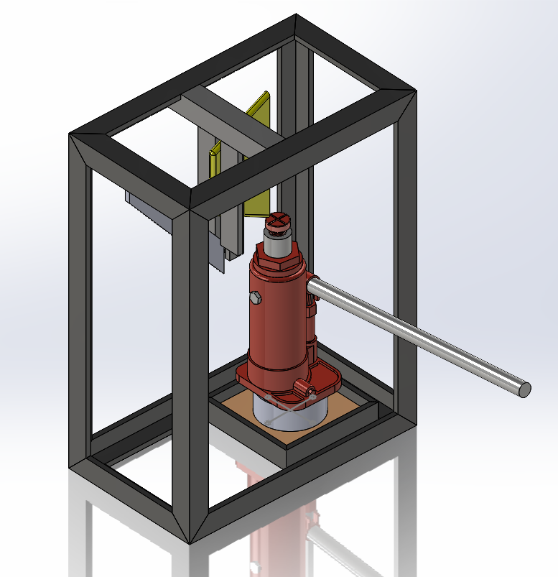
Test 2 - Fin Stress
Overview:
Question: Can the fin structure and mounting system withstand aero. and inertial loading without structural failure?
CR: Tripoli safety compliance (CR6), deliverables (CR9)
ER: Dynamic loading capacity (≥ 70 lbf) (ER6), reliability (ER7)
Equipment: 500kg compressive load cell, test stand, bottle Jack, and Arduino Microcontroller
Vars
Ind: F (N)
Ctrl: load app. Pt., fin angle, mounting hardware, print orientation, fixture stability
Dep: deflection, permanent deformation, cracking or struct. failure
Chyler B 8
Notes:
Basically import the test plans

Slide 9
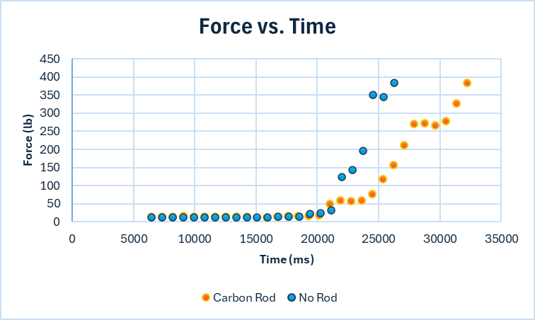
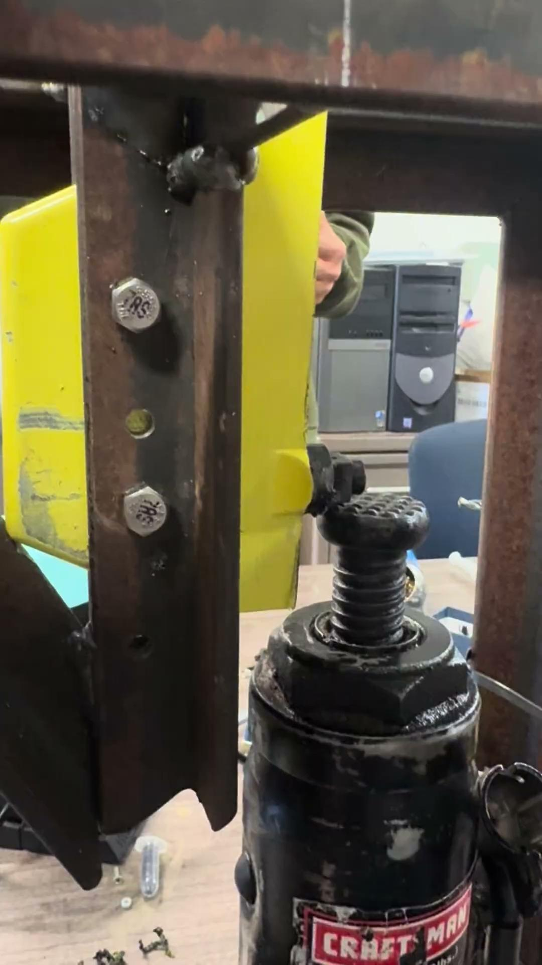

Results 2 - Fin Stress
Max Force: Carbon Rod = 382.8 lb No Rod = 380.1 lb
Chyler B 9
Notes:
Basically import the test plans

Slide 10
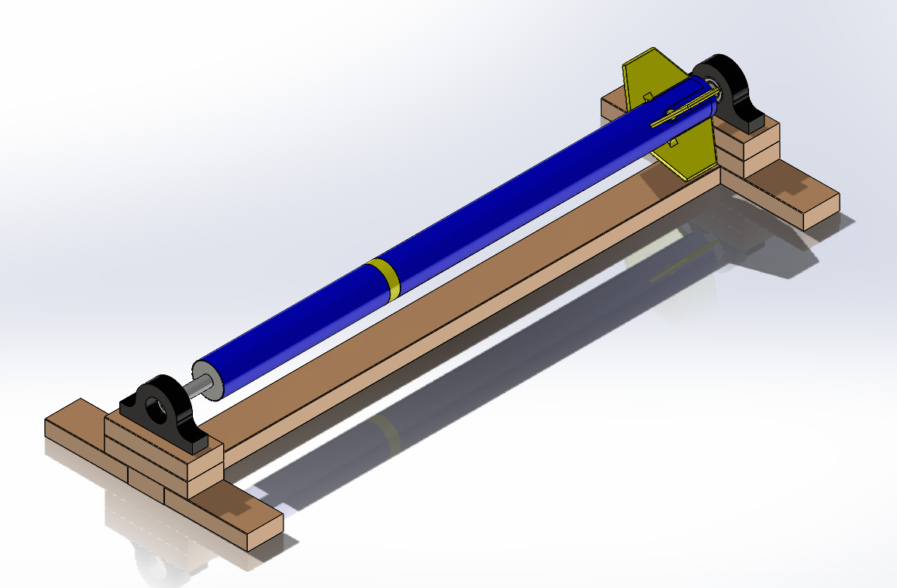
Test 3 - PID Spin Test
Overview:
Question: Can the fin structure and mounting system withstand aero. and inertial loading without structural failure?
CR: Tripoli safety compliance (CR6), deliverables (CR9)
ER: Dynamic loading capacity (≥70 lbf) (ER6), reliability (ER7)
Equipment: force gauge/hanging scale, test stand, strap/cable, calipers, safety gear
Emilio H 10
Notes:
Basically import the test plans

Slide 11
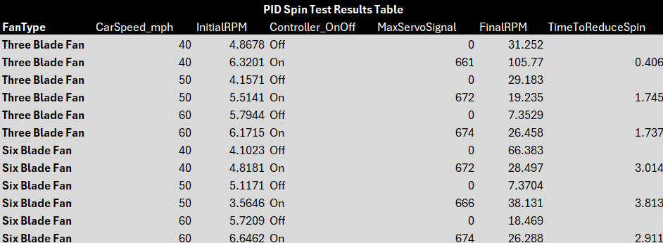
Test 3 - PID Spin Test
Emilio H 11
Notes:
Basically import the test plans

Slide 12
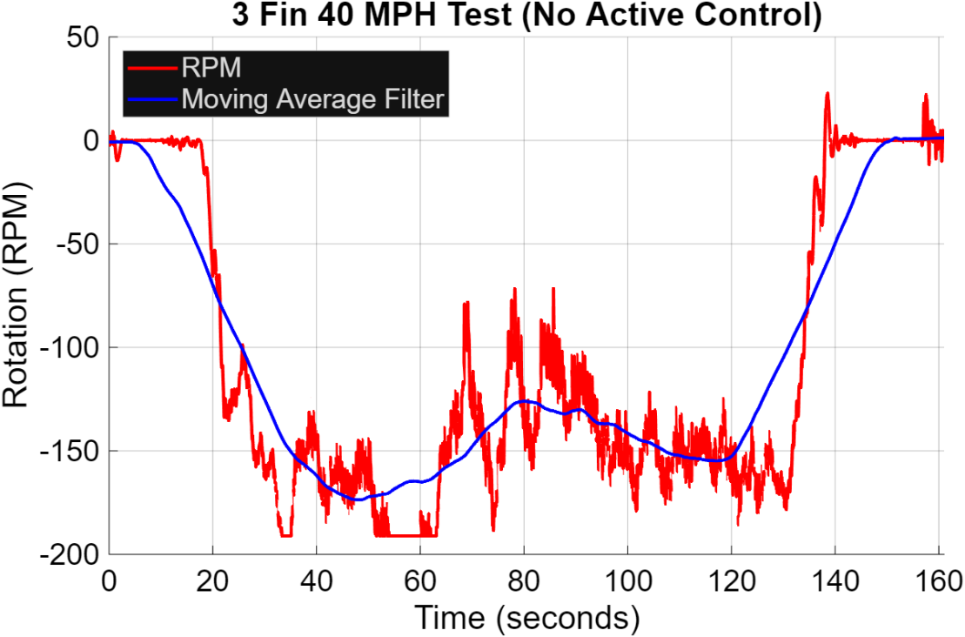
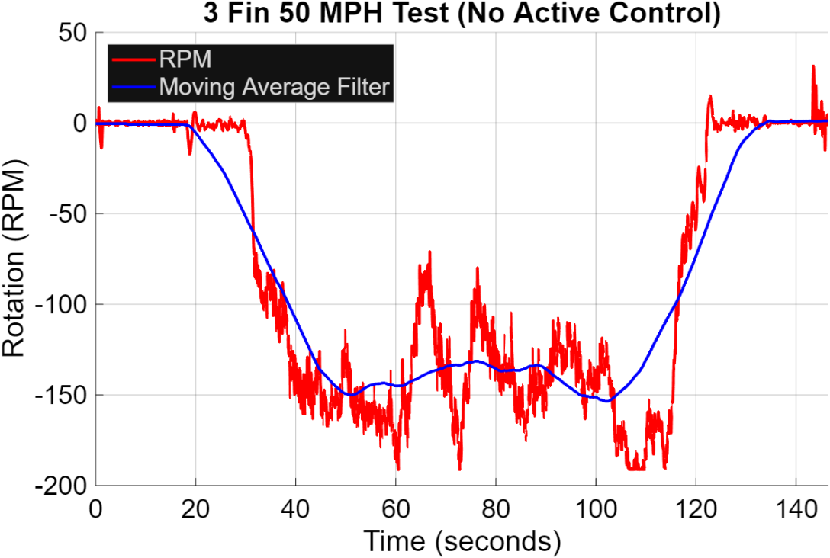
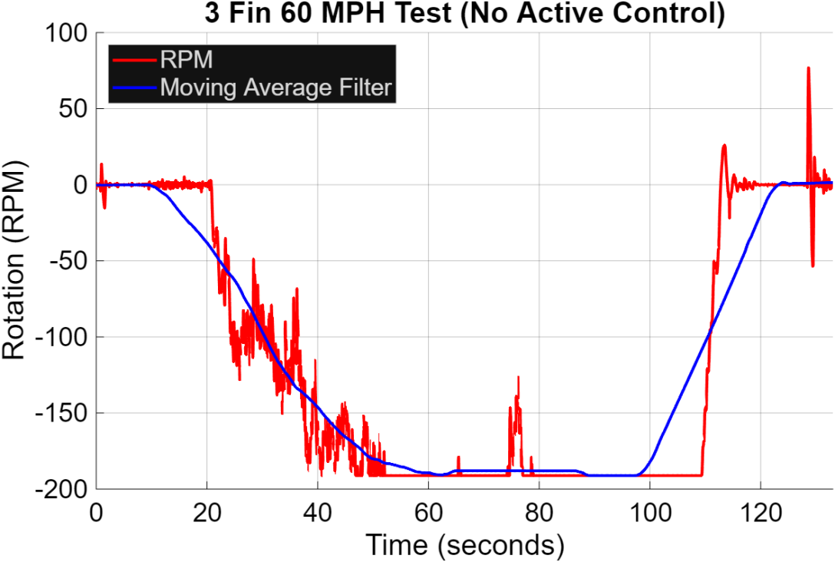
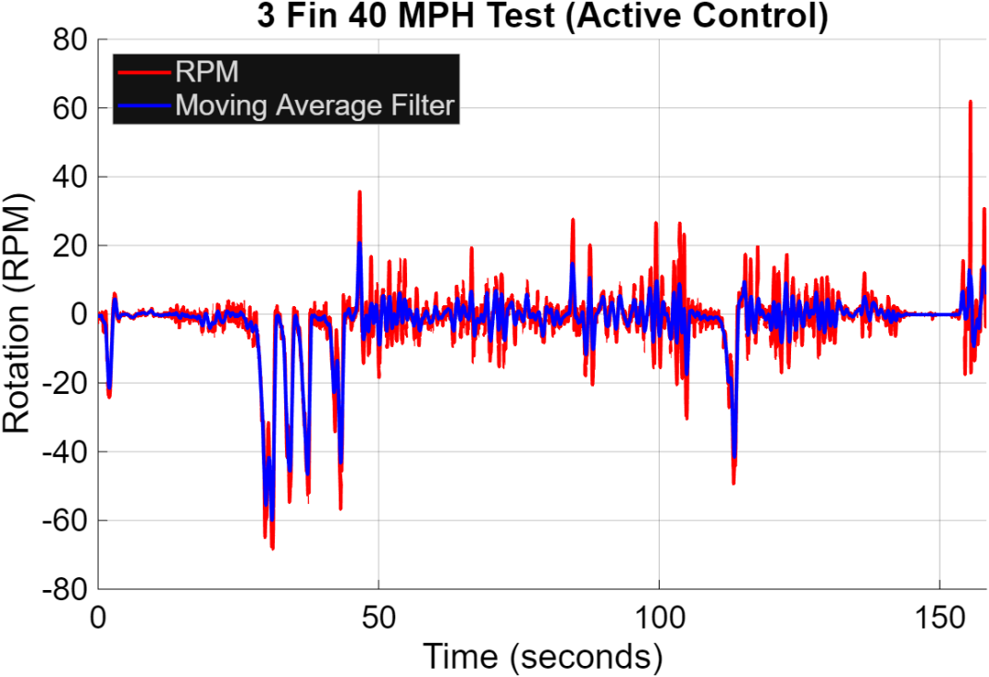
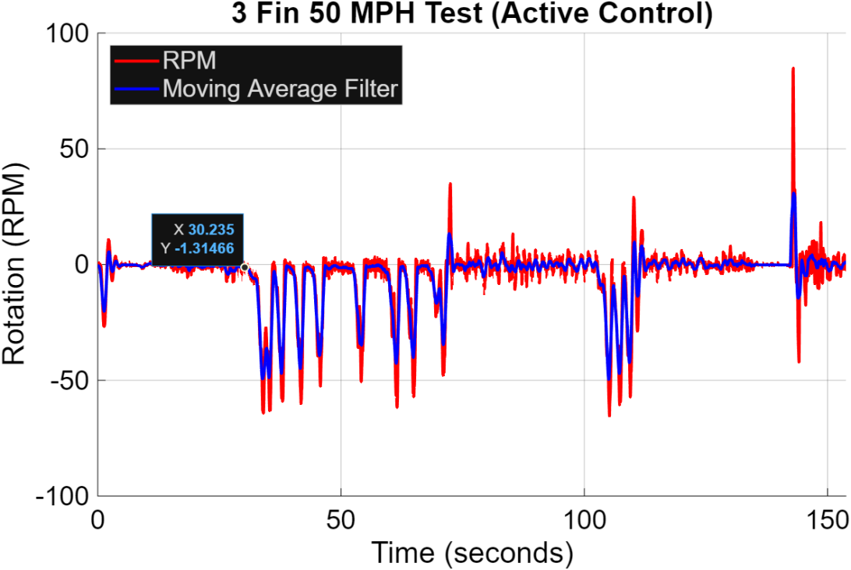
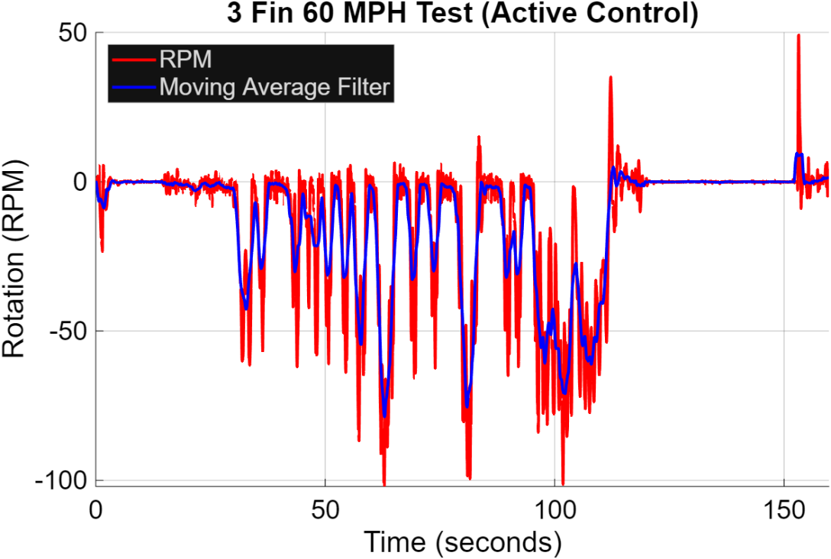
Test 3 - PID Spin Test
Henry B 12
Notes:
Basically import the test plans

Slide 13
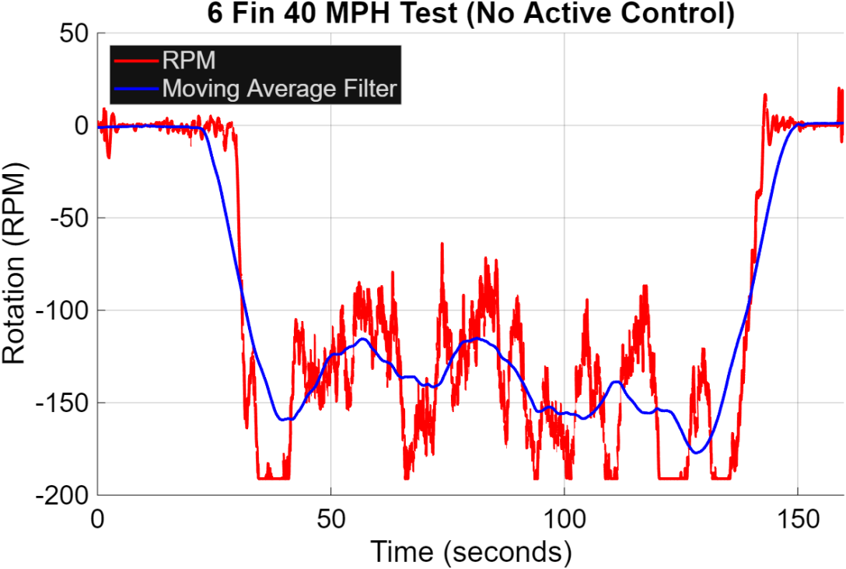
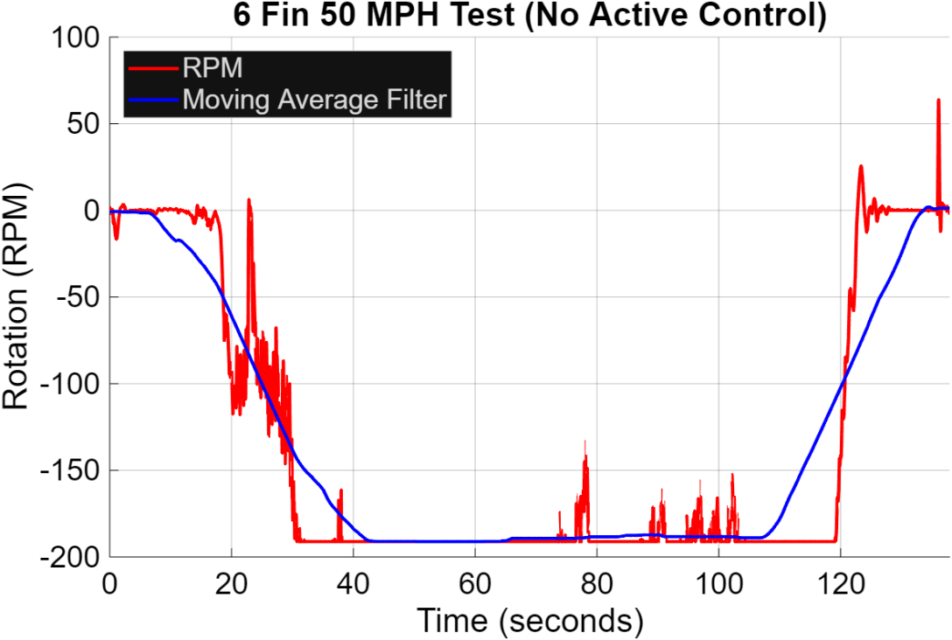
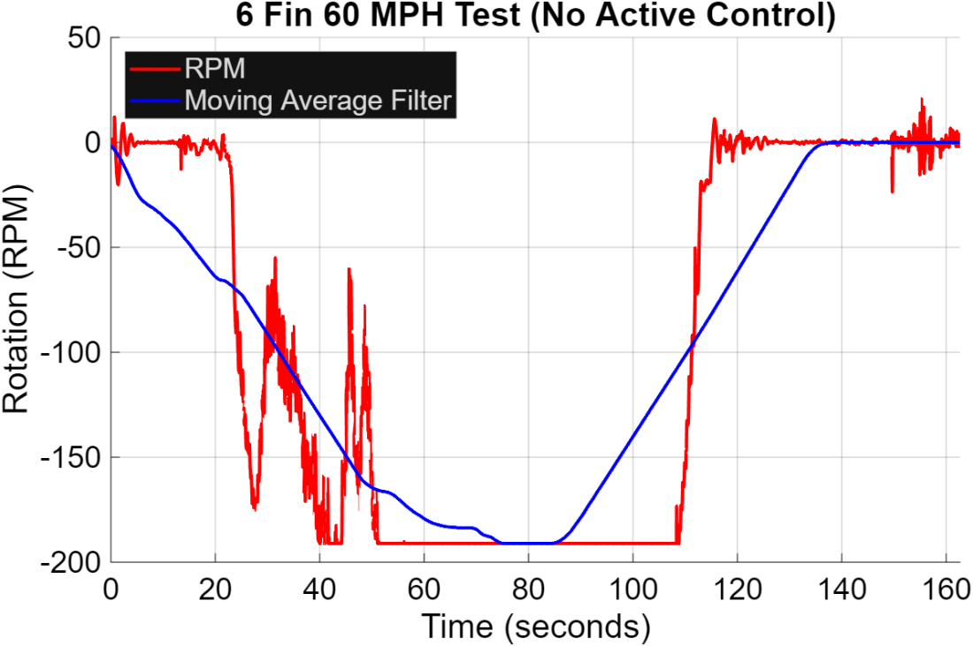
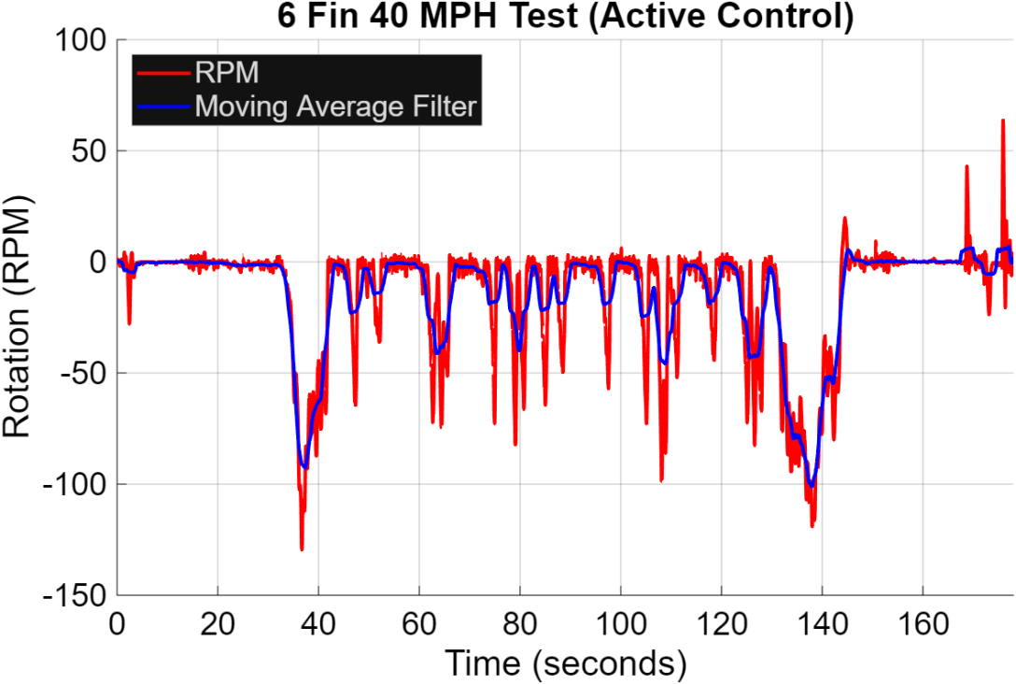
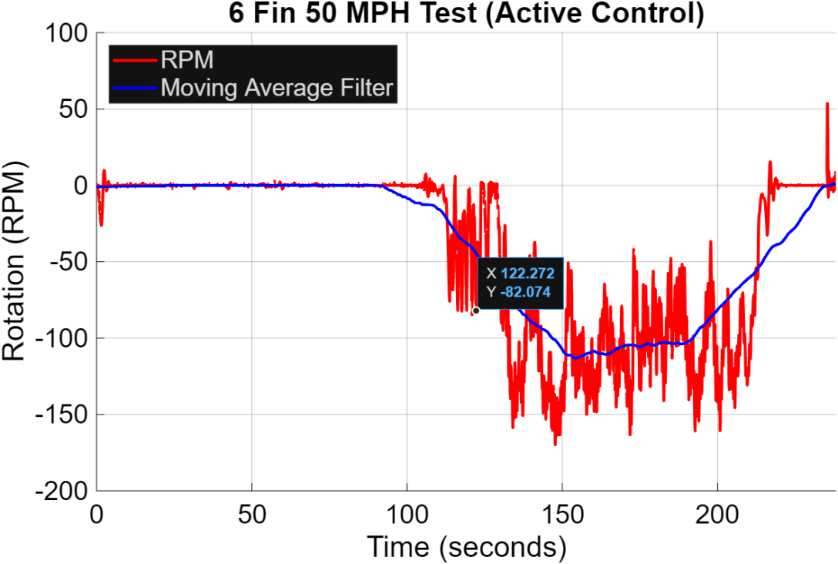
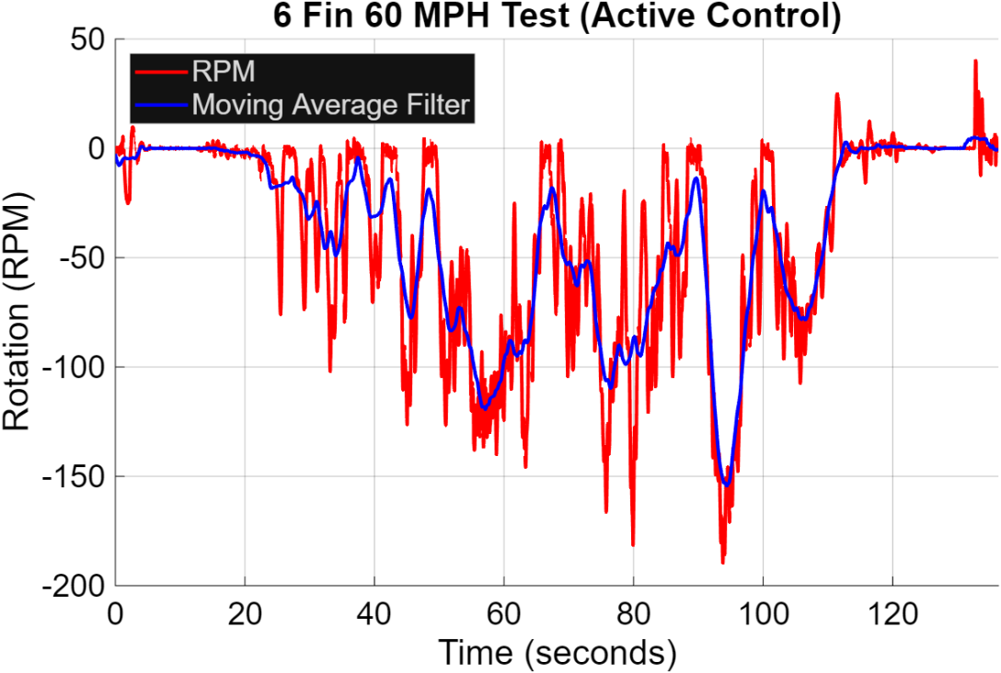
Test 3 - PID Spin Test
Henry B 13
Notes:
Basically import the test plans

Slide 14
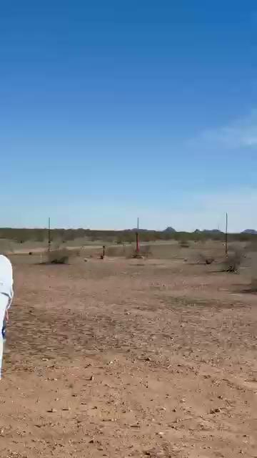
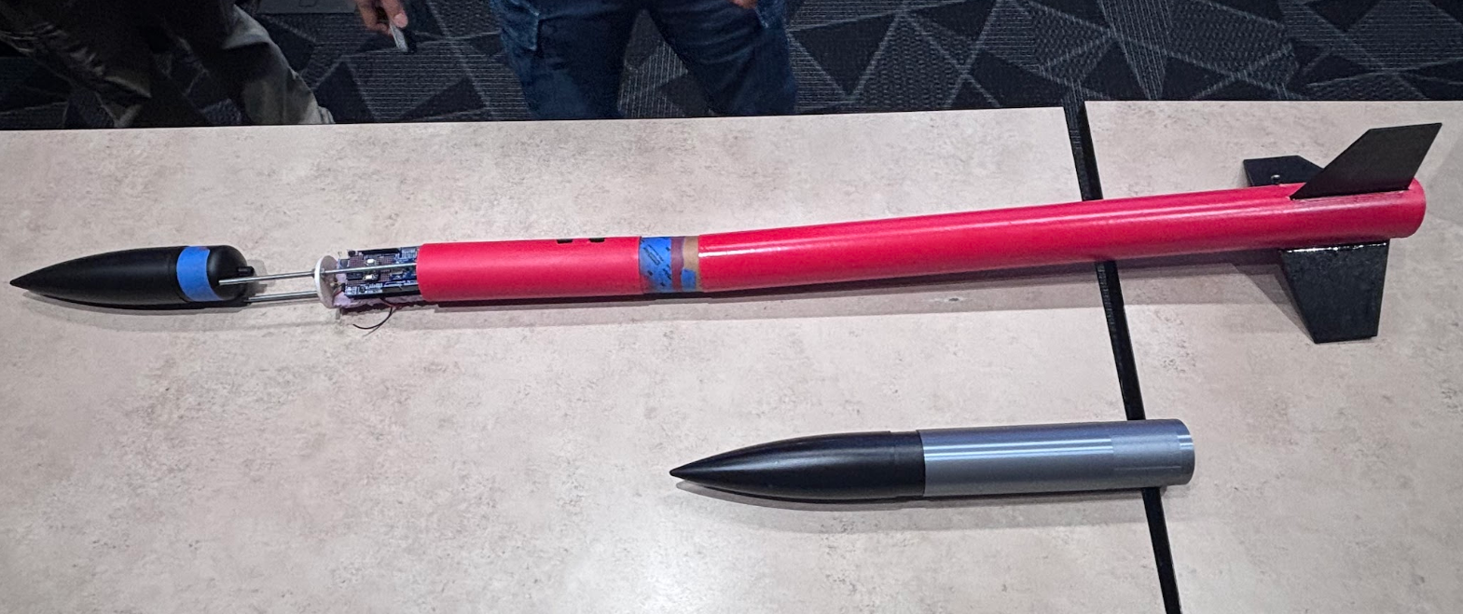
Test 4 - 2° Spin Test (Red Rocket)
Overview:
Question: Does the 2° fixed-fin configuration create the expected rocket roll behavior during actual flight?
CR: Demo launch (CR3), sensor feedback (CR4), Tripoli safety compliance (CR6), deliverables (CR9)
ER: Reliability (ER7)
Henry B 14
Notes:
Basically import the test plans

Slide 15
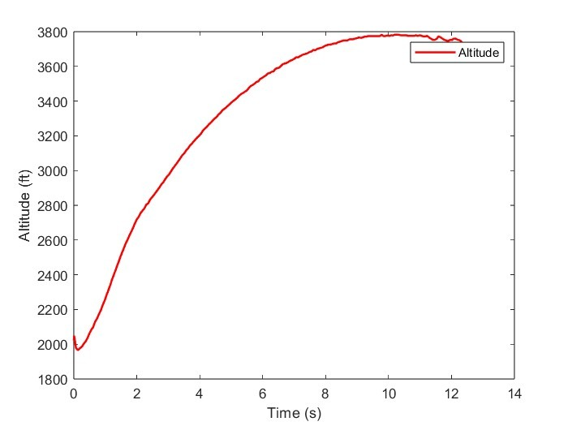
Results 4 - Altitude vs. Time
Henry B 15
Notes:
Basically import the test plans

Slide 16
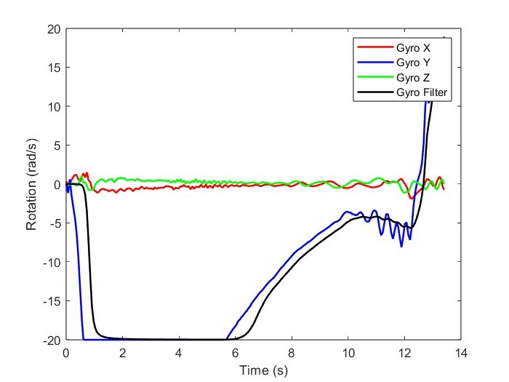
Results 4 - Rotation vs. Time
Henry B 16
Notes:
Basically import the test plans

Slide 17
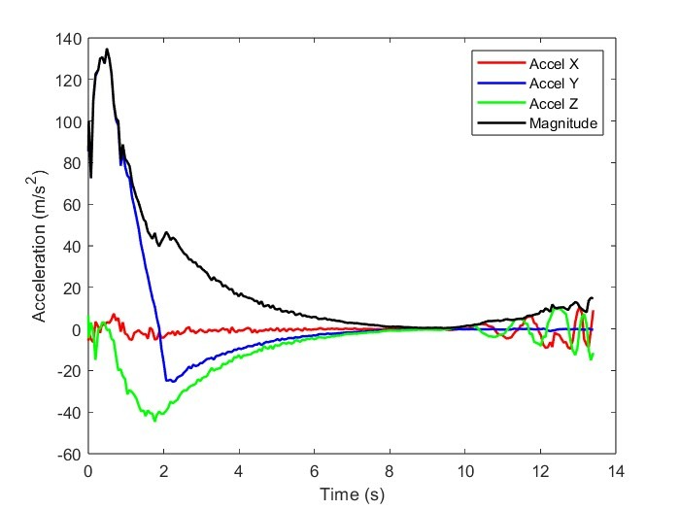
Results 4 - Acceleration vs. Time
Henry B 17
Notes:
Basically import the test plans

Slide 18
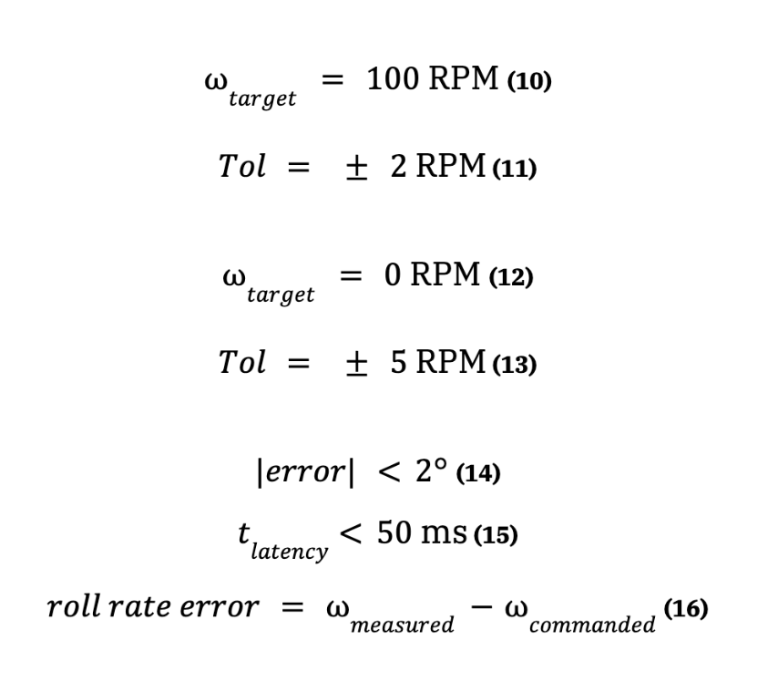
Test 5 - Spin/No-Spin Final Launch
Overview:
Question: Can the rocket system reliably induce spin and also avoid inducing spin when commanded, while remaining within the required tolerance?
CR: Dynamic Z-axis control (CR1), demo launch (CR3), sensor feedback (CR4), no-roll (0 RPM +/- 5 RPM) and induced-roll (100 RPM +/- 2 RPM) function (CR5), Tripoli safety compliance (CR6), deliverables (CR9)
ER: Z-axis roll control error (<2°) (ER3), induce roll rate to 100 RPM within 2 s (ER4), control latency (<50 ms) (ER5), reliability (ER7)
Eric R 18
Notes:
Basically import the test plans

Slide 19
Test 5 - Spin/No-Spin Final Launch
Overview:
Question: Can the rocket system reliably induce spin and also avoid inducing spin when commanded, while remaining within the required tolerance?
CR: Dynamic Z-axis control (CR1), demo launch (CR3), sensor feedback (CR4), no-roll (0 RPM +/- 5 RPM) and induced-roll (100 RPM +/- 2 RPM) function (CR5), Tripoli safety compliance (CR6), deliverables (CR9)
ER: Z-axis roll control error (<2°) (ER3), induce roll rate to 100 RPM within 2 s (ER4), control latency (<50 ms) (ER5), reliability (ER7)
FAILED
Eric R 19
Notes:
Basically import the test plans

Slide 20
Customer Requirements
Customer Requirement | Met (y/n) | Client Acceptable (y/n)
CR1. Dynamic Z-Axis Control: System controls rocket roll axis during flight | y
CR2.Fits in 2.5–4 in Rocket Body: All components integrate within body diameter constraint | y | y
CR3.Demo Launch: System demonstrates functionality during scheduled flight test phases | y
CR4. Sensor Feedback: Arduino-based control system records flight data from onboard sensors | y | y
CR5. No-Roll and Induced-Roll Modes: The system can both induce roll and maintain a stabilized no-roll state | n
Emilio H 20
Notes:
Basically import this shit

Slide 21
Customer Requirements Cont.
Customer Requirement | Met (y/n) | Client Acceptable (y/n)
CR6. Tripoli Safety Compliance: Design adheres to Tripoli safety standards and procedures | y | y
CR7. Cost-Effective Solution: System remains within the maximum project budget | y | y
CR8. 3D Printed Components: At least 50% of system components are manufactured using 3D printing | y | y
CR9. Deliverables: Final design documentation, test data, and verification reports are completed | y
AJ G 21
Notes:
Basically import this shit

Slide 22
Engineering Requirements
Engineering Requirement | Target | Tolerance | Measured/calc. Value | ER Met (y/n) | Customer Acceptable (y/n)
ER 1. Weight Constraint: The total rocket system must not exceed 10lb to ensure flight stability and compatibility with flight vehicles. | <10 lbs | 0 | 7.7 lbs with Motor 6.64 lbs without Motor | y | y
ER 2. Constrained Diameter: systems must fit into a 2.5 in - 4 in rocket tube diameter | 2.5 in - 4 in | 0 | 3.125in OD. 3 in ID. | y | y
ER 3. Z-Axis Roll Control Error: The roll orientation error must remain below 2° during active control. | <2° | ±0.5° |  | y
ER 4. Induce Roll Rate: System must induce and damp roll to 100 RPM within 2 s and then stop rotation. (0-100 RPM) | 100 RPM ≤ 2 s | ± 10 RPM, ± 0.2 s |  | n
Henry B 22
Notes:
Basically import this shit

Slide 23
Engineering Requirements Cont.
Engineering Requirement | Target | Tolerance | Measured/calc. Value | ER Met (y/n) | Customer Acceptable (y/n)
ER 5. Control Latency: Control loop latency must be under 50 ms to ensure reliable control over the rocket control system. | <50 ms | ± 5 ms | 3-5 s | n
ER 6. Dynamic loading capacity: The system must handle aerodynamic and inertial loading of at least 70 lbf. | ≥ 70 lbf | ± 5 lbf | 380 lbf | y
ER 7. Reliability: The control system must achieve at least 99% operational reliability during test launches. | ≥ 99% | ± 1% | 100% | y
ER 8. Cost Constraint: Total system cost should not exceed $2,000. | < $2,000 | $0 | $ 1,307.89 | y | y
ER 9. Custom Part Integration: At least 50% of system components must be custom-fabricated or 3D printed. | ≥ 50% | ± 5% | 100% | y | y
Eric R 23
Notes:
Basically import this shit

Slide 24
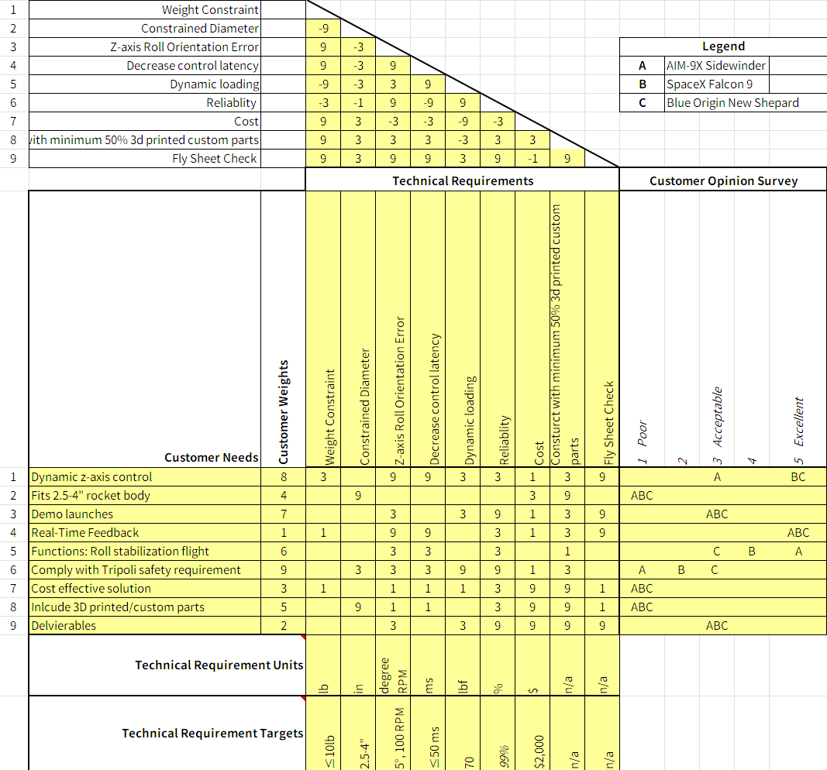
QFD
Chyler B 24

Slide 25
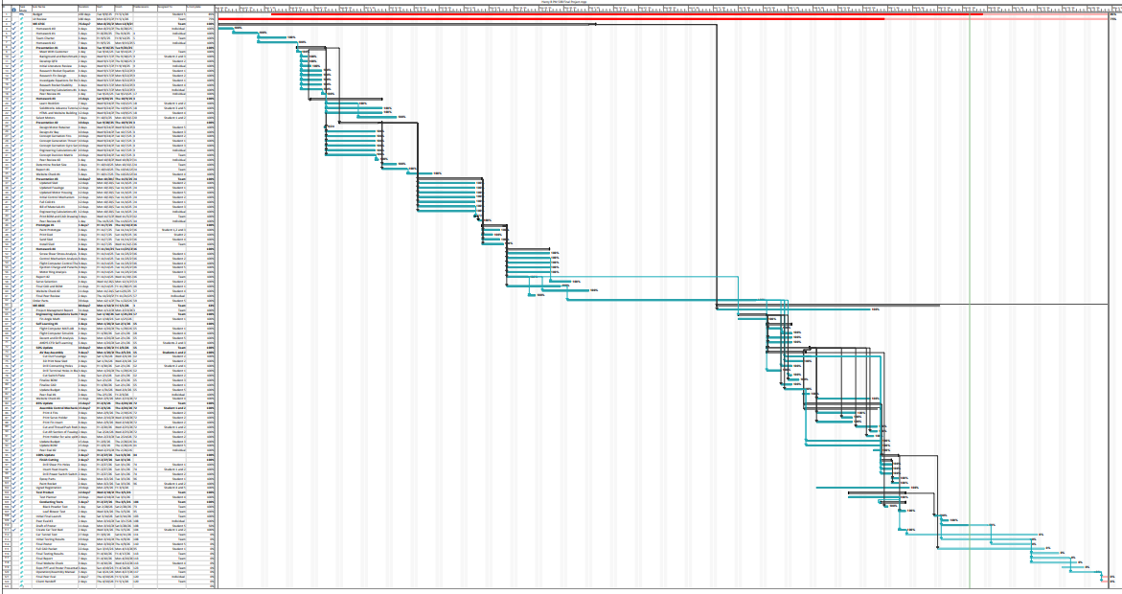
Gantt Chart
Henry B 25

Slide 26
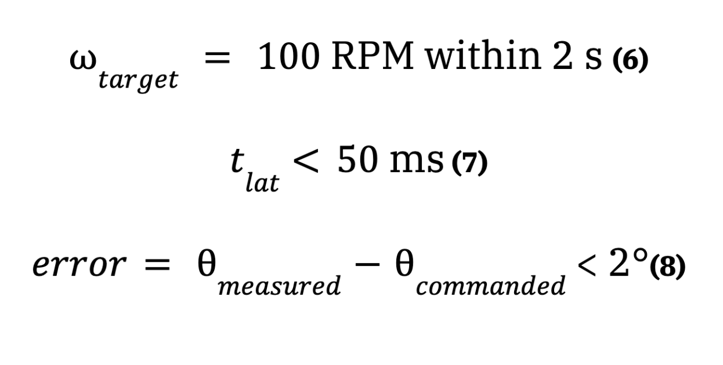
Results 3 - PID Spin Test
Fin error ± 2 deg
Emilio H 9
Notes:
Basically import the test plans

