Slide 1
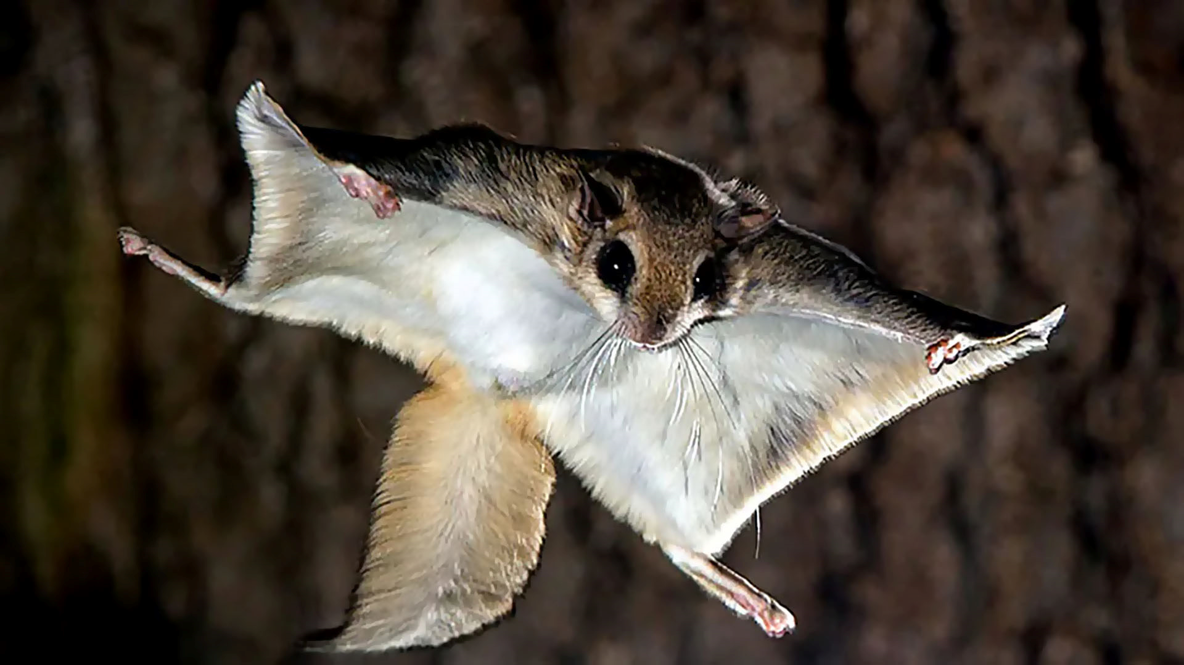




Flying Squirrel
Jonathan Avila, Ryan Donnellan, Justin Joy, Owen Kehl, Joey Mathews

Slide 2

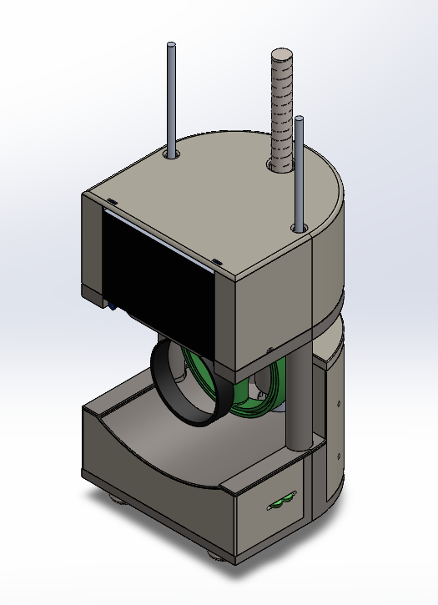
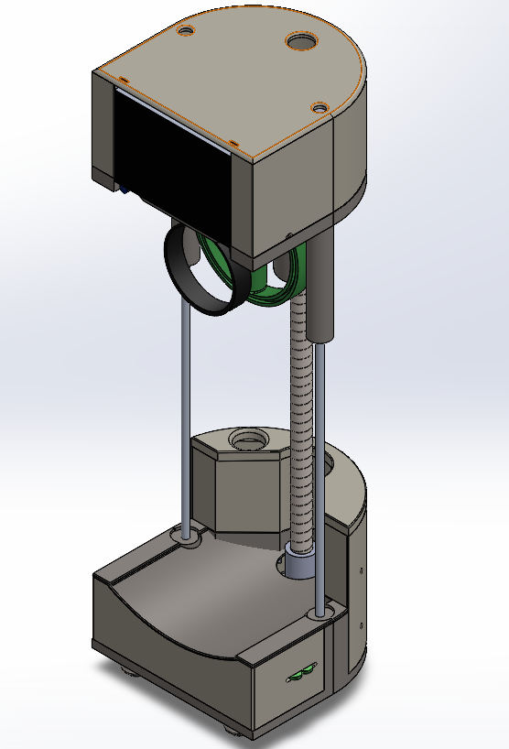
PHOTO
Design Progress
Our final iteration of the Flying Squirrel design
One lead screw and two supports
Divot in the bottom assembly to accommodate user's hand
Notes:
Show that the need is there and give impactful statements on why it is a problem. Give statistics on these problems. Patient population and why they would use it.

Slide 3
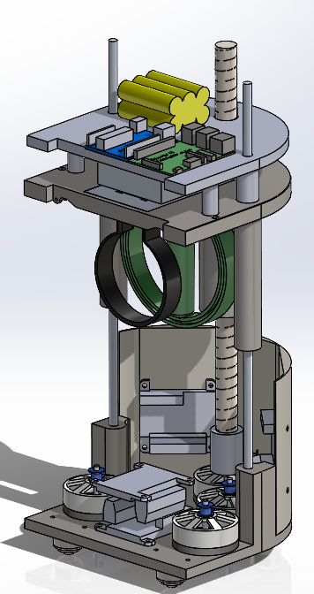
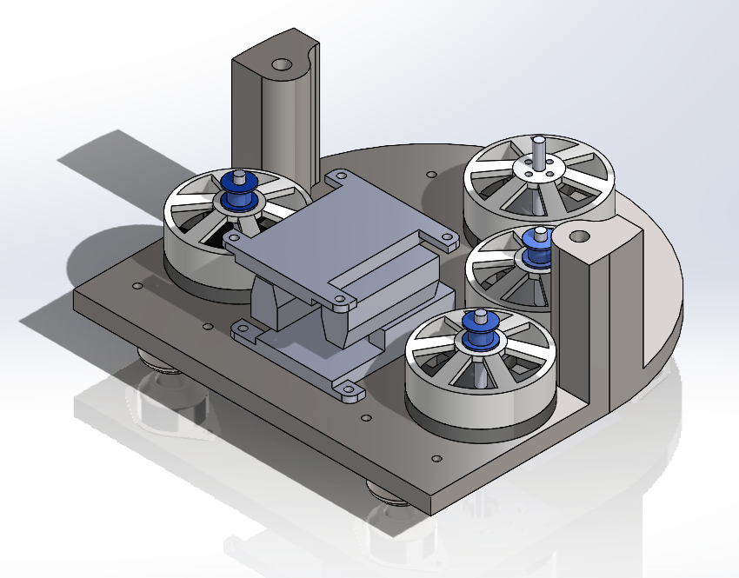
PHOTO
CAD Assembly
Components are separated into two sections
Upper section includes battery, Raspberry Pi, Arduino, and force sensor
Lower section includes motors, encoders, and motor controllers.
Lower section also includes pulley guides for cables.
Notes:
Show that the need is there and give impactful statements on why it is a problem. Give statistics on these problems. Patient population and why they would use it.

Slide 4
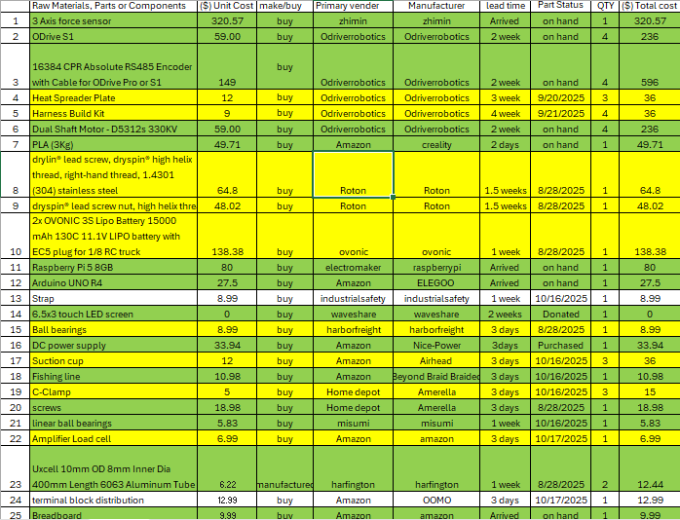
Purchasing Plan/BOM

Slide 5
Manufacturing Plan
Aspects
Most or all custom components will be 3D printed
Skeletal components were originally going to be machined aluminum, but our client recommended sticking to PLA
Ryan Donnellan is handling most 3D manufacturing
All other components will be purchased
Bottom section of the robot will be assembled first
Upper section will be assembled in time for the final build check and demonstration

Slide 6
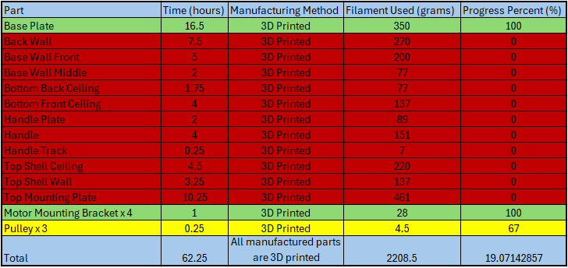
Manufacturing Plan

Slide 7
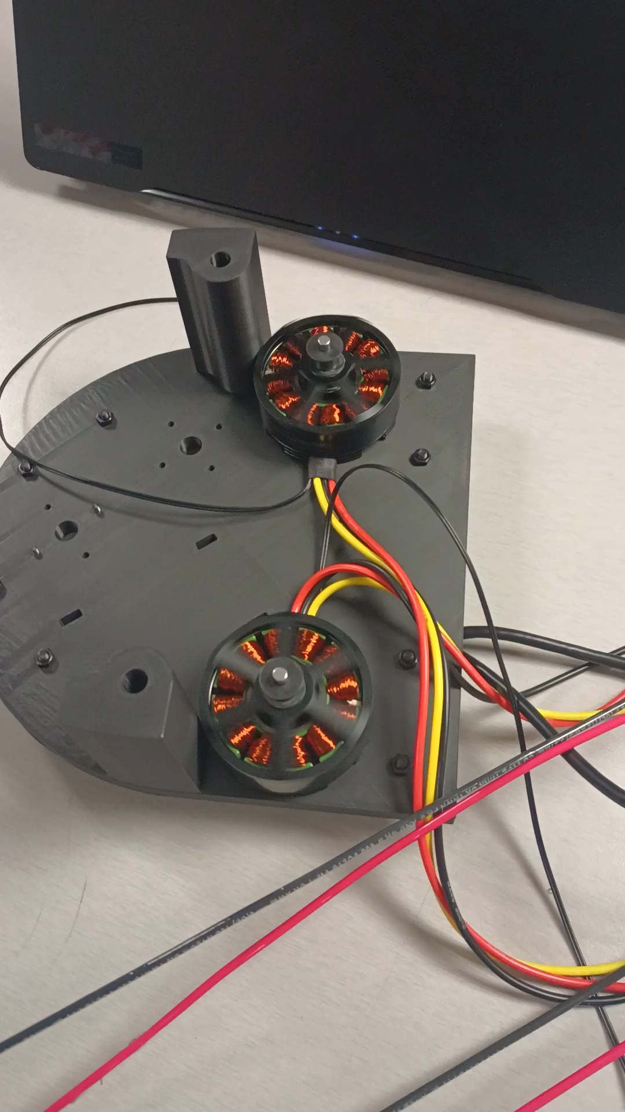
Demonstration
Motor controllers operate as intended
Motors controllable through online GUI and Arduino
Motors and encoders properly mounted to bottom plate assembly
Successfully controlled both motors through Teensy (Arduino Uno lacks necessary connection ports)
Independent control of motors (Motors spin opposite directions)
Unfortunately, the assembly is very cumbersome, and takes a great deal of time to set up
Notes:
Need more metrics

Slide 8
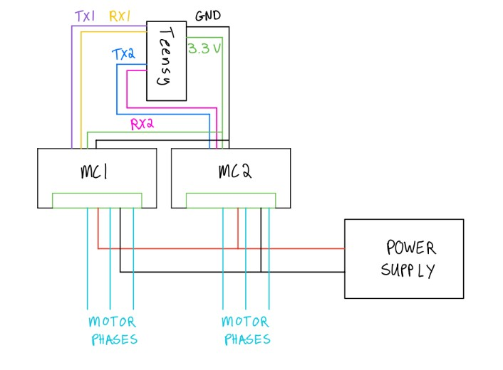
Control Diagram
Notes:
Need more metrics

Slide 9
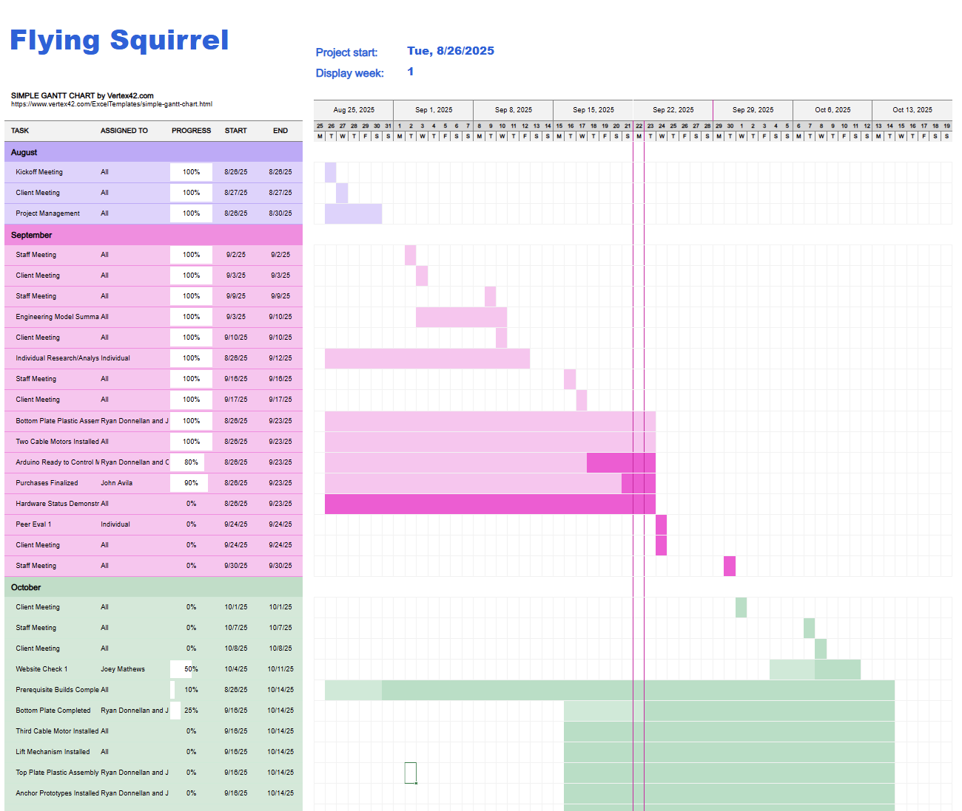
Gantt Chart
Progress
Individual tasks are on schedule
Tasks relating to force detection and generation assigned
Firmly established expectations with client
Continuing to meet and update with client
Notes:
Needs to be more in-depth, as more calculations are done revisit and update this. Add more columns

Slide 10
Takeaways/Moving Forward
Spools will be secured to motor axle by screw rather than clearance fit
Controllers and code must have same baud rate
Bottom plate holes for mounting motors must be wider (Mounting screws were threading into the PLA)
Conducting speed and force tests
Integrating all four motors with the Teensy
Next step to build process is integrating the lift mechanism

Slide 11
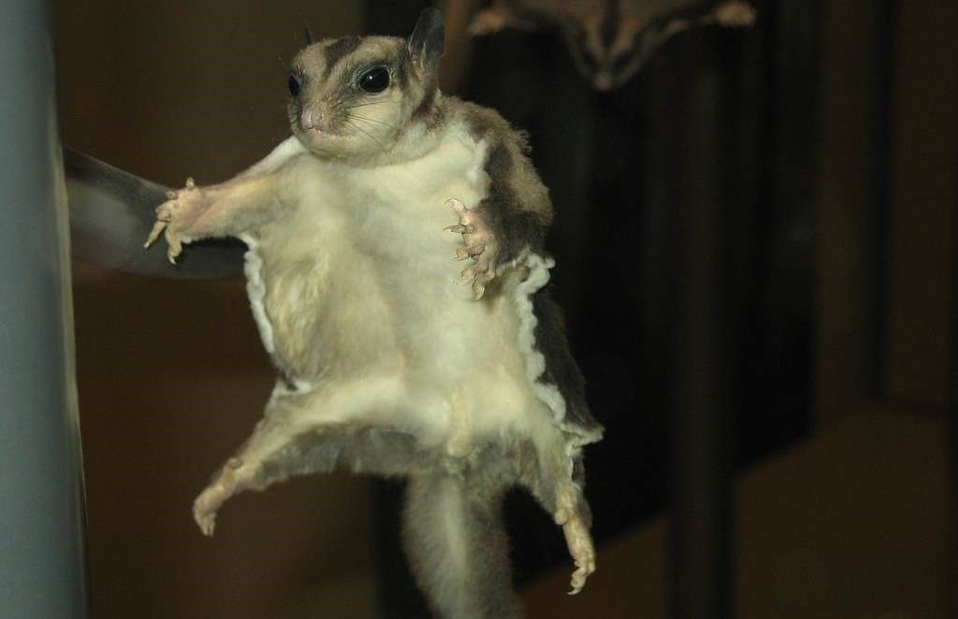


Thank you!

Slide 12
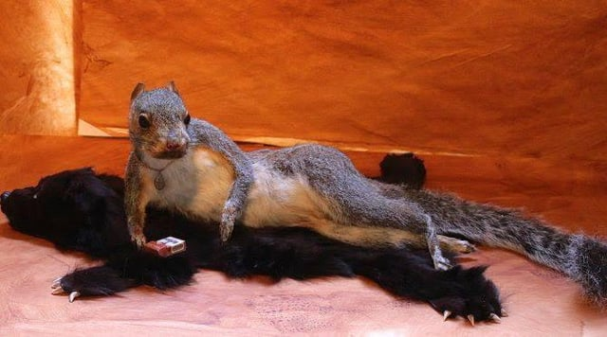
Questions?

