Slide 1
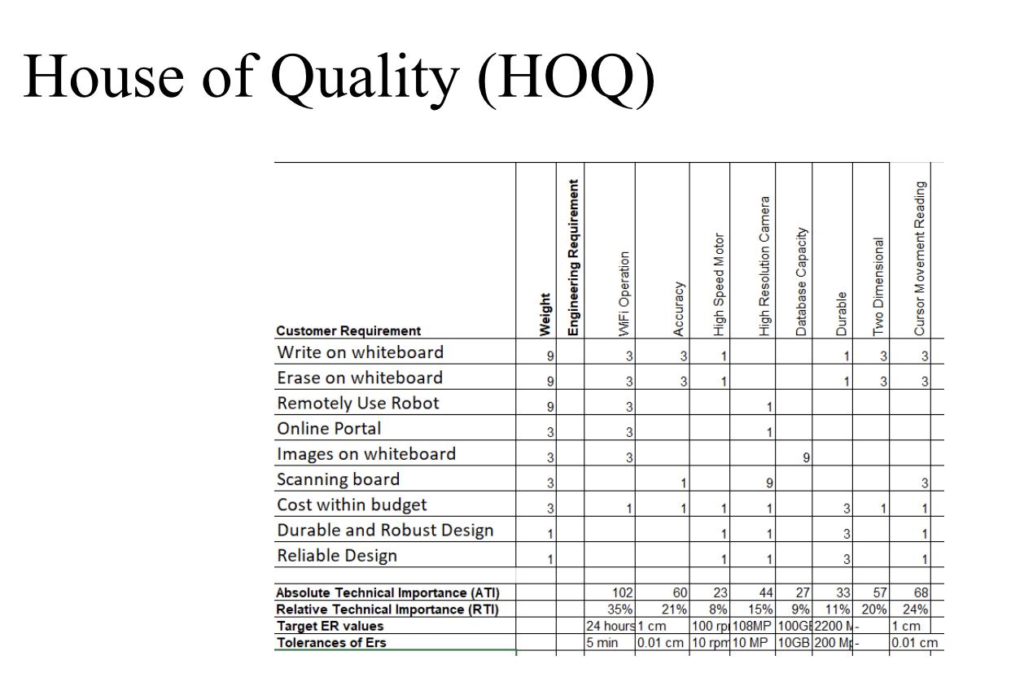
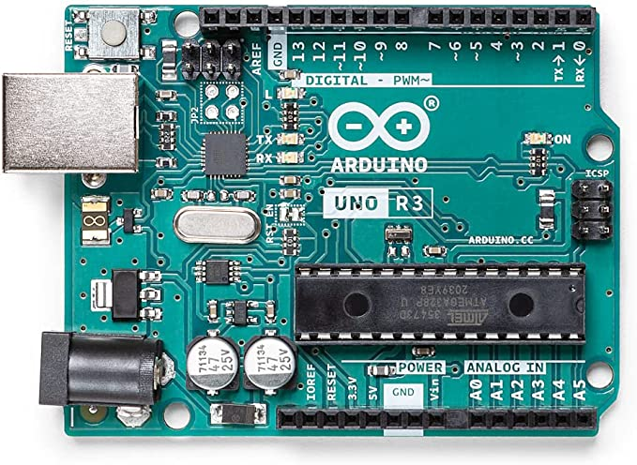
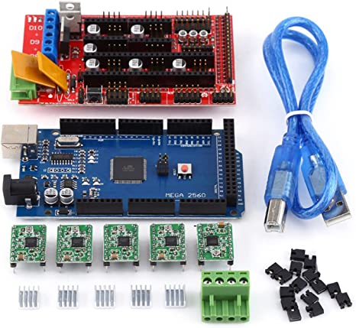
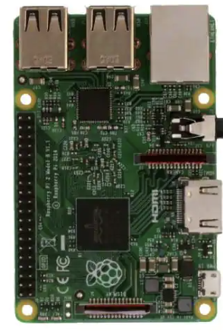
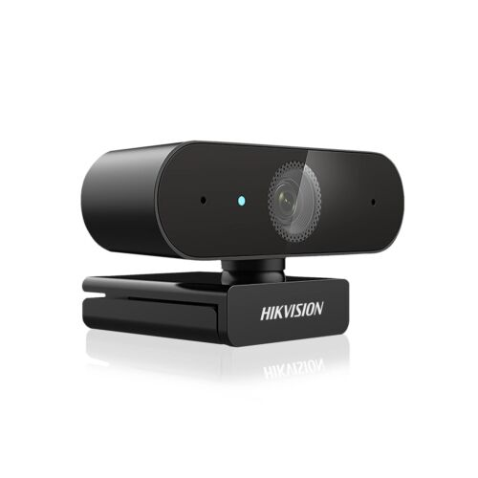
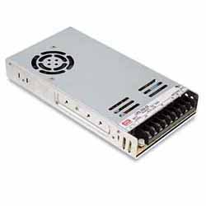
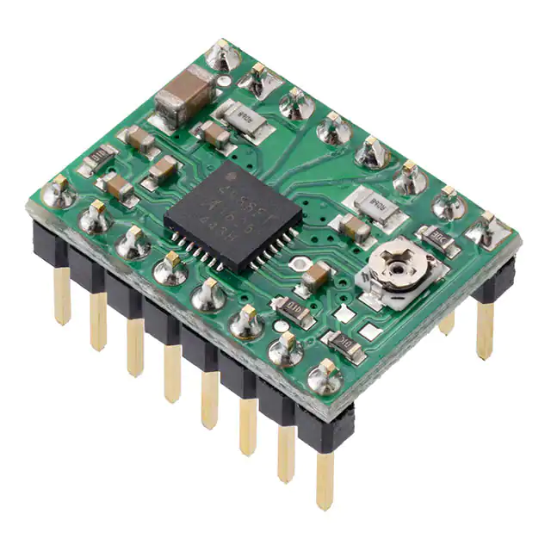
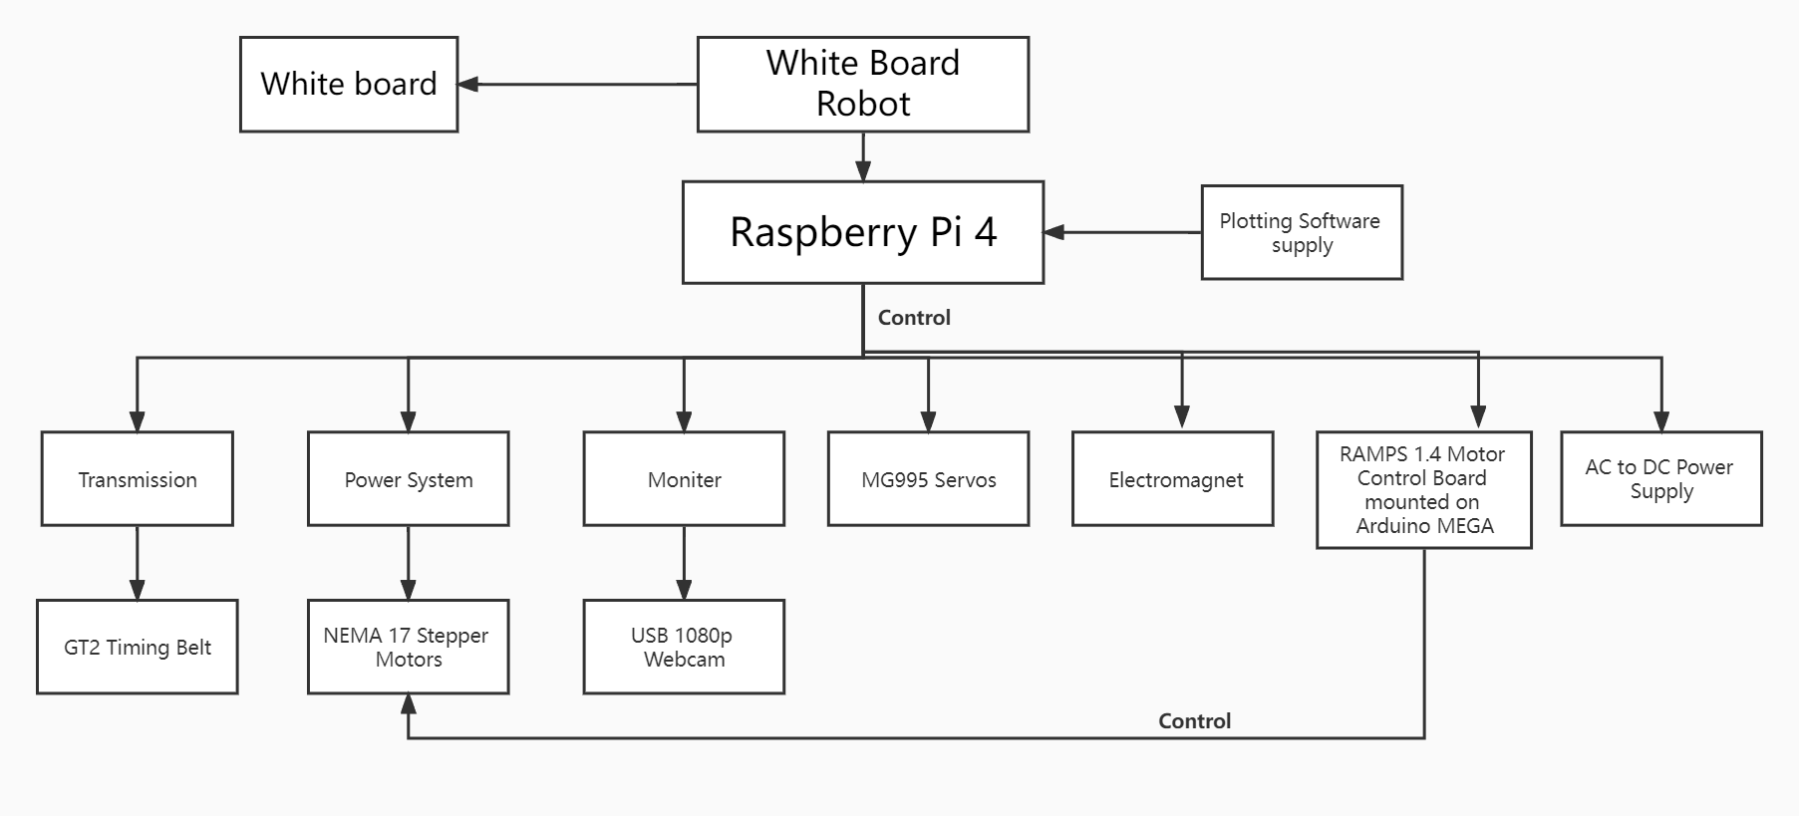
Smart Board
Wenkun Xiao,Mohammad Ahmad,Yanjun Duan
The College of Engineering, Informatics, and Applied Sciences, Northern Arizona University, Flagstaff, AZ 86011
Abstract
Required Materials
Flow chart
vv
Many professors have a need for whiteboards in their offices, however, keeping track of what is
on the board, erasing content and adding notes can be difficult. This project is about combining a
traditional whiteboard with a new type of smart whiteboard that pushes the physical boundaries
of a traditional whiteboard and gives it many digital whiteboard features
Arduino UNO REV3
RAMPS 1.4 Motor Control Board
RASPBERRY PI
Hikvision 2K HD Webcam
Method
vv
Prototype 1
We designed a website and a mobile app to enable remote control so that users can use their mobile devices to connect to the whiteboard and complete the writing function
Prototype 2
We use a camera to record user actions such as writing, deleting, scribbling, etc., and also to position the user's actions on the whiteboard to be able to write more accurately on the whiteboard
Prototype 3
We drive the brush through the motor, position the user's actions on the whiteboard through the algorithm, and finally transmit it to the remote whiteboard
AC to DC Power Supply
Pololu Corporation
It has developed by using the customer requirements and engineering requirements. As the customer requirements have listed on the left side of table and engineering requirements have listed on the top of the table. The relation of each customer requirement with the engineering requirement has listed with the marks given in the corresponding box and the table has generated the priority list of engineering requirements according to which the most important requirement is Wi-Fi operation, that need to be active for full time a day so anyone can access the robot at any time. The next most important requirement is cursor reading as it can easily locate the exact point where the cursor is present. And the next important requirement is two-dimensional movement of the cursor to move the cursor for writing and cleaning purpose in both horizontal and vertical direction and the least important is motor speed as the cursor writing and erasing has to be done with a specific speed and doesn’t require any high-speed motor. Hence house of quality plays a great a role in determining which engineering requirement is most important and which is least important.
Conclusion
Objective Tree
vv
Overall, the project provides great experience of distance learning as the white board robot can use in multiple ways that can help in educating students online. Whiteboard robot with online access provide complete data on the server that can access directly along with the robot. The project used the design process approach from start till end. The design process is a great way to understand the engineering design and contribute in improving designing skills.]

