Slide 1
Visualizing C0₂ Emissions
Team Climate Change

Slide 2
Team Members
Team Faculty Mentor
Scooter Nowak
Team Members
Kiley Jacobs (Team Leader)
Mumbi Macheho-Mbuthia
Tung Nguyen
Zihang Shen
Yisheng Wang

Slide 3
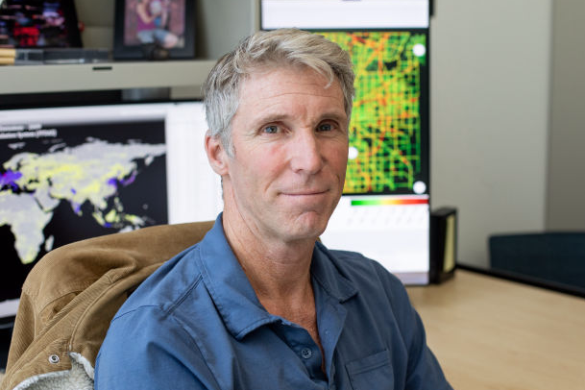
Project Sponsors
Doctor Geoffrey Roest
Postdoctoral Researcher
Professor Kevin Gurney
Researching in carbon cycle science
and climate science

Slide 4
Introduction
Climate change is drastically affecting our planet. All of our lives are being changed by it and we have little to no way to see this.
Our client is asking us to help develop a web app that will allow users to see just how much CO2 Americans are putting into the atmosphere, as far down as the impact from their own town within the last hour so that everyday people can see the impact we are having on the environment.
Our clients are seeking a way to help everyday people see the change we are making to the environment.
Notes:
kiley

Slide 5
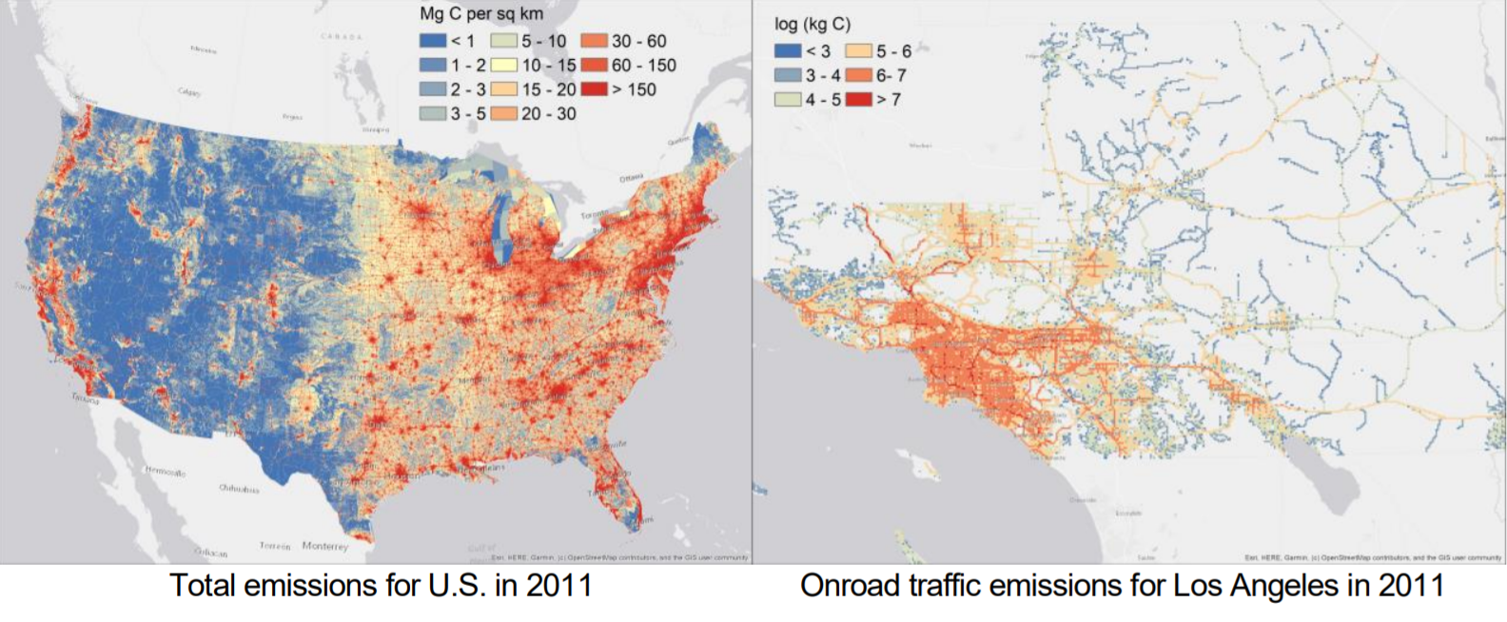
History and Our Client
Currently our client has a version of their map working. It allows data to viewed over a map of the united states in a few different ways, such as seeing emissions per capita rather than as the raw data.

Slide 6
What’s the problem?
Communication with general public
Data is only accessible for specific audience
Technical background

Slide 7
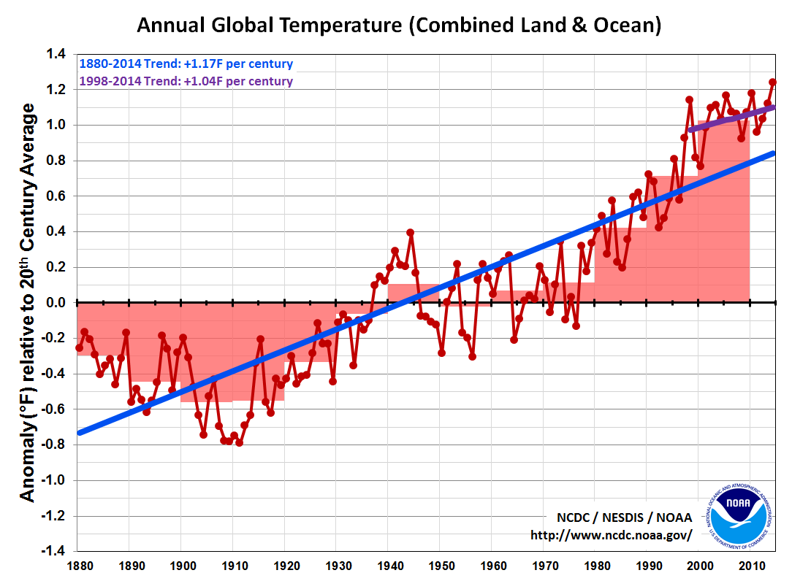
Why does it matter?
Increasing of CO2 emission is not easy for people to really see.
Seeing a map of it lets people know how fast the CO2 emission increasing.
Can see the development for where they live.

Slide 8
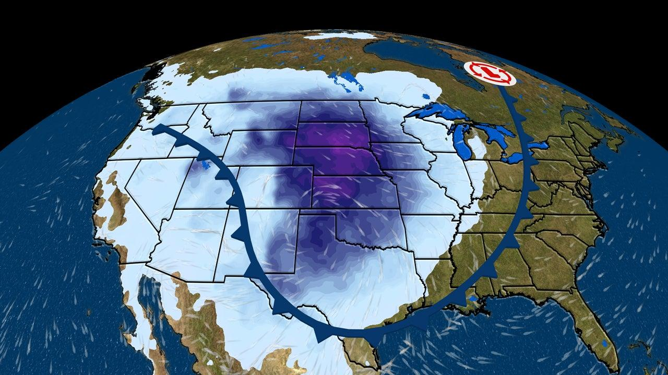
Our current approach
A good design is a good start:
Design ideas based on weather apps
Search locations by clicking
Have several years back of data for cities

Slide 9
Plan for Development
Refinement
Weekly team meeting
Monthly client meeting
Technical challenges
Graphical/ data visualizations
Handling data
Plan for investigation
Frequent client communication
Framework
Research and team collaboration on ideas

Slide 10
Conclusion

