Slide 1

South Commuter Low Impact Development (LID) Detention Basin
Sydney Graves, Gabrial Harju, Jessica Hillman
CENE 476
December 6th, 2024
Notes:
END AT 15 SEC MAX

Slide 2
Project Introduction
Project Purpose
  The City of Flagstaff has increased the imperious stormwater runoff taxes and is offering tax reduction for stormwater infrastructure that attenuates a 100 year + design storm.
  The NAU South Commuter parking lot has been identified as a major contributor to impervious runoff into Sinclair Wash. Fixing this will help NAU meet its sustainability goals.
  Reduce runoff tax contributions and for NAU.
Clients
  Erin Trejo, NAU Facilities Services
  Dr. Adam Bringhurst

Slide 3
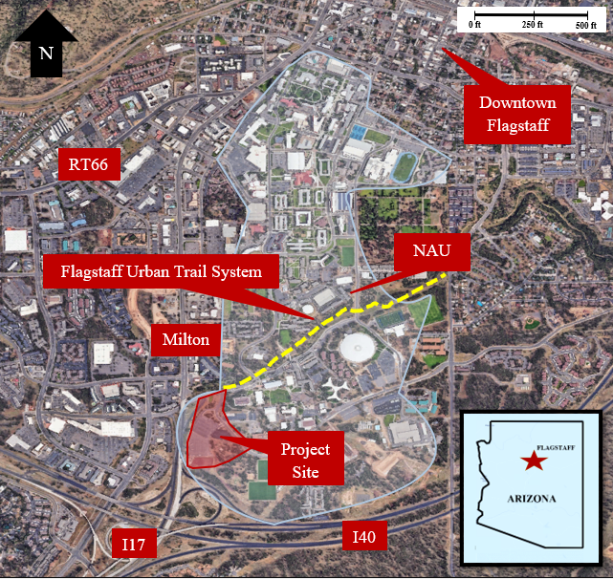
Figure 1: Project Vicinity Map

Slide 4
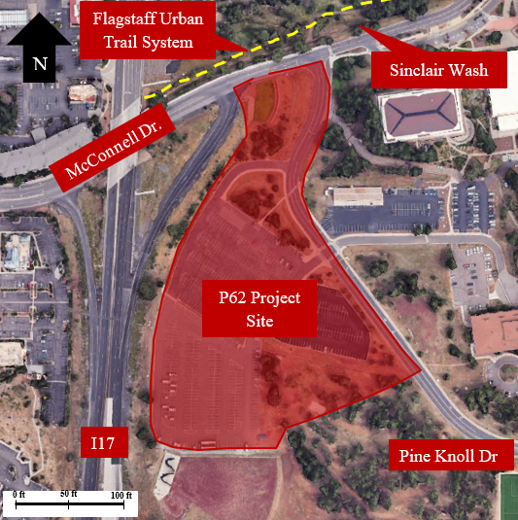
Figure 2: Project Site Map

Slide 5
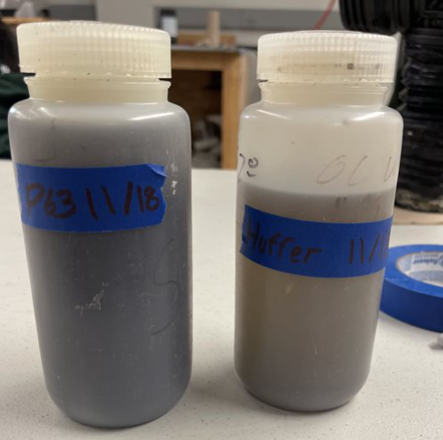

Task 1: DATA COLLECTION FROM SUBCONTRACTORS
Earthwise Solutions will subcontract out:
  The Topographical Features Survey
  Runoff Water Sampling for Lab Analysis
  Analysis of Soil Matrices for Infiltration Abilities
Figure 5: Collected Sample from Subcontractor [Bringhurst]
Notes:
Task 6: LID Design
Task 5: Ecologic and Environmental Considerations
The little arrows denote that the task is informing another task later

Slide 6
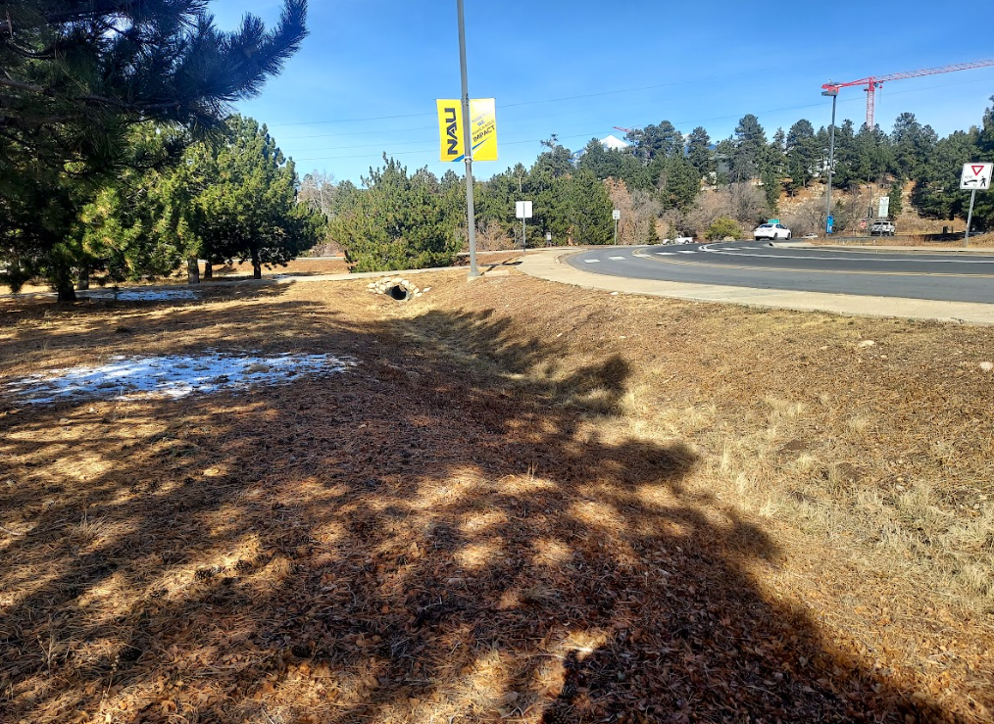
Task 2: SITE INVESTIGATION
Investigation and analysis of:
  Existing Channel Conditions
  Existing Culverts
  Existing Utilities
  Impervious Areas
  Outlet into Sinclair Wash
Figure 6: Existing Channel near Pine Knoll Dr. [Hillman]
Notes:
Confirmation of existing features and dimensions for use in hydrologic and hydraulic modeling

Slide 7
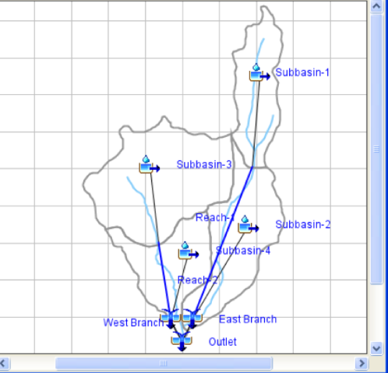
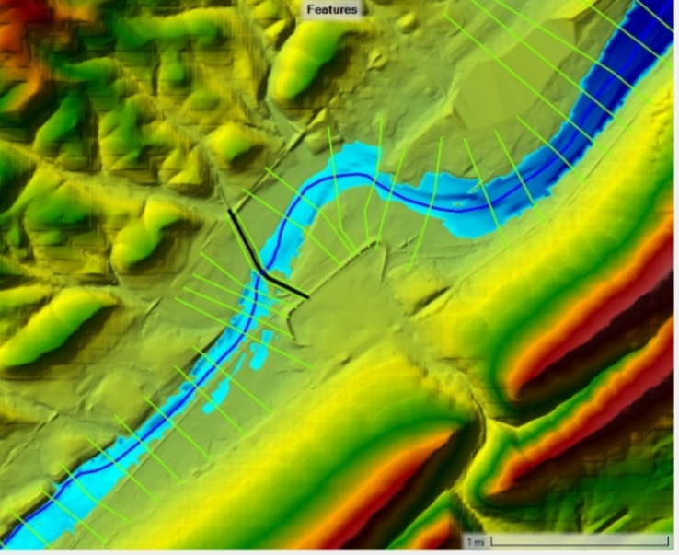
Task 3: Hydrological Analysis
Task 4: hydraulic analysis
3.0 Hydrological Analysis
  3.1: Watershed Delineation
  3.2: Determination of Site Runoff Coefficients
  3.3: Calculation of Peak Design Flow
4.0: Hydraulic Analysis
  Modeling of Existing Conditions
Figure 7: HECHMS [2]
Figure 8: HECRAS [3]

Slide 8

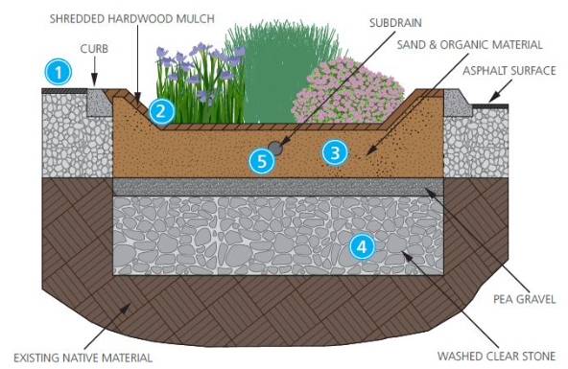
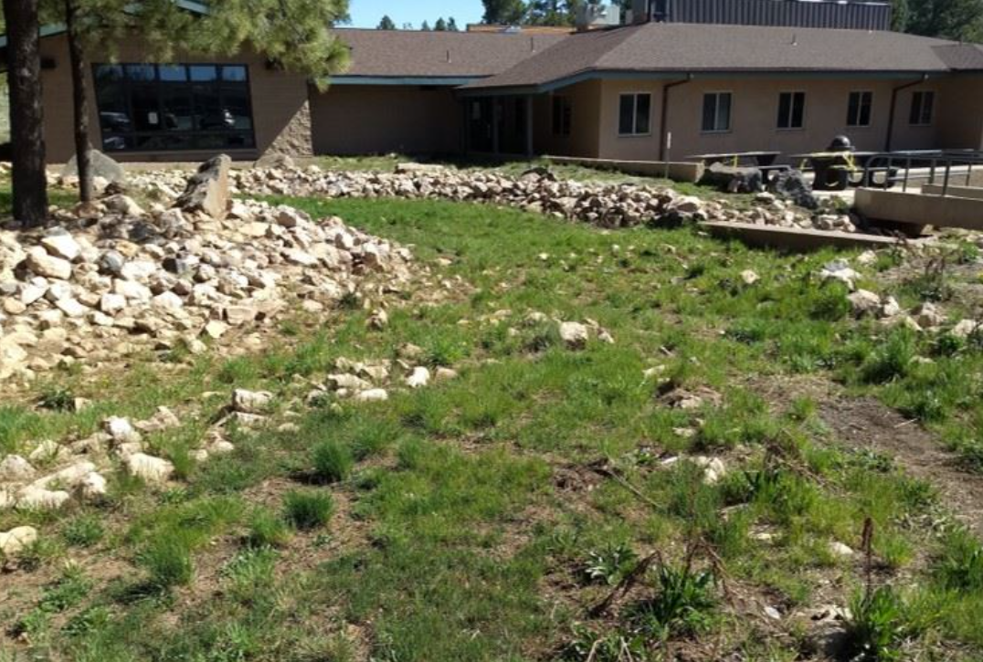
Task 5: ecological and environmental consideration
  5.1: Selection of Appropriate Vegetation
  5.2 :Selection of Soils
Figure 9: Example LID in COF [4]
Figure 10: Example LID Basin Cross Section [5]
Notes:
Task 1: Subcontractor Data Collection

Slide 9

Task 6: LID Basin design
6.1: Development of Alternative Solutions
6.2: Selection of Preferred Alternative
6.3: Design of Preferred Alternative
Recommended Solution
Alternatives
Decision Matrix

Slide 10
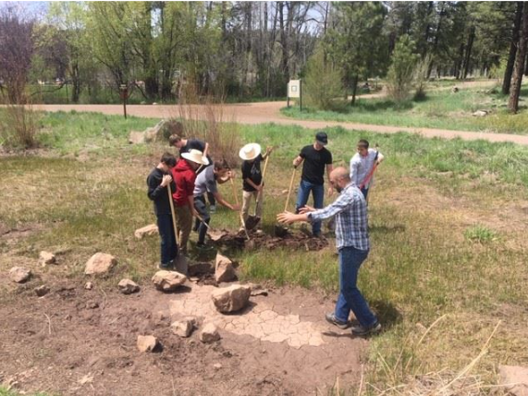


Task 7: Maintenance and monitoring plan
Task 8: development of construction plan set
Task 7: Maintenance and Monitoring Plan
Task 8: Development of Construction Plan Set
Figure 11: LID Sediment Removal Maintenance [4]

Slide 11




Task 9: Cost estimation and quantities
Task 10: project impacts
Task 9: Cost Estimation and Quantities
Task 10: Project Impacts
  Environmental
  Economic
  Social

Slide 12


Task 11: Deliverables
Task 12: project management
Task 11: Deliverables
  30, 60, 90, 100%
Task 12: Project Management
  Schedule Management
  Resource Management

Slide 13
Exclusions
Exclude:
  Development of a Stormwater Management Plan
  Development of Environmental Impact Assessment

Slide 14
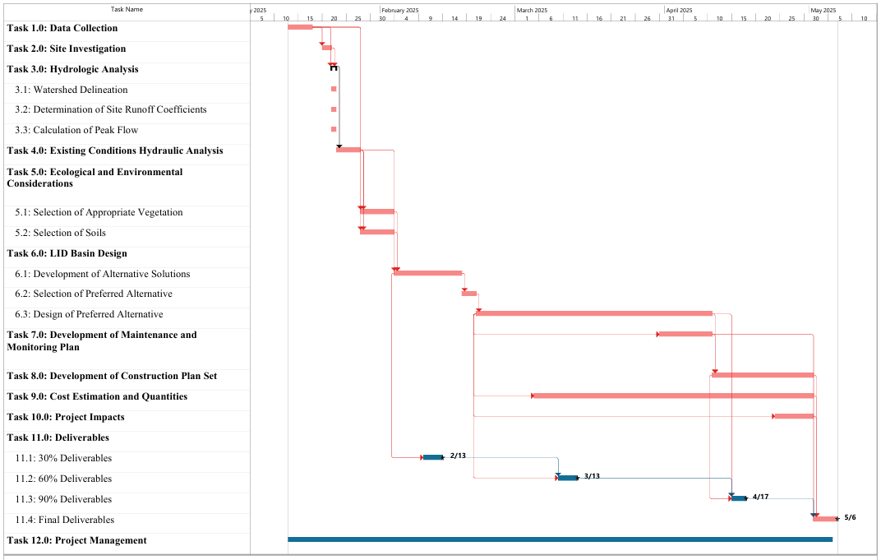
14
Notes:
Start Date: January 13, 2025
End Date: May 6, 2025
Duration: 114 Days

Slide 15
Table 4-1: Staffing Table

Slide 16
Table 5-1: Cost Estimate of Engineering Services

Slide 17
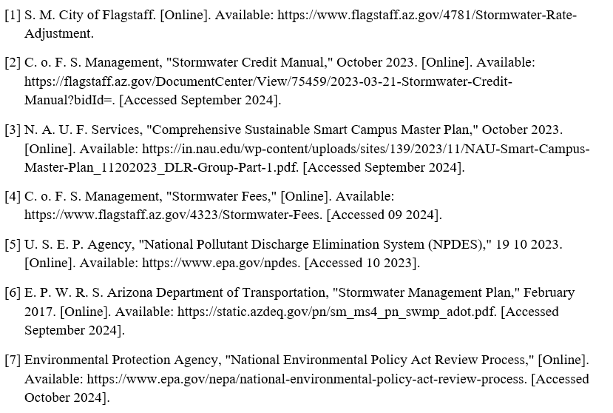
references
Figure References
Proposal References

Slide 18
Questions And CommeNts?

