Slide 1
Dragon Mine Preliminary Assessment, Site Investigation & Remediation Proposal Bureau of Land Management. Ground Guardians LLC.
Bowie Ching, Andres Garcia Rico, Zack Kauranen, Jorja Whitcher,
CENE 476
(12/06/2024)
1

Slide 2
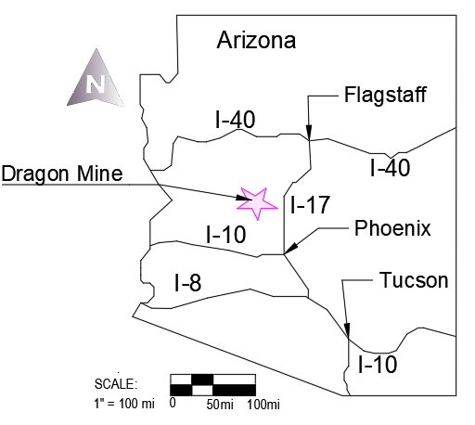
Introduction
Purpose:
Preliminary Assessment and Site Investigation to assess health risks and propose remedial action
Client:
Eric Zielske from the Bureau of Land Management
Background:
Active from 1800s to 1942 produced vanadinite, gold, and silver
Figure 1: Arizona Location Map [1]
2

Slide 3
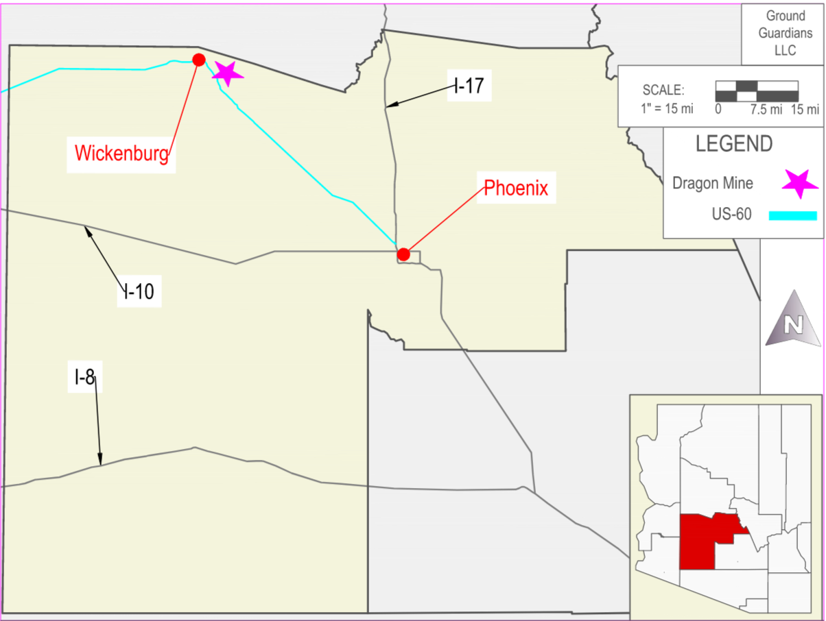
Location Map
Figure 2: County Location Map [2]
3
Notes:
MAKE WICKENBURG MORE CLEAR

Slide 4
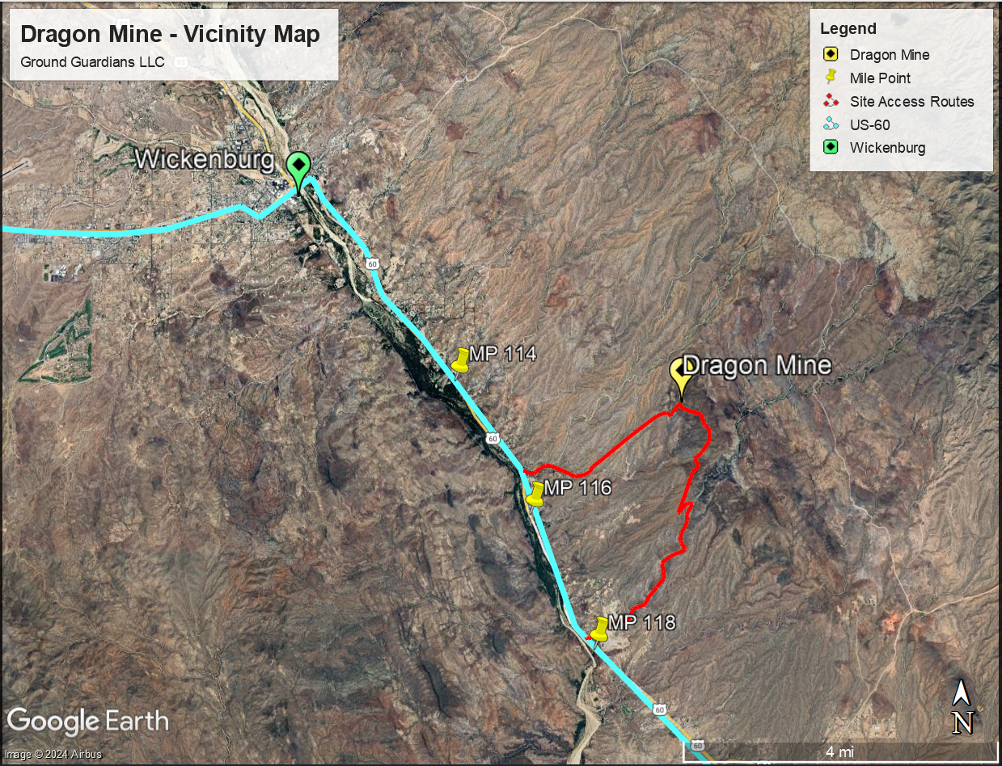
Vicinity Map
Figure 3: Vicinity Map [3]
4
Notes:
MAKE WICKENBURG MORE CLEAR

Slide 5
Table 1: Contaminants of Concern ECM Site Investigation 2019 [4]
Soil | Antimony | Arsenic | Lead | Molybdenum | Vanadium
Area of Concern | (mg/kg)
Downgradient Debris | <394 | 5 | 16 | <29 | 259
Mill Foundation | <437 | 10 | 115 | <34 | 368
Water Troughs | <199 | 15 | 101 | 27 | <56
Waste Pile | <368 | <28 | 667 | <28 | 548
Foundation | <579 | 29 | 593 | 12 | 515
Conveyor Foundation | <447 | 26 | 373 | <35 | 409
Heap Leach? | <396 | <24 | 414 | <30 | 378
Heap Leach? | <405 | 9 | 141 | <31 | 295
Heap Leach? | <385 | <36 | 1062 | 17 | 455
Heap Leach? | 43 | <33 | 827 | 5 | 538
Waste Rock Pile | <381 | <18 | 228 | <29 | 1241
Waste Rock Pile | <390 | <14 | 127 | <31 | 347
Mill Platform | <334 | <60 | 3967 | 88 | 581
Red Tailings | <324 | <65 | 4894 | 102 | 440
Red Tailings near collapsed structure | <226 | <83 | 10776 | 485 | 594
Tailings near mill | <438 | <38 | 862 | <35 | 288
Background | <410 | 7 | 91 | <32 | 369
Background | <380 | 5 | 49 | <30 | 432
Background | <371 | 10 | 42 | <29 | 371
Background | <426 | 7 | 57 | <33 | 335
Background | <375 | 5 | 21 | <29 | 323
Legend
= Above AZ Non-residential Soil Remediation Levels
= Above AZ Residential Soil Remediation Levels
= Above AZ Ecological Soil Remediation Levels
5

Slide 6
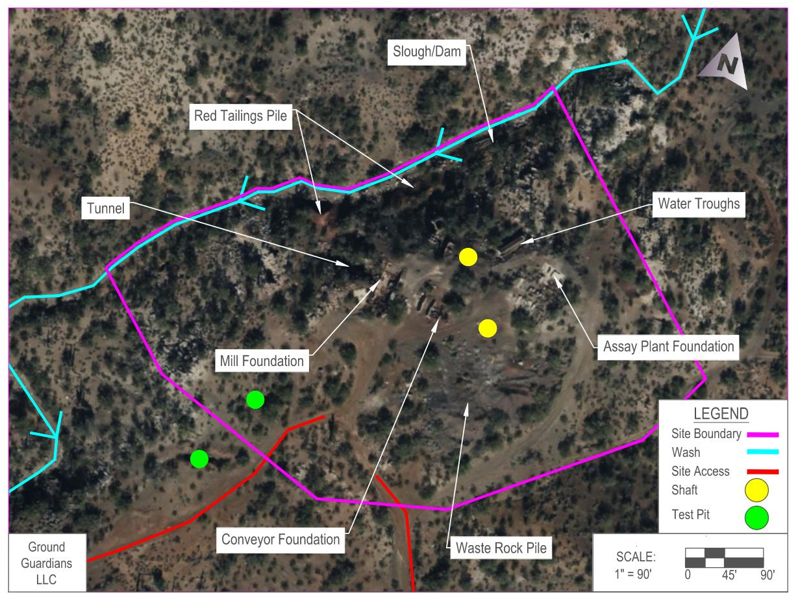
Project Map
Figure 4: Project map [5]
6

Slide 7
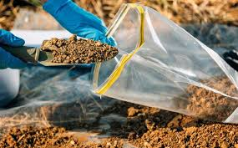
Task 1: Work Plan
Task 2: Site Investigation
Task 1.1: Sampling and Analysis Plan
Task 1.2: Health and Safety Plan
Task 1.3: Lab Binder/Lab Access
Figure 5: Soil Collection [6]
7

Slide 8
Task 4: Data Analysis
Task 3: Laboratory Analysis
Task 4.1: Identification of Human Health and Ecological Contaminants of Concern (COCs)
Task 4.2: Identify Exposure Point Concentrations for all COCs
Task 4.3: XRF in-situ vs ex-situ Analysis
Task 4.4: XRF ex-situ vs FAA/ICP Analysis
Task 4.5: Quality Assurance & Quality Control Analysis
Task 3.1: Sample Drying
Task 3.2: Sample Sieving
Task 3.3: X-Ray Fluorescence (XRF) Testing
Task 3.4: Acid Digestion
Task 3.5: Flame Atomic Absorption (FAA) / Inductively Coupled Plasma (ICP)
8

Slide 9
Task 5: Contaminant Pathways
Task 6: Human Health Risk Assessment
Task 5.1: Maps of Contaminant Distribution
Task 5.2: Migration Pathways
Task 5.3: Conceptual Site Model (CSM)
Task 6.1: Toxicity Assessment
Task 6.2: Exposure Assessment
Task 6.3: Risk Characterization
9

Slide 10
Task 8: Remedial Actions
Task 7: Ecological Risk Assessment
Task 8.1: Remedial Action Objectives
Task 8.2: Develop Alternatives
Task 8.3: Evaluate Alternatives and Select Preferred Alternative
Task 8.4: Design of Preferred Alternative
Task 7.1: Identification of Potentially at-risk Species
Task 7.2: Identification of Area Use Factors
Task 7.3: Determination of Ecological Risk
10

Slide 11
Task 9: Project Impacts
Task 11: Project Management
Task 10: Project Deliverables
Task 11.1: Meetings
Task 11.2: Schedule Management
Task 11.3: Resource Management
Task 10.1: 30% Report
Task 10.2: 60% Report
Task 10.3: 90% Report
Task 10.4: Final Report
11

Slide 12
Exclusions
Water Sampling/Analysis
Air Sampling/Analysis
12

Slide 13
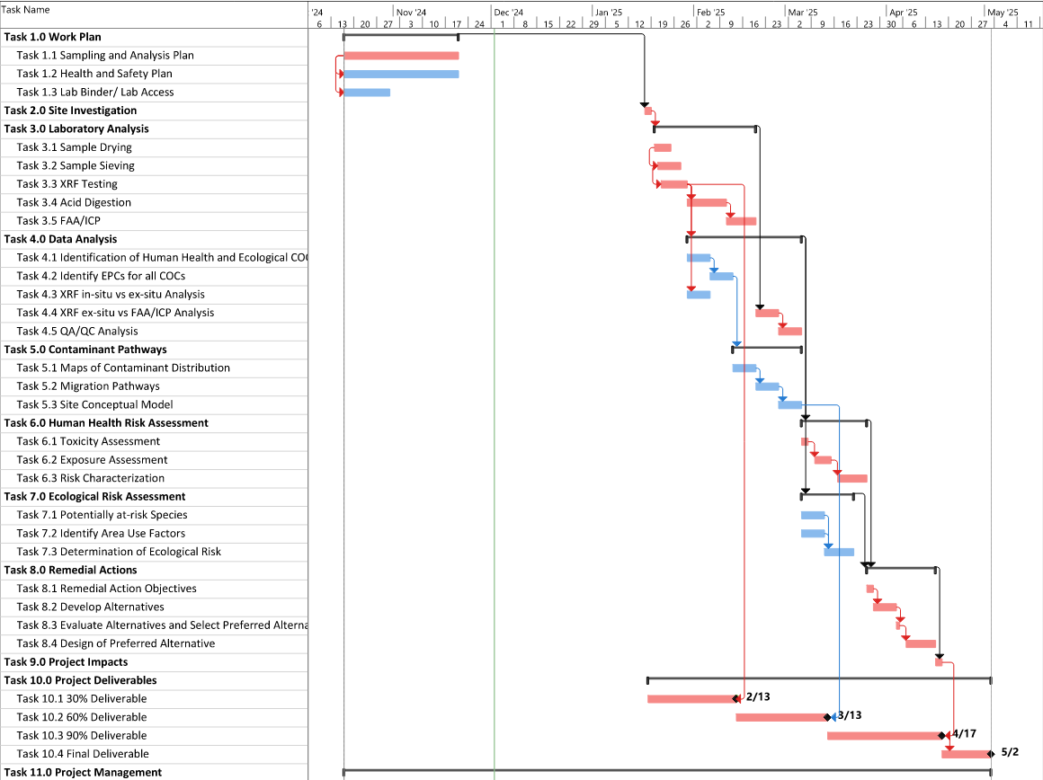
Figure 6: Project Gantt Chart
13

Slide 14
Staffing
‌Senior Engineer
Master’s Degree
Professional Engineer
15+ years of experience
Project Manager
Engineer
Bachelor’s Degree
Engineer-In-Training
~3 years of experience
Performs majority of project work
Lab Technician
Performs all laboratory work with supervision of Engineer
Present during Site Investigation
14

Slide 15
Staffing
Task 6.0 Human Health Risk Assessment
Task 6.1 Toxicity Assessment | 0 | 8 | 0 | 8
Task 6.2 Exposure Assessment | 0 | 20 | 0 | 20
Task 6.3 Risk Characterization | 2 | 10 | 0 | 12
Task 7.0 Ecological Risk Assessment
Task 7.1 Identification of Potentially at-risk Species | 2 | 15 | 0 | 17
Task 7.2 Identification of Area Use Factors | 2 | 15 | 0 | 17
Task 7.3 Determination of Ecological Risk | 2 | 10 | 0 | 12
Task 8.0 Remedial Actions
Task 8.1 Remedial Action Objectives | 2 | 6 | 0 | 8
Task 8.2 Develop Alternatives | 5 | 15 | 0 | 20
Task 8.3 Evaluate Alternatives and Select Preferred Alternative | 1 | 5 | 0 | 6
Task 8.4 Design of Preferred Alternative | 5 | 20 | 0 | 25
Task 9.0 Project Impacts | 1 | 3 | 0 | 4
Task 10.0 Project Deliverables
Task 10.1 30% | 2 | 8 | 0 | 10
Task 10.2 60% | 2 | 8 | 0 | 10
Task 10.3 90% | 2 | 8 | 0 | 10
Task 10.4 Final | 2 | 8 | 0 | 10
Task 11.0 Project Management
Task 11.1 Meetings | 30 | 60 | 30 | 120
Task 11.2 Schedule Management | 10 | 5 | 0 | 15
Task 11.3 Resource Management | 2 | 2 | 0 | 4
Subtotal Hours | 117 | 405 | 272
Total Hours | 794
Task | Senior Engineer | Engineer | Lab Technician | Task Total
Task 1.0 Work Plan
Task 1.1 Sampling and Analysis Plan | 5 | 30 | 0 | 35
Task 1.2 Health and Safety Plan | 5 | 15 | 0 | 20
Task 1.3 Lab Binder | 0 | 5 | 15 | 20
Task 2.0 Site Investigation | 25 | 50 | 50 | 125
Task 3.0 Laboratory Analysis
Task 3.1 Sample Drying | 0 | 2 | 50 | 52
Task 3.2 Sample Sieving | 0 | 2 | 60 | 62
Task 3.3 XRF Testing | 0 | 2 | 60 | 62
Task 3.4 Acid Digestion | 0 | 1 | 1 | 2
Task 3.5 FAA/ICP | 0 | 1 | 1 | 2
Task 4.0 Data Analysis
Task 4.1 Identification of Human Health and Ecological COCs | 2 | 5 | 0 | 7
Task 4.2 Identification of EPCs for all COCs | 2 | 15 | 0 | 17
Task 4.3 XRF In-situ vs Ex-situ analysis | 0 | 10 | 0 | 10
Task 4.4 XRF Ex-Situ vs FAA/ICP analysis | 0 | 10 | 0 | 10
Task 4.5 QA/QC analysis | 2 | 10 | 5 | 17
Task 5.0 Contaminant Pathways
Task 5.1 Maps of Contaminant Distribution | 2 | 15 | 0 | 17
Task 5.2 Migration Pathways | 0 | 2 | 0 | 2
Task 5.3 Conceptual Site Model (CSM) | 2 | 4 | 0 | 6
15

Slide 16
Cost of Engineering Services
Project Costs Summary
Subsection | Classification | Qty | Rate | Unit | Cost
Personnel | Senior Engineer | 117 | $300 | $/hr | $35,100
 | Engineer | 405 | $135 | $/hr | $54,675
 | Lab Technician | 272 | $35 | $/hr | $9,520
 | Total Personnel |  |  |  | $99,295
Travel | NAU Mileage Rate | 300 | $0.40 | $/mile | $120
 | Rental: NAU Suburban | 2 | $65 | $/day | $130
 | Hotel 1 Night | 5 | $100 | $/room | $500
 | PerDiem; 5 persons | 2 days | $30 | $/day-person | $300
 | Total Travel |  |  |  | $1,050
Supplies | Ziplock Gallon Freezer Bags, 120 ct | 1 | $16 | $/pack | $16
 | Trowel | 8 | $10 | EA | $80
 | Rental: 2 GPS devices | 2 days | $120 | $/device-day | $480
 | Soap | 1 | $6 | $/bottle | $6
 | Marker Flags, 50 pack | 2 | $7 | $/pack | $14
 | Plastic Bins, 2 pack | 2 | $57 | $/pack | $114
 | 5 gal Buckets | 4 | $7 | EA | $28
 | Water, 12 pack | 2 | $4 | $/pack | $8
 | Paper Towels, 2 pack | 1 | $7 | $/pack | $7
 | Sharpie, 5 pack | 1 | $5 | $/pack | $5
 | Nitrile Gloves, 1000 pack | 1 | $45 | $/pack | $45
 | Trash Bags, 74 pack | 1 | $20 | $/pack | $20
 | Clipboards, 6 pack | 1 | $12 | $/pack | $12
 | Logbooks | 2 | $5 | EA | $10
 | Measuring Tapes | 4 | $20 | EA | $80
 | Scrub Brushes | 4 | $3 | EA | $12
 | Rental: NAU Soils Lab | 20 | $100 | $/day | $2,000
 | Rental: XRF Device | 10 | $300 | $/day | $3,000
 | Total Supplies |  |  |  | $5,937
Subcontract | Western Technologies | 10 | $100 | $/sample | $1,000
Total Cost |  |  |  |  | $107,282
Personnel = $99,295
Travel = $1,050
Supplies = $5,937
Total = $107,282
16

Slide 17
References
[1] J. Whitcher, "Dragon Mine: Preliminary Assessment Location Map," AUTOCAD, 2024.
[2] A G. Rico, "Dragon Mine: Preliminary Assessment Location Map," AUTOCAD, 2024.
[3] A. G. Rico, Google Earth , 2024.
[4] ECM Consultants, "Site Summary Report for the Dragon Mine," ECM Consultants, 2020.
[5] G. G. LLC, "Dragon Mine: Preliminary Assessment Project Map," AUTOCAD, 2024.
[6] “Redevelopment Site Assessments,” Environmental Site Assessment and Environmental Due Diligence, Aug. 29,
2024. https://www.aeasinc.com/redevelopment
‌
17

Slide 18
QUESTIONS?
18

